Slide 1
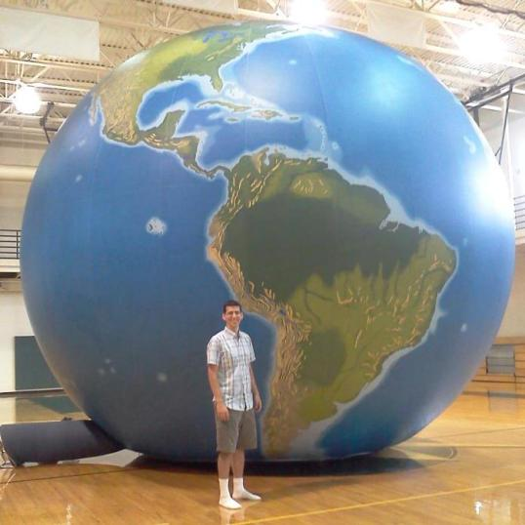
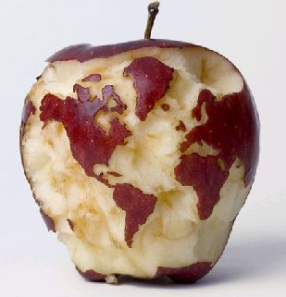
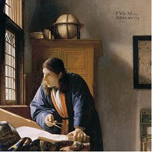





Practical Strategies
for Teaching Geography

Slide 2
How can competent teachers help students understand a complex interconnected world?
Provide geographic information
Teach geographic concepts
Use data, maps, and geospatial technology
Ask questions which encourage spatial thinking.
Geographic Literacy

Slide 3

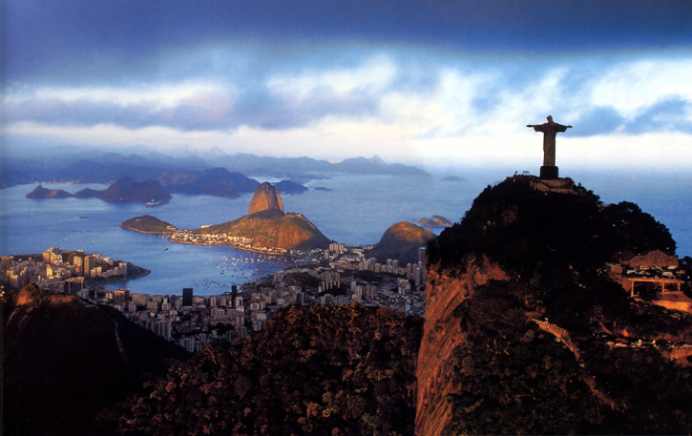
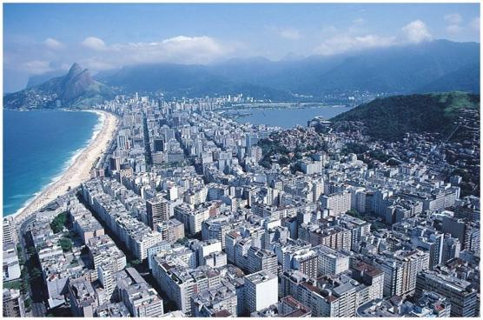
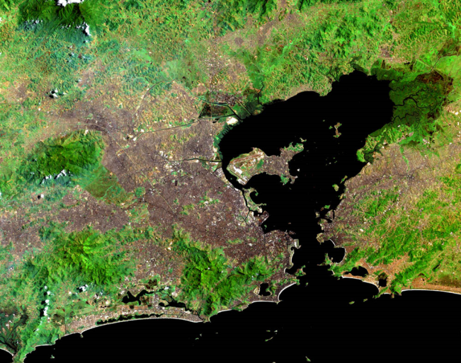
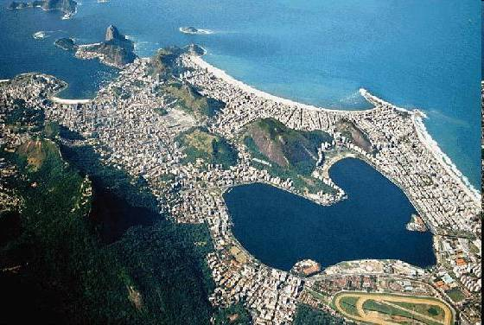
  1. Give students a prompt
Notes:
What country is this? What city is this? What language do they speak? Why did the Portuguese settle here? Rio is considered the most beautiful and is called the “Marvelous City.”

Slide 4
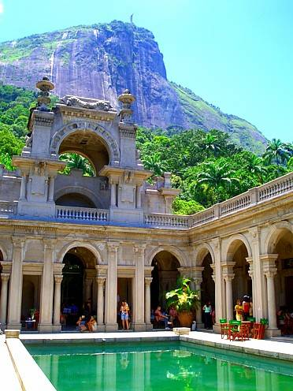
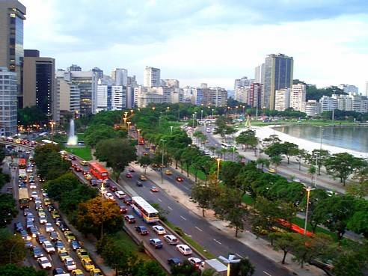
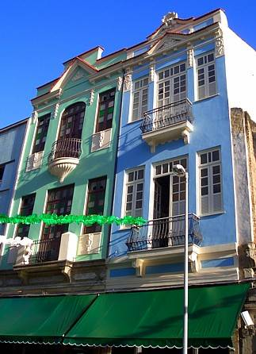
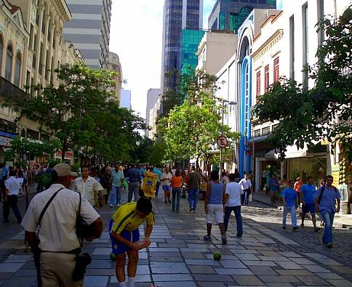
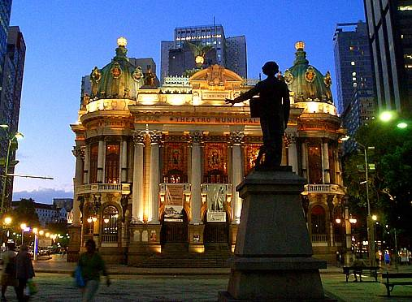
Notes:
What words describe this city? The public places mirror the city planning and architectural designs prevalent in Europe.
Parque Lage, with the “Jesus” statue in the background
4

Slide 5
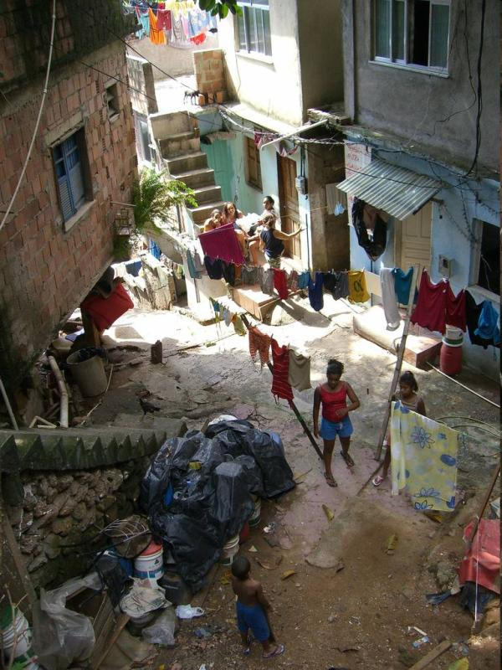
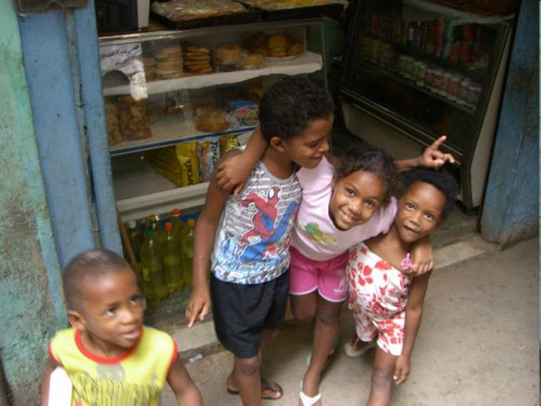
2. Kids forget…Students need to translate information
  Questions to IDENTIFY, DESCRIBE and EXPLAIN
Notes:
Is this still Rio de Janeiro? Describe what this neighborhood is like (Look for clues). What is life in this neighborhood like?

Slide 6
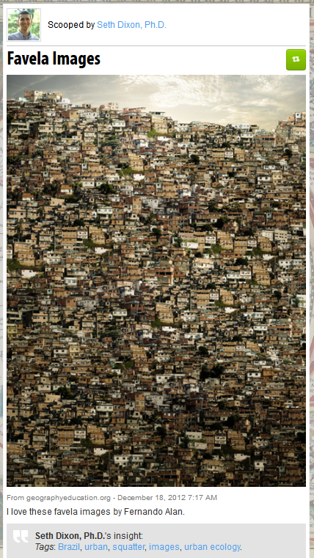
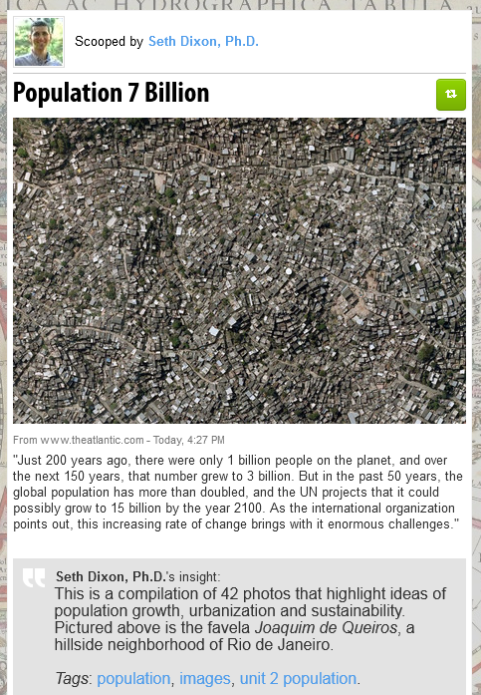
The City from Above

Slide 7
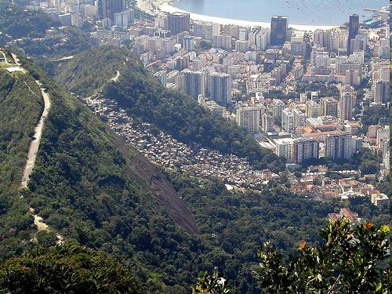
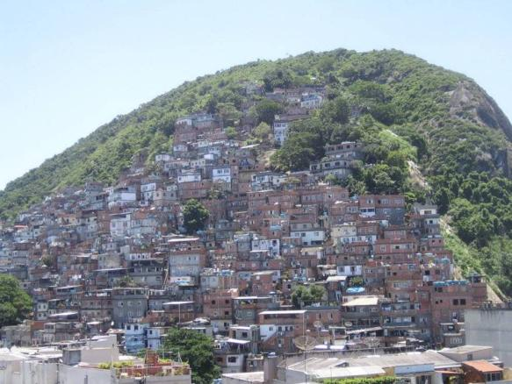
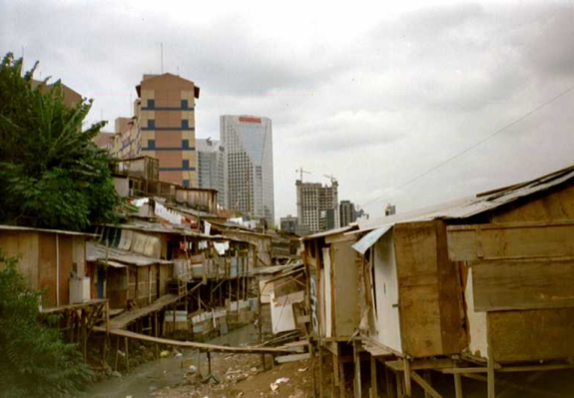
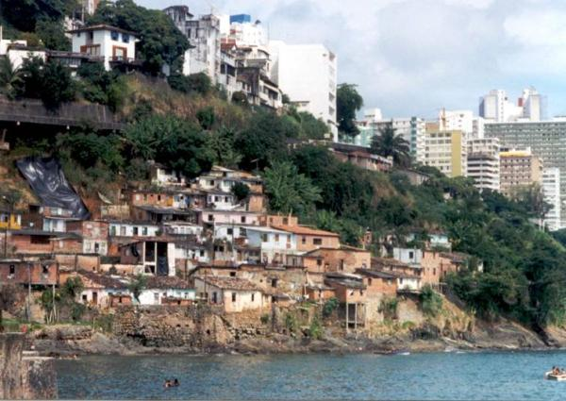
3. Make Connections (scaffold new content 1st)
Notes:
The poor neighborhoods, called favelas, are as spectacular as the wealthy areas. Where are they located? Floodplains, near rivers, steep hillsides WHY are they located there?

Slide 8
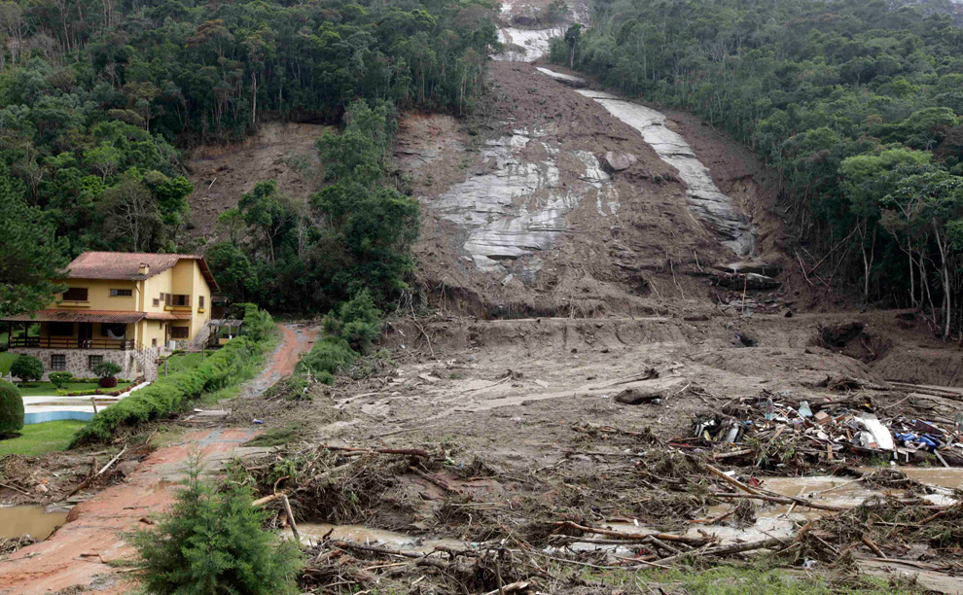
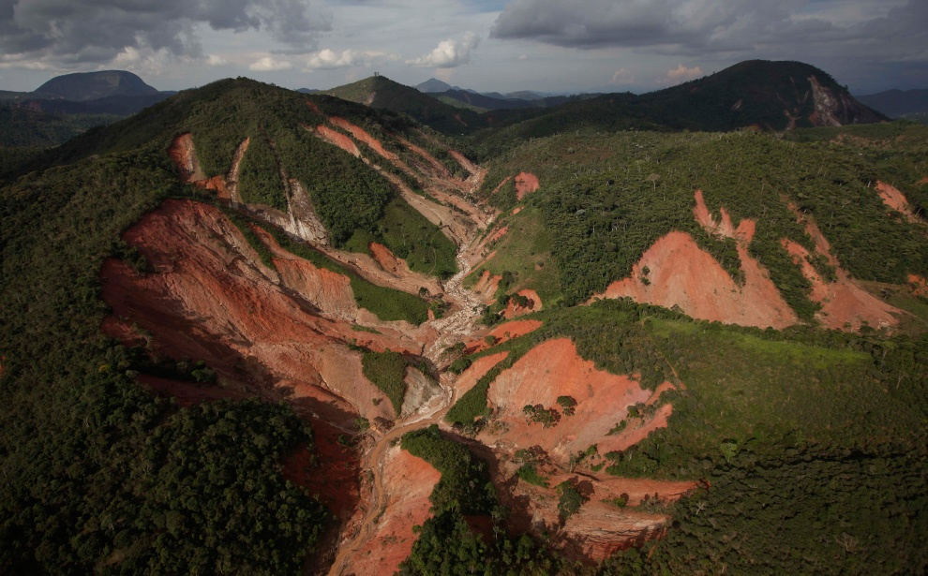
Physical Geog: Slopes, Moisture, Vegetation cover

Slide 9
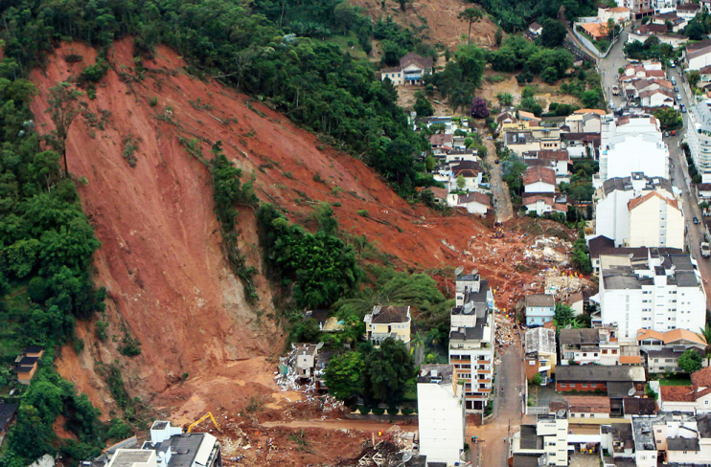
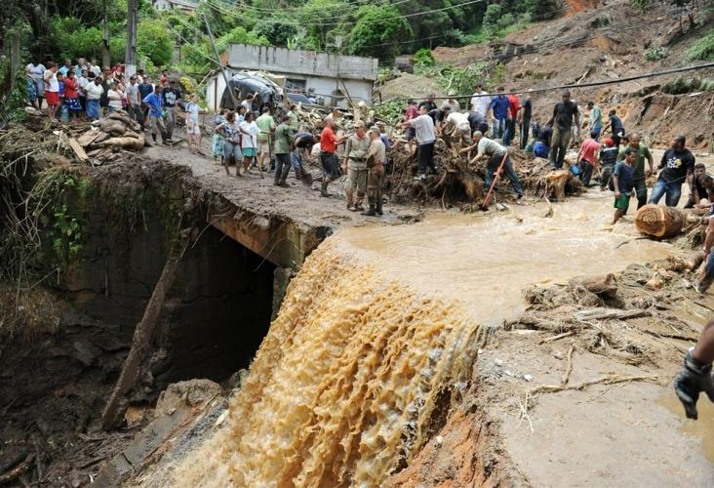
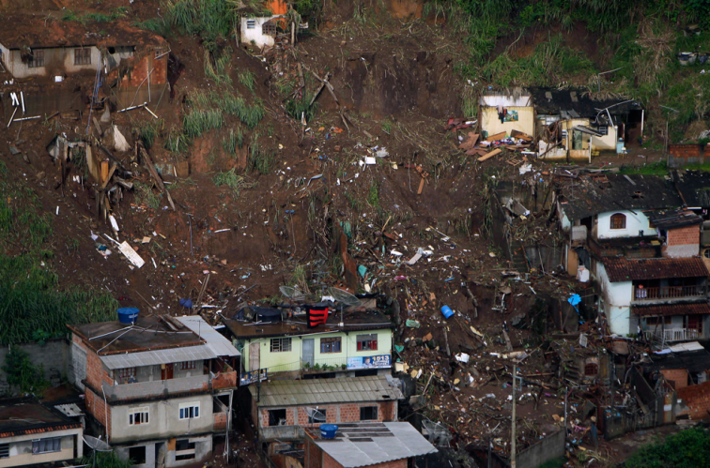
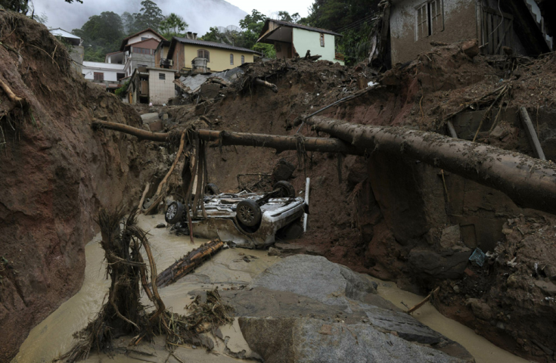

Slide 10
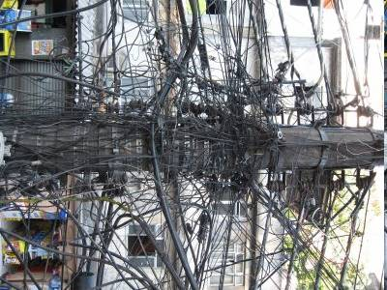
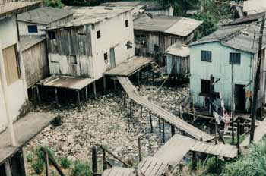
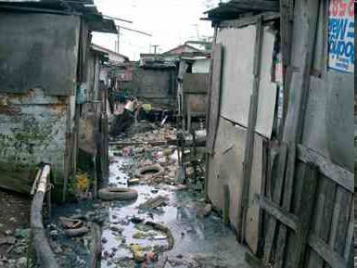
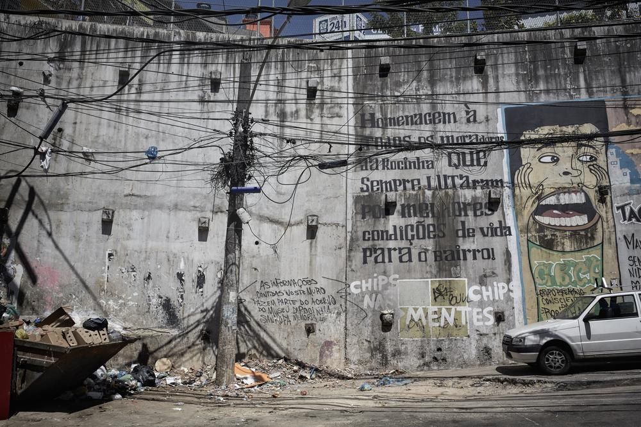
Human Geog: Poverty, Informal Housing
Notes:
So how do people live in such poverty? The Brazilians have a saying, “Ju Chinyo” Find the way. The way isn’t always legal. What’s in these pictures? The wires are illegally tapping into powerlines.

Slide 11
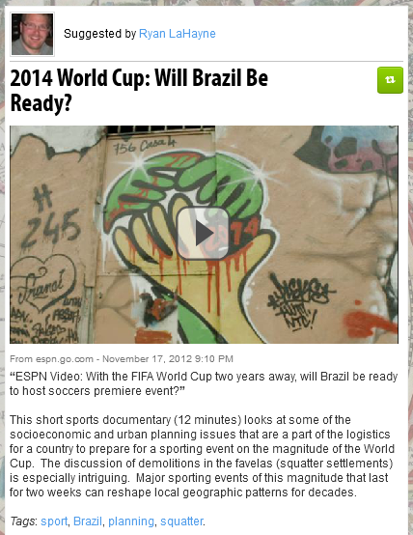


4. Ask questions/develop activities
which encourage spatial thinking
Notes:
How

Slide 12
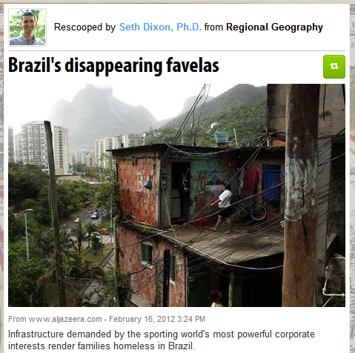
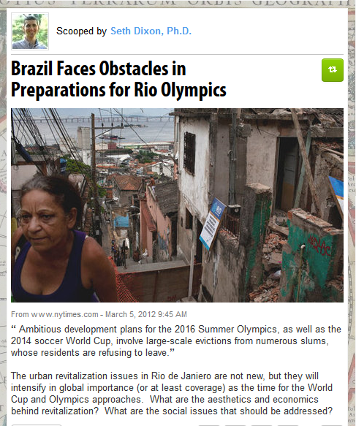
How will these events change the city?

Slide 13
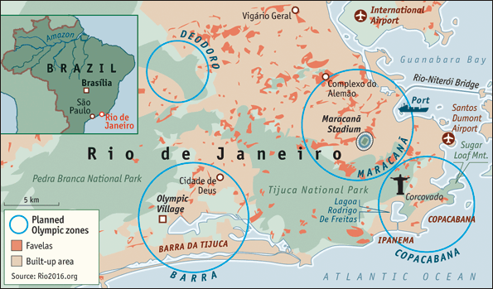
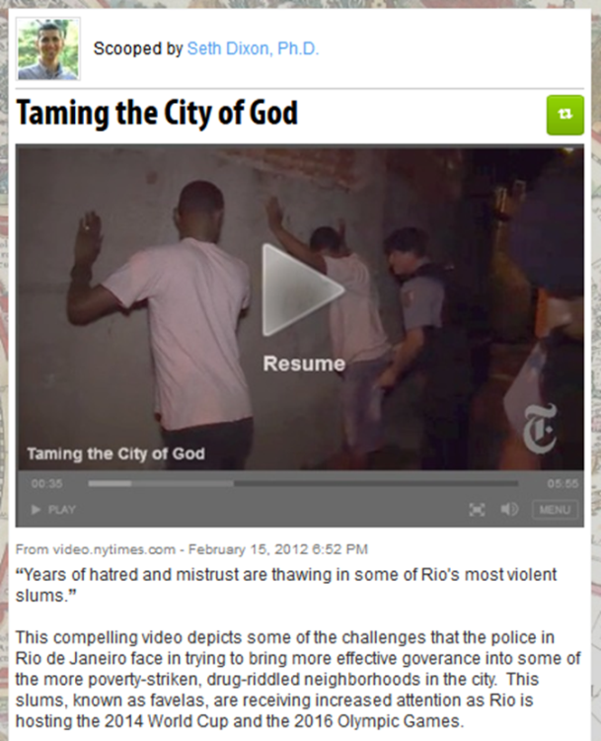
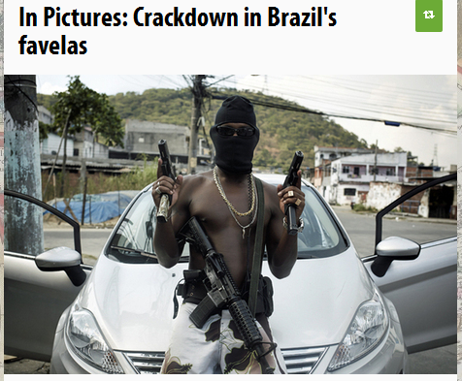
Police Interventions and Demolitions
Notes:
Rio de Janeiro will be hosting the World Cup and the Olympics soon.

Slide 14
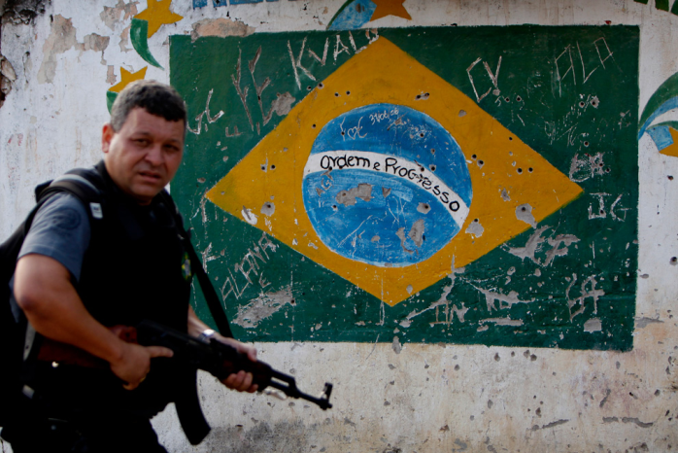
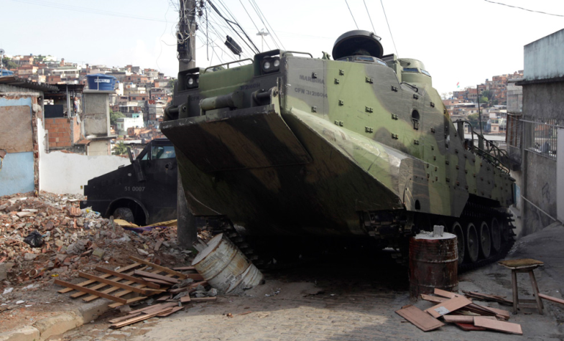
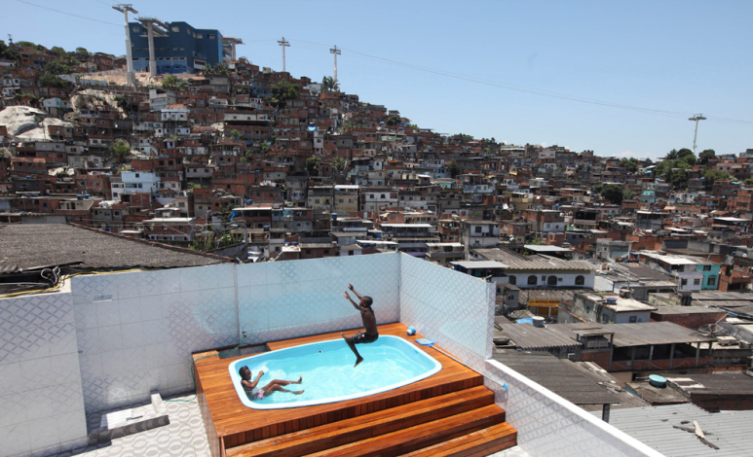
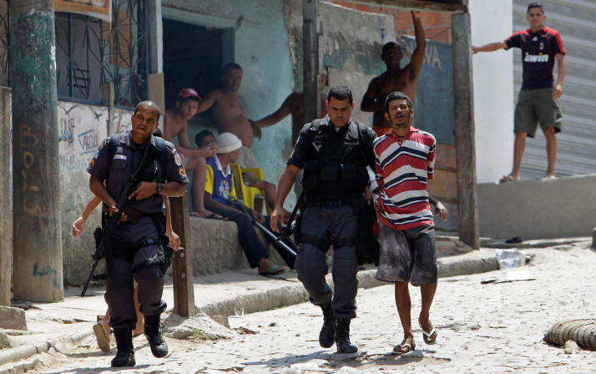

Slide 15
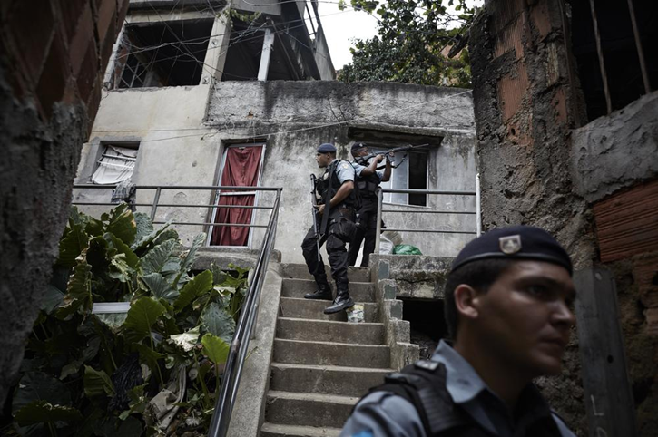
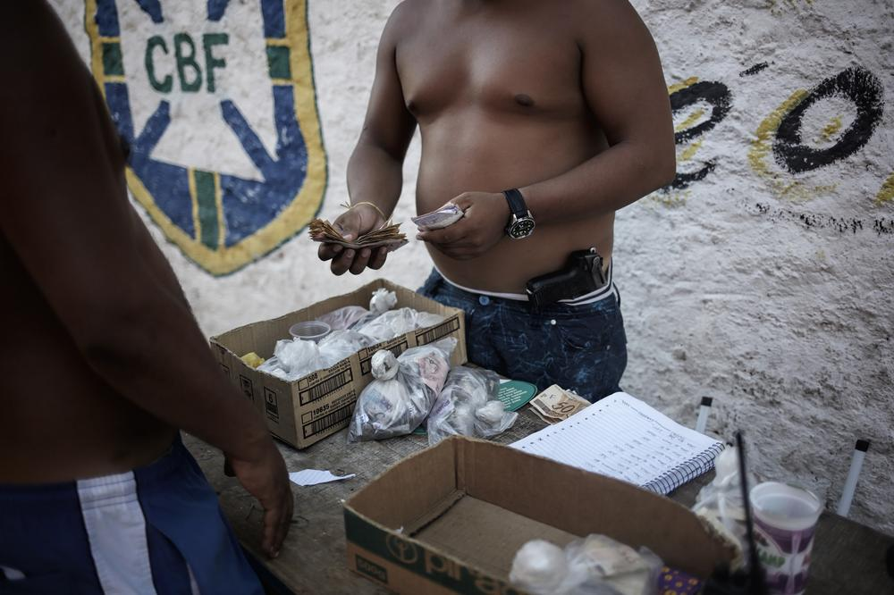
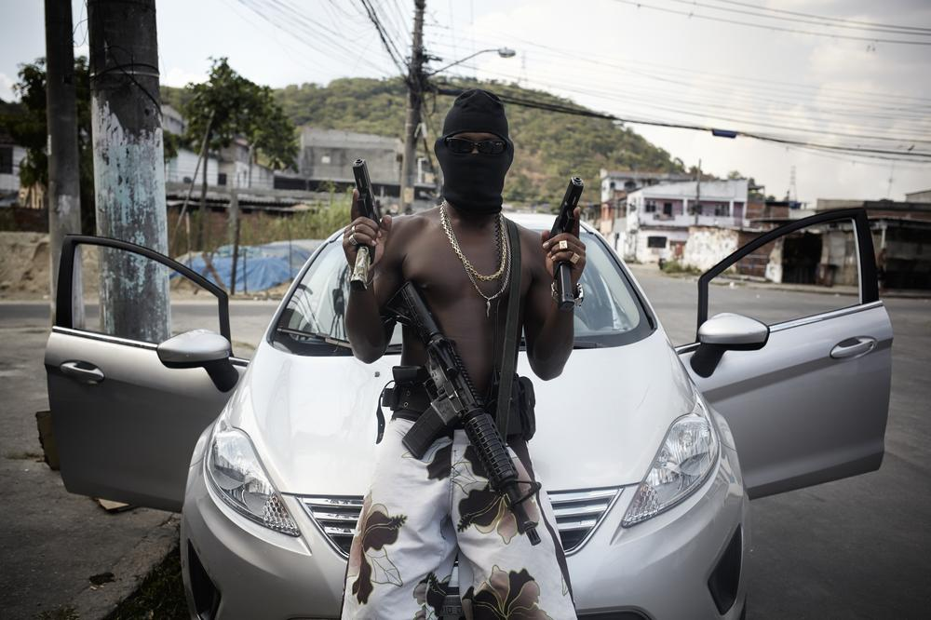
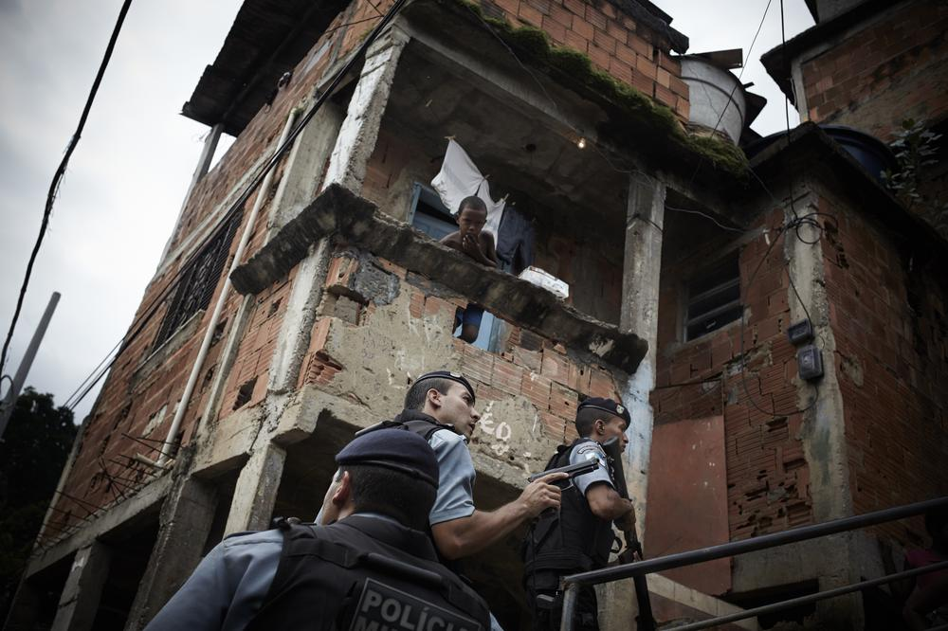

Slide 16
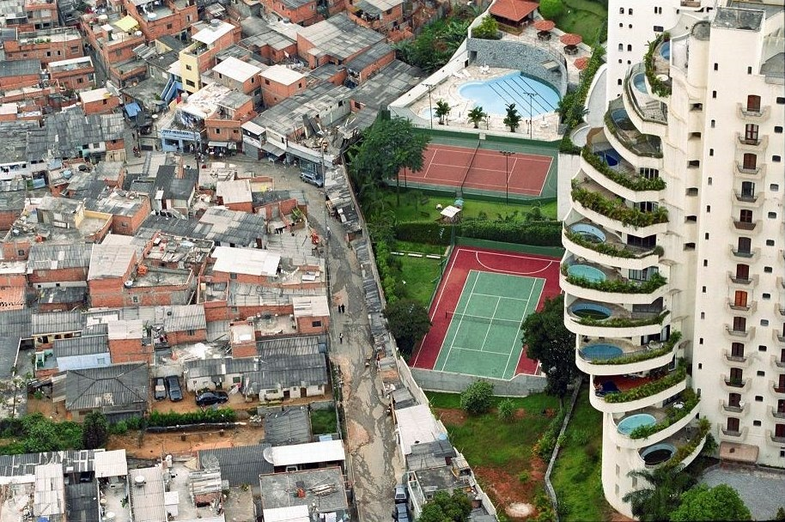
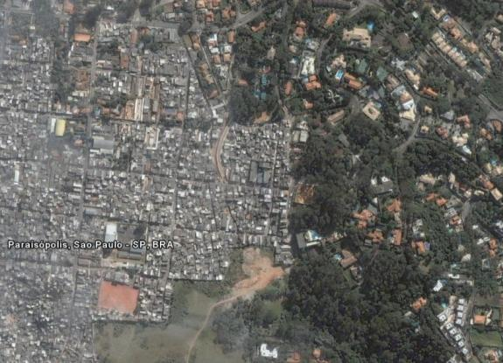
5. Make Comparisons
Paraisópolis Sao Paulo

Slide 17

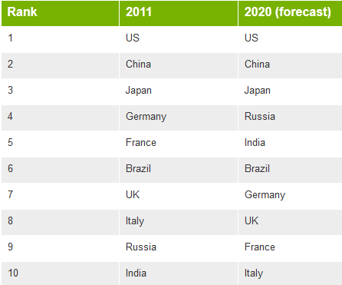
BRIC-Poised for the future
(Brazil, Russia, India, China)
5th –Area & Population
6th-Economy
Rich, diverse resource base
Large labor base
Foreign Investments

Slide 18
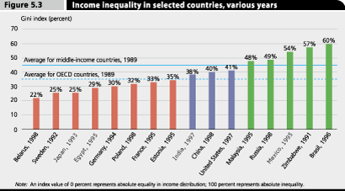
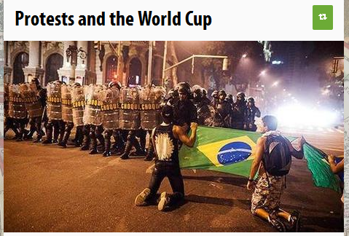
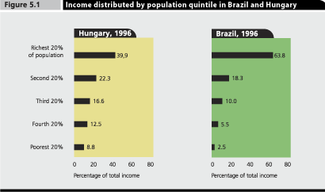
Poverty increased by 50% from 1980-2000
Since 2001, disparity dropping

Slide 19



Slide 20


