Slide 1
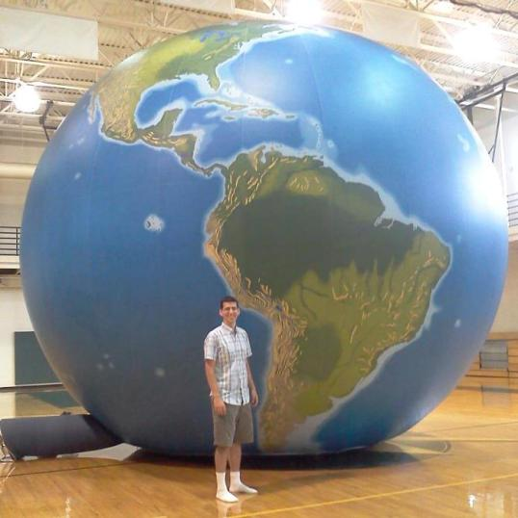
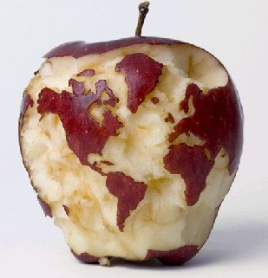






Strengthening Geographic Content in the Classroom
Notes:
Strengthening Geographic Content in the Classroom
Many efforts to strengthen geography education focus on altering the standards at the district, state and national levels. Sustained improvement in geographic content in the classroom needs to start with teachers and pre-service teachers, where that actual teaching happens. Practical ideas for teachers to strengthen geography education in their classrooms will be presented.

Slide 2
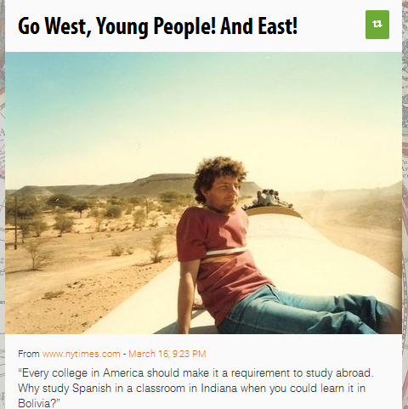

Study Abroad Article

Slide 3
Study Abroad
Fewer than 10 percent of college students study overseas during undergraduate years.
Three times as many foreigners study in America as the other way around.
One of the aims of higher education is to broaden perspectives, and what better way than by a home stay in a really different country, like Bangladesh or Senegal?
Time abroad also leaves one more aware of the complex prism of suspicion through which the United States is often viewed. If more Americans had overseas experience, our foreign policy might be wiser.

Slide 4
Study Geography
Fewer than 10 percent of college students study GEOGRAPHY during undergraduate years.
Three times as many foreigners study GEOGRAPHY than Americans.
One of the aims of higher education is to broaden perspectives, and what better way than by studying GEOGRAPHY?
Studying GEOGRAPHY also leaves one more aware of the complex prism of suspicion through which the United States is often viewed. If more Americans had GEOGRAPHIC EXPERTISE, our foreign policy might be wiser.

Slide 5
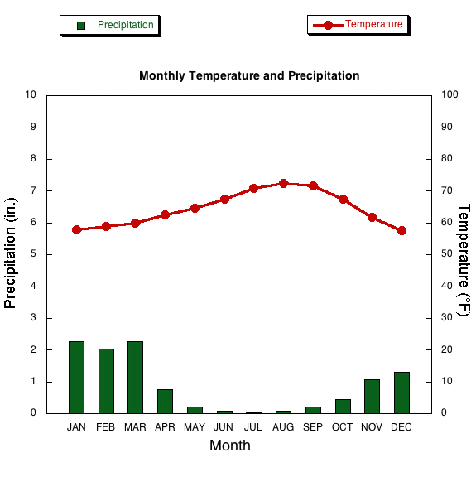

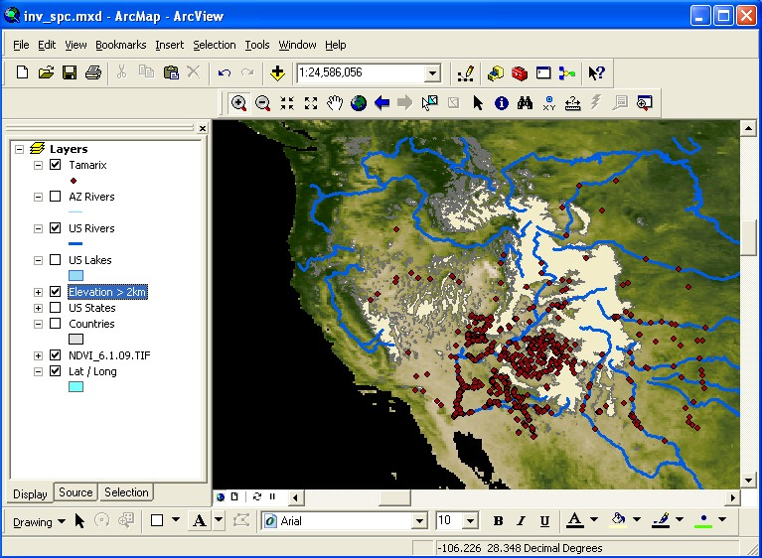
The truth…if you always lived in San Diego

Slide 6
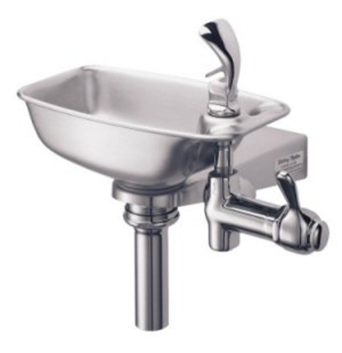
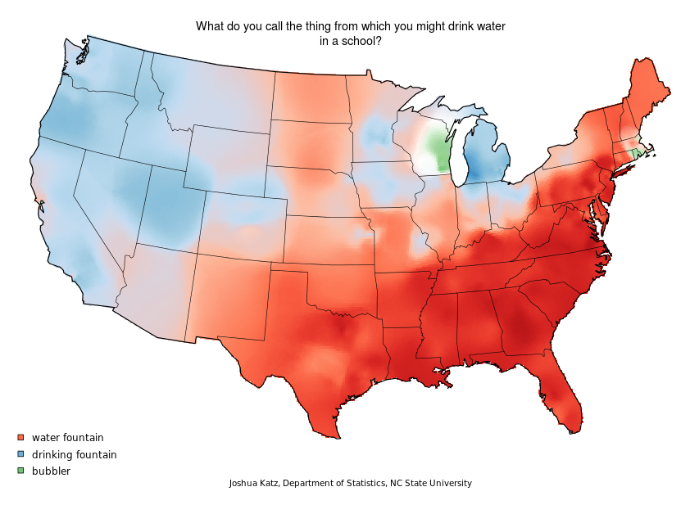
What is this item called?

Slide 7
Truths can be spatially contingent
How far from the here do you live?
What time is it?

Slide 8
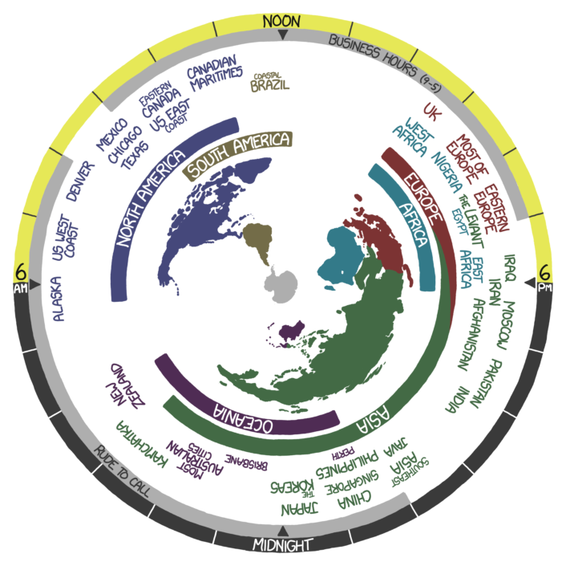

Slide 9
Truths can be scale-dependent
Where are you from?
Is overpopulation a problem in North America?

Slide 10
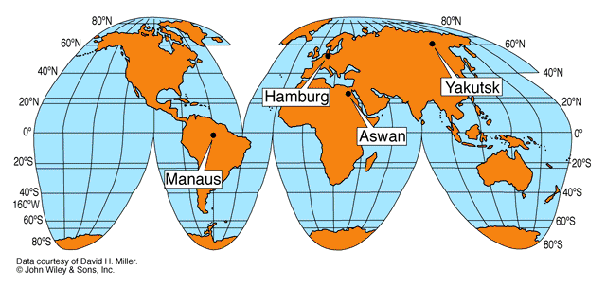
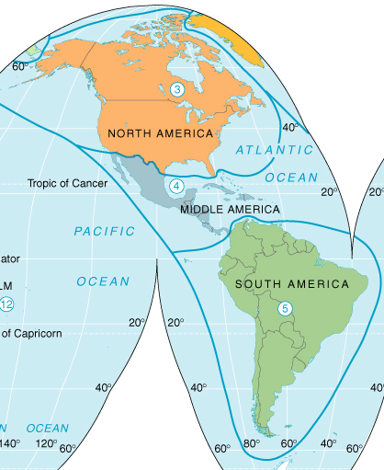
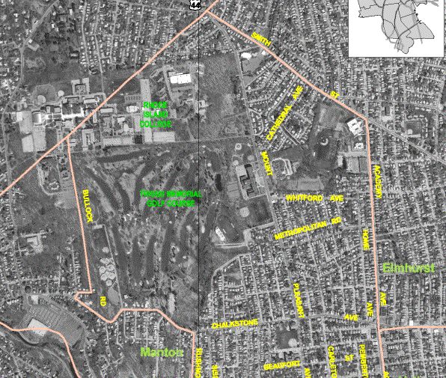
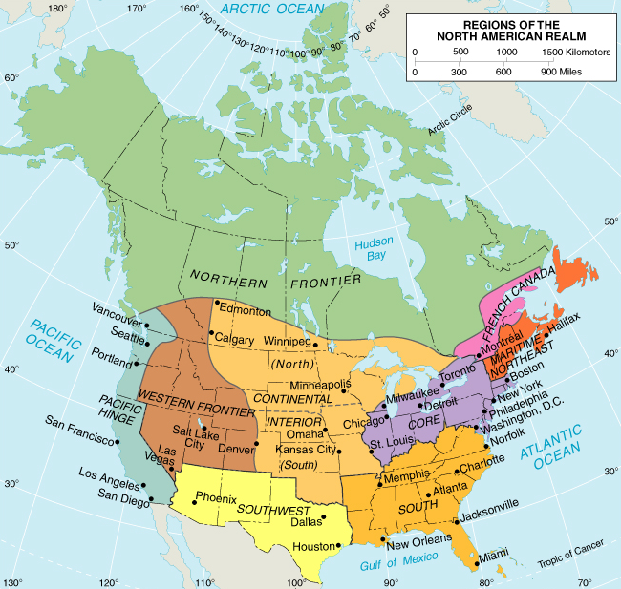
GEOGRAPHICAL CLASSIFICATION
World
Realms
Neighborhoods
Regions
Notes:
Truth is also dependent on scale.

Slide 11

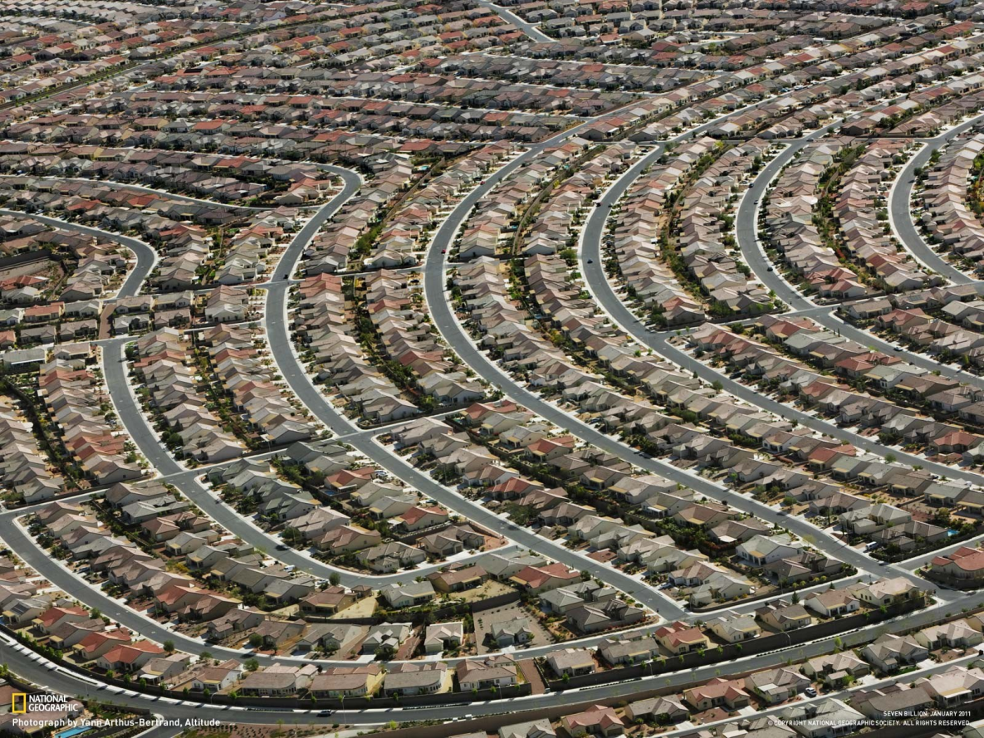
Globalization has made the world ‘flat’
Geography has been conquered
Place is increasingly less relevant
Notes:
World has changed and geographic factors aren’t what they used to be…Truth is both spatially AND temporally contingent. But different doesn’t mean irrelevant.
globalization makes place increasingly important---many think that geography is being conquered by transportation and communications technologies in this era of globalization rendering geography increasingly irrelevant as we move forward. Nothing could be further from the truth.

Slide 12
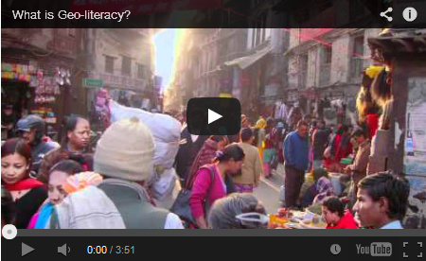
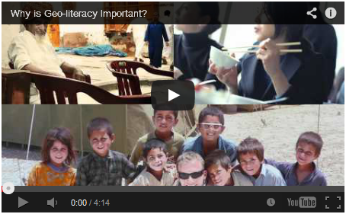
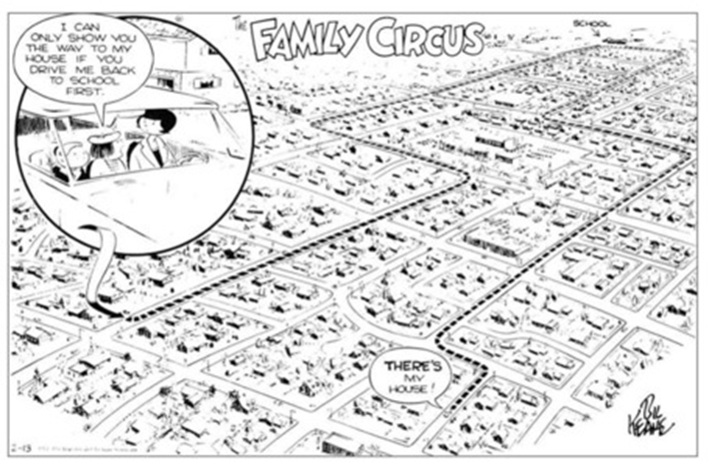
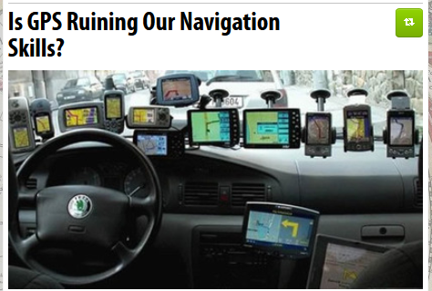
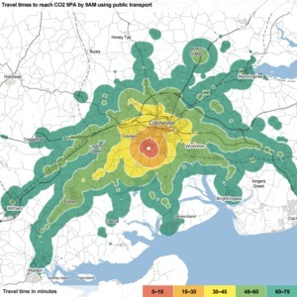
Place still matters
Distance and Time

Slide 13
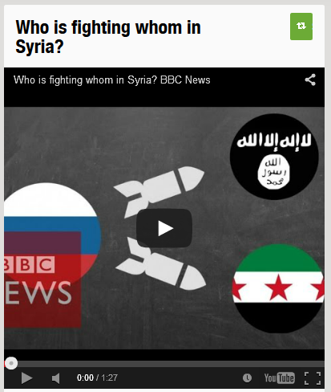
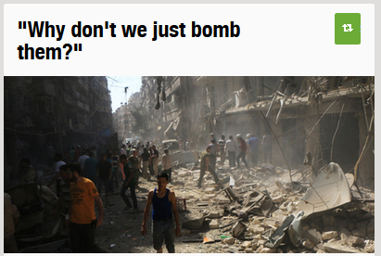
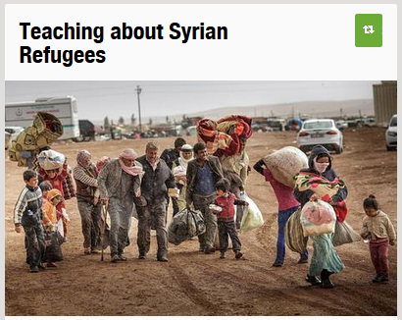
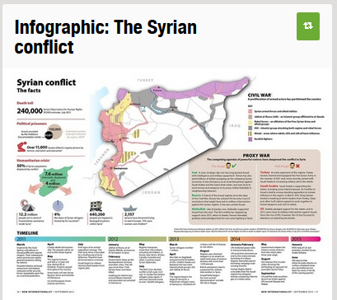
Global News Demands Geographic Context
http://www.scoop.it/t/geography-education/?tag=Syria
Notes:
global news does not make sense without geographic context

Slide 14
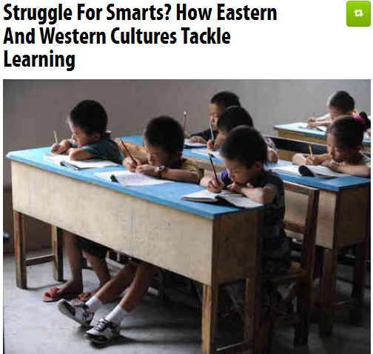

Diverse cultural understanding needed
Army training
Notes:
appreciation for cultural diversity is critical for global business

Slide 15
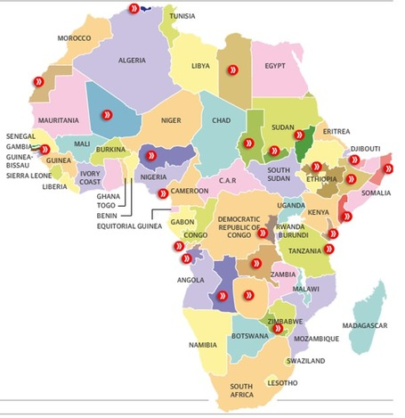
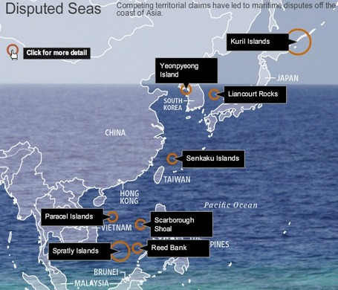

Understanding Conflicts
devolution

Slide 16
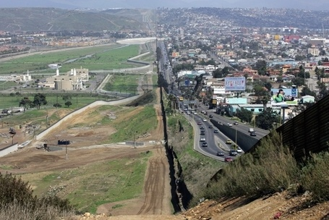
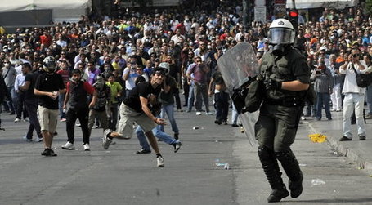

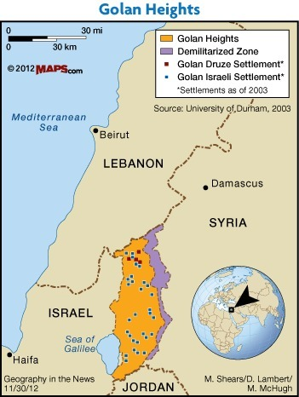
Borders Supranationalism

Slide 17
What Does Good Geography Teaching Look Like?
Answering the Big Questions in Geography
Notes:
Strengthening Geographic Content in the Classroom
Many efforts to strengthen geography education focus on altering the standards at the district, state and national levels. Sustained improvement in geographic content in the classroom needs to start with teachers and pre-service teachers, where that actual teaching happens. Practical ideas for teachers to strengthen geography education in their classrooms will be presented.

Slide 18
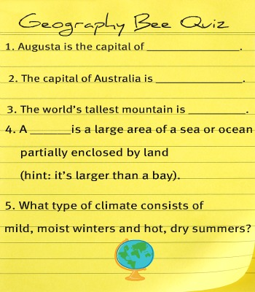
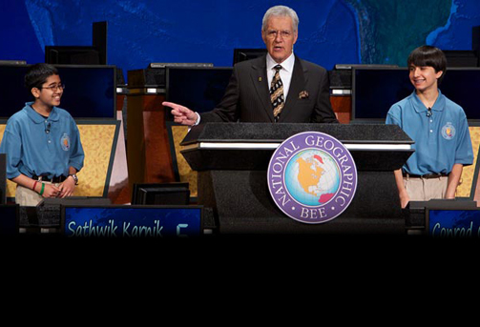
Geography education is not…

Slide 19


How can competent teachers help students understand a complex interconnected world?
Provide geographic information
Teach geographic concepts
Use data, maps, and geospatial technology
Ask questions which encourage spatial thinking.
Geographic Literacy

Slide 20
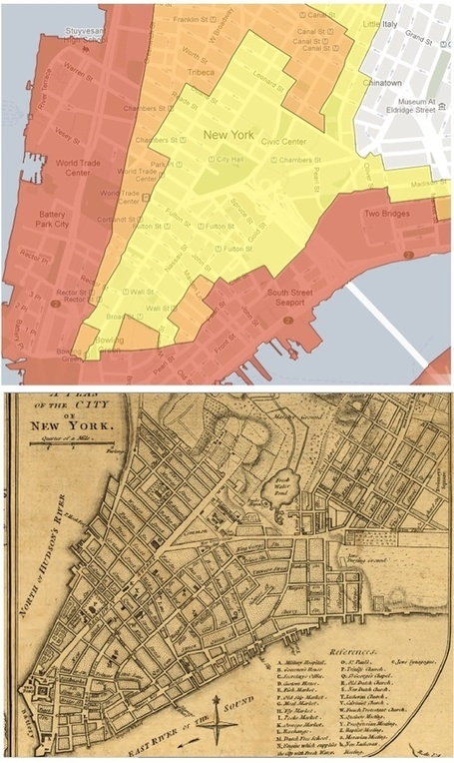
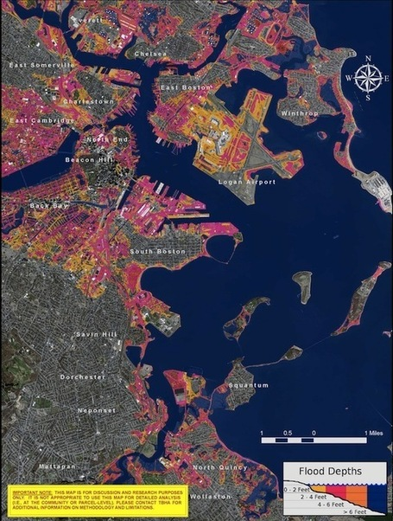

1. Provide geographic information

Slide 21
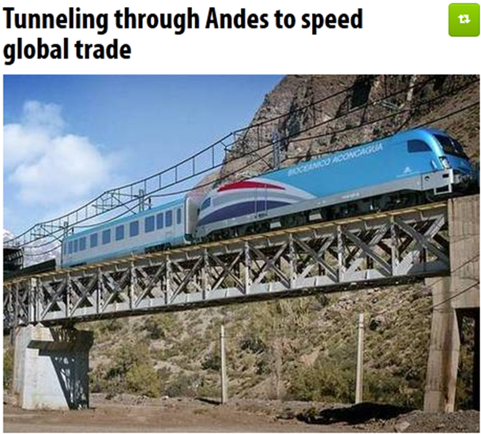
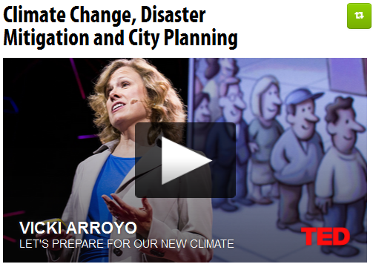
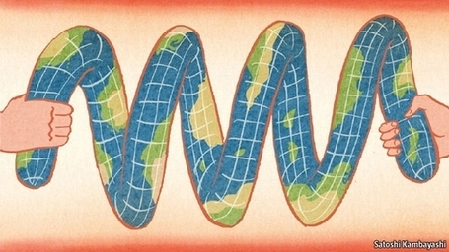
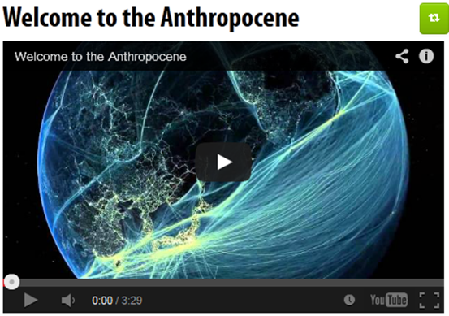
Environmental changes require holistic, systemic thinking
Notes:
environmental changes require holistic thinking about place

Slide 22
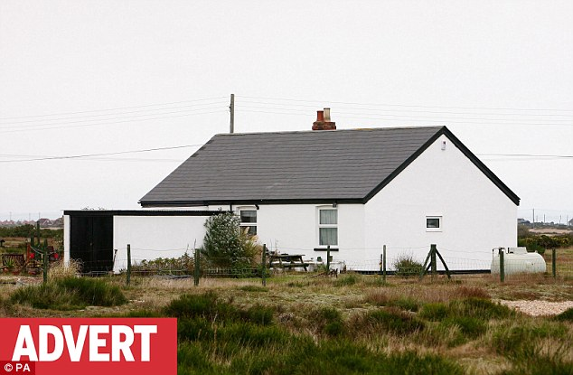
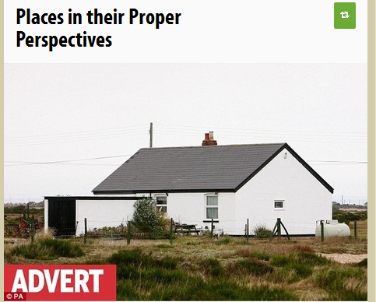

Perspective

Slide 23
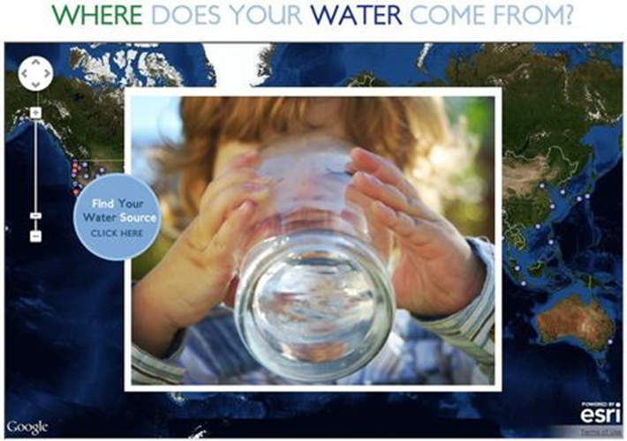
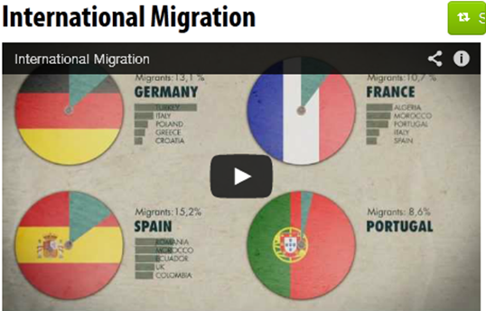
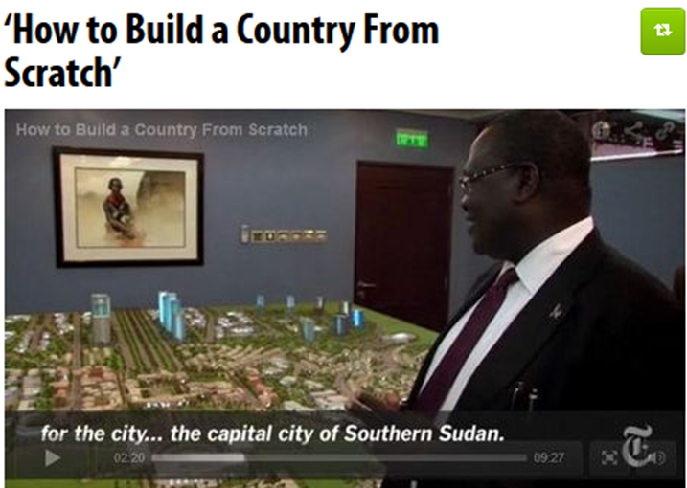
2. Teach geographic concepts
Notes:
Geographic thinking can unite and synthesize all the social studies

Slide 24
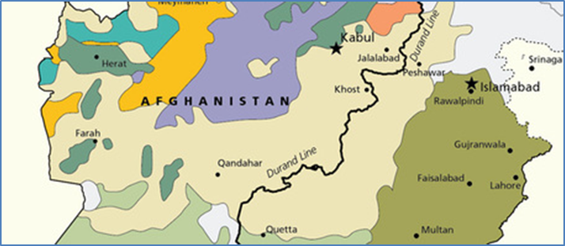
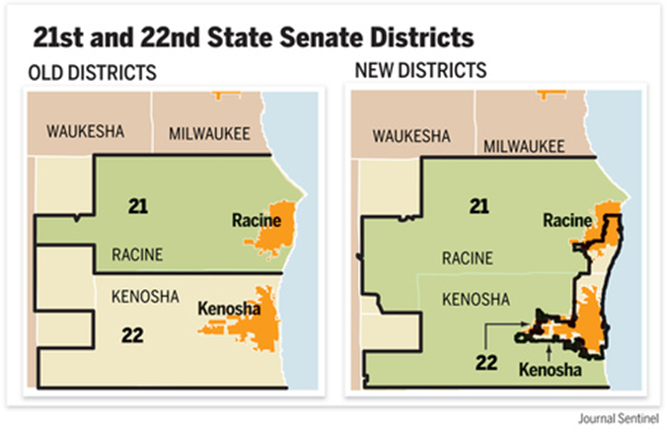
What do these maps have in common?

Slide 25
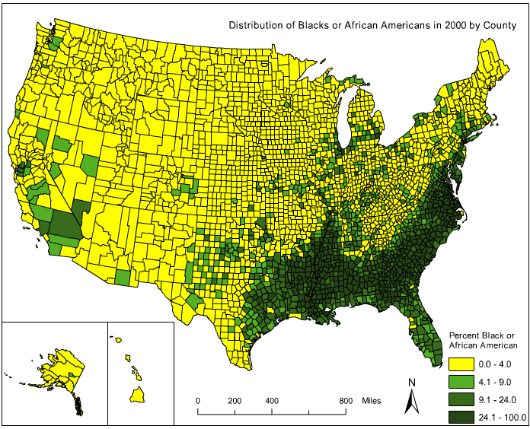

Slide 26
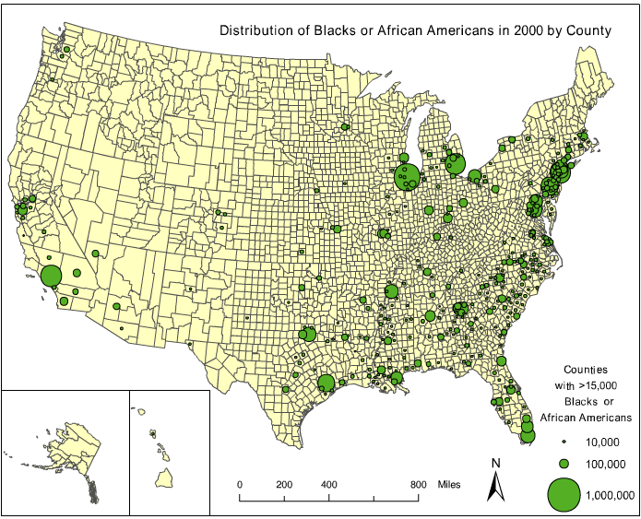

Slide 27
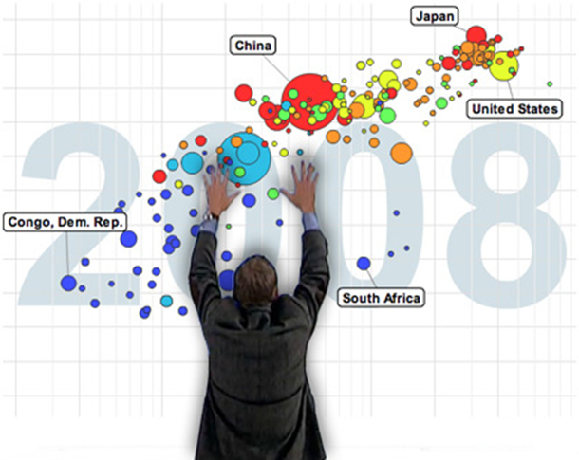
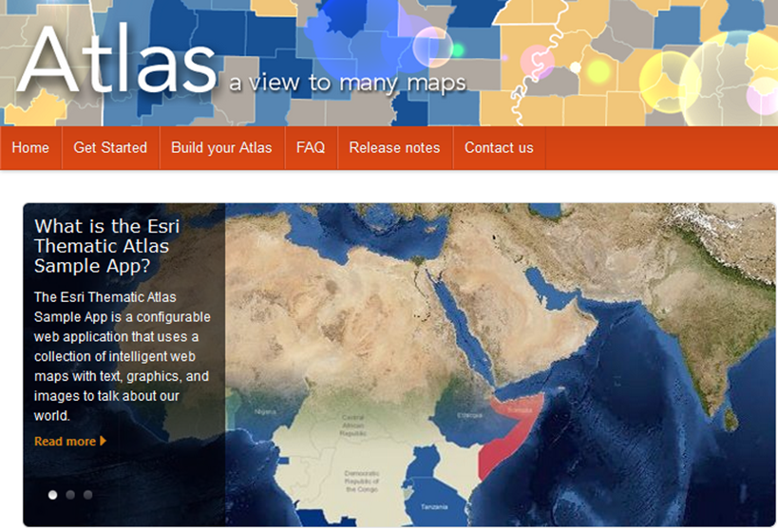
3. Use data, maps, and geospatial technology

Slide 28
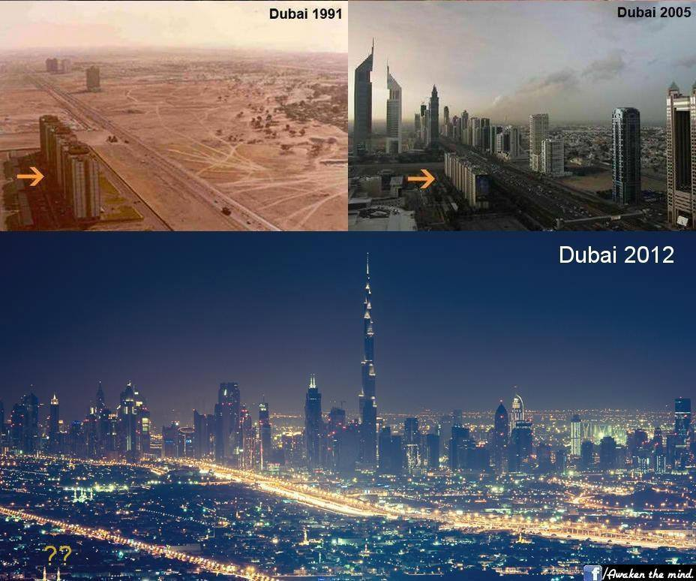

Slide 29
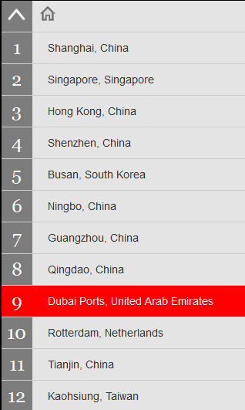
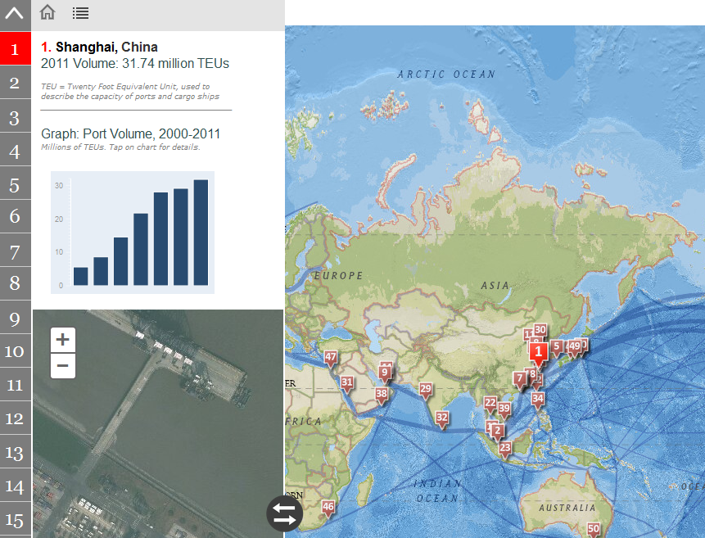
Regions are increasingly interconnected
Notes:
Regions are artificial constructs that we make to group similar places together since we can't know everything about an infinite number of places. Far distant places are incredibly relevant to the daily interactions of many places.

Slide 30



Geography integrates Social Studies
Notes:
The cultural is political. The demographic is economic. The urban and the rural are not mutually exclusive.

Slide 31

4. Ask questions which encourage spatial thinking.

Slide 32

How is this a “human” landscape?
Notes:
A Union Pacific freight train passes between windmills on January 17, 2010 near of Palm Springs, California.

Slide 33

ee
Boeing 787 assembly plant in Everett, Washington

Slide 34


CULTURAL LANDSCAPE
Human imprint on Earth’s surface.

Slide 35

Multiple layers on the landscape

Slide 36




2002
3 Types of Place
2010
2010
2010
Notes:
3 types of Place: Absolute, Relative, and Relational

Slide 37



Slide 38




Messages of cultural landscapes?

Slide 39


Cultural Landscape Meanings
http://www.scoop.it/t/geography-education/?tag=landscape
Notes:
Canal Burano Venice Italy Mesa Verde National Park (Cliff Palace)

Slide 40

Cultural Landscapes
Notes:
If you were to parachute in to a new place, where you didn’t speak the language, what are some clues you might be able to get about the culture just from looking around?
You would “read” the cultural landscape—This is the Orkhon Valley Cultural Landscape World Heritage Site (Mongolia)

Slide 41




Slide 42


A spatial perspective is not just for geographers
spatial
mapping
map projections

Slide 43


Notes:
How can there be violence right on our doorstep? Flip it. There is violence in Northern Mexico BECAUSE it’s right on the border with the USA.

Slide 44



The Global becomes Local

Slide 45


How can competent teachers help students understand a complex interconnected world?
Provide geographic information
Teach geographic concepts
Use data, maps, and geospatial technology
Ask questions which encourage spatial thinking.
Geographic Literacy

