Slide 1
Best Practices in Teaching APHG
It’s All Spatial
Sarah Witham Bednarz

Slide 2
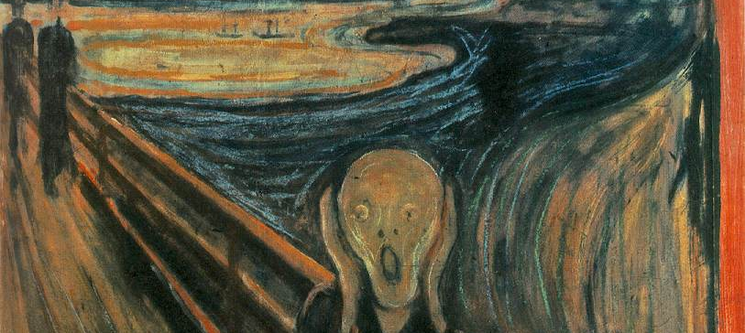
Embarrassment
Geographic thinking
Best practices
Advice
Notes:
I would like to start by expressing my deep embarrassment.
I am embarrassed to be talking about teaching and learning with a large audience of the best geography teachers in the world.
And I am embarrassed to be talking about geography with colleagues who think deeply about the discipline, content, and how best to teach it every day.
I read the Facebook Readers page every day and monitor the AP Community—in digest form—and am amazed and impressed at the creativity, the commitment, and the care that so many of you take.
So I wonder what I can really contribute that would be valuable and appreciated—Nothing! Good night! Kidding….
But I told Fearless Leaders I wanted to talk about teaching students to think geographically—not necessarily to do well on the examination—but to really develop that geographic habit of mind.
So I will cast aside my embarrassment and seek your patience with me while I talk about geographic thinking and how best to develop it in students.
To proceed I first want to explore geographic thinking: what it is and isn’t. Next I have some suggestions for best practices to nurture geographic thinking, and finally I offer some advice for you.

Slide 3
Three Types of Thinking
Spatial Thinking
Learning to Think Spatially (2006)
Geospatial Thinking
Baker et al., Journal of Geography (2015)
Concepts of space, tools of representation, and processes of reasoning
Application of spatial thinking in the context of using geospatial technologies
Geographic Thinking
Notes:
We can identify three types of thinking key to geography today: geographic thinking, spatial thinking, and geospatial thinking.
Spatial thinking can be defined as a constructive combination of cognitive skills comprised of knowing concepts of space, using tools of representation, and applying processes of reasoning. Spatial thinking allows people to use space to model the world (real and theoretical), structure problems, find answers, and express and communicate solutions. The inclusion of concepts of space makes spatial thinking unique from other types of thinking. Concepts of space like location, dimensionality, pattern, and spatial association are declarative forms of knowledge, the building blocks for spatial thinking. Tools of representation such as maps, images, and models support spatial thinking by describing, explaining, and communicating information about objects and their associated spatial characteristics. Spatial thinking often requires complex reasoning, the capacity of individuals to think, make sense of the world, and understand. Processes of reasoning are crucial for learning as individuals obtain, change, or justify practices, institutions and beliefs and range from simple, lower-level thinking such as recognizing, defining, and listing, to higher levels of cognition, such as evaluating, synthesizing, and generalizing.
Geospatial thinking is an application of spatial thinking in the context of using GST. The relationship between GST and thinking processes is assumed to be reciprocal: using GST influence and mediate how people think about the world (Uttal 2000; 2005) and geospatial thinking facilitates the use of GST. How this works is yet unknown but a detailed research agenda in this arena has been proposed (Baker et al. 2014).
Geographic thinking, in contrast, is a term frequently used by geographers but one without an agreed-upon definition. While similar to spatial and geospatial thinking, geographic thinking is unique. But what is it precisely? What knowledge, skills, and practices constitute thinking geographically? And how can knowing this help you to develop meaningful learning experiences for students?

Slide 4
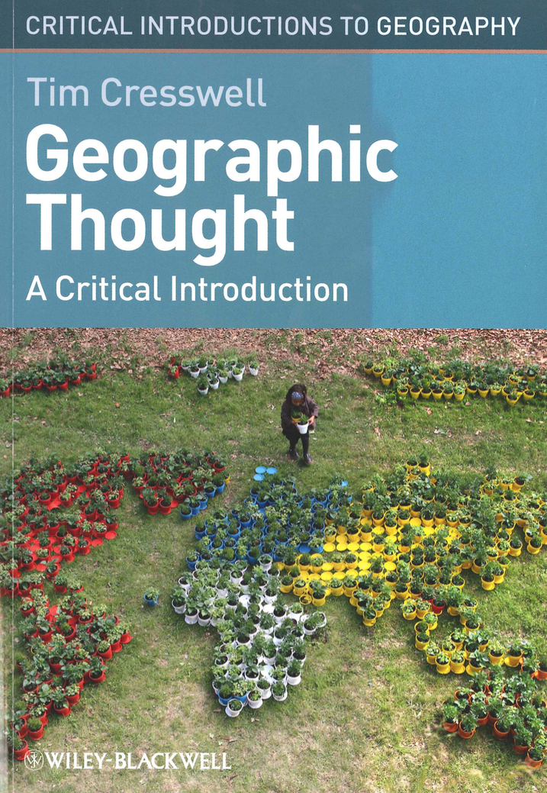
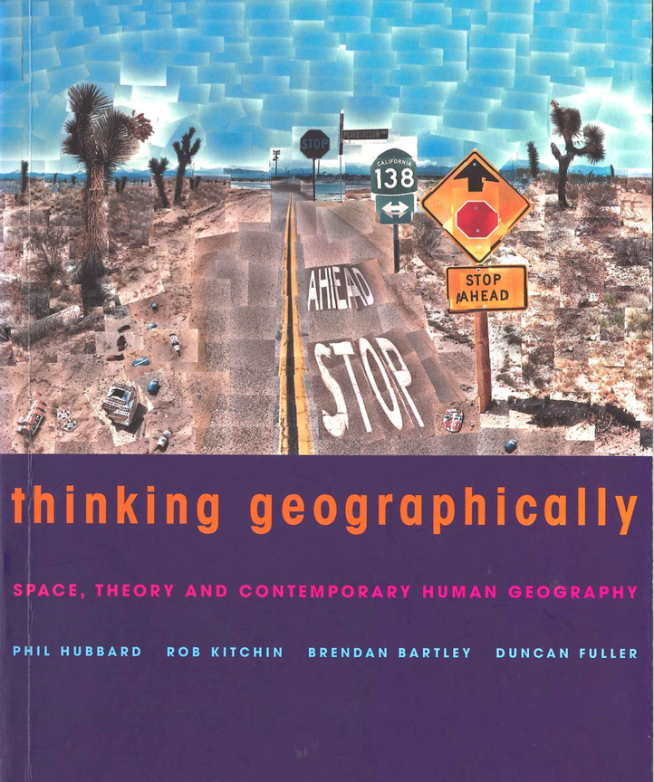
Geographic Thought ≠ Geographic Thinking
Notes:
As I began thinking about geographic thinking, I read books that I thought would help in defining geographic thinking. What I quickly learned was that geographic THOUGHT is not the same as geographic thinking. These two well known resources, for example, are all about the WHAT of geography and how the discipline has changed its perspectives over time. The “isms” of geography or the DECLARATIVE knowledge of geographers. But there really isn’t any clue to what it means to think geographically in a cognitive sense, that is, CONDITIONAL or PROCEDURAL knowledge.

Slide 5
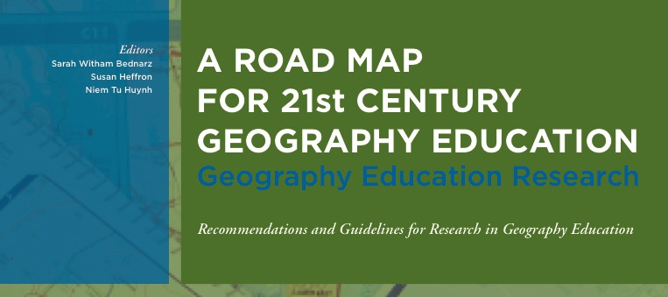
US Geography Education
National Assessment of Educational Progress (NAEP) (1992): Concepts, tools, skills
Geography for Life, National Standards in Geography (1994, 2012): Skills
Road Map (2013): Practices
Notes:
Geography Education in the United States has paid special attention to thinking and doing geography beginning with the creation of the National Assessment of Educational Progress (NAEP) framework in 1992. This effort was followed quickly by completion of the National Geography Standards in 1994.
Terminology was an issue. In NAEP, : tools, concepts, and skills were identified but without a clear focus on geographic thinking. Map interpretation skills, for example, were placed in the same category as understanding urban patterns or the interplay between climate, soils, and agriculture.
In Geography for Life: a discrete set of skills were identified to describe the activities that constitute doing geography. in essence describing a cycle of geographic inquiry, from asking a geographic question to answering that question.
But how well does the term skills describe “the complex, goal directed behaviors that constitute geographic practice.” (p.25).
The Roadmap for 21st Century Geography Education did pay special attention to skills, redefining them as PRACTICES.

Slide 6
Geographic Practices
Categories | Practices
Posing geographic questions | Identify problems/questions that can be addressed using geographic principles, models, data, perspectives
Acquiring geographic information | Identify geographic data that can help to answer a question or solve a problem; Collect data (including observations and measurements) about geographic phenomena
Organizing geographic information | Organize and represent data
Analyzing geographic information | Identify data analysis strategies; find and describe spatial and temporal patterns in data; construct an explanation or prediction for phenomena using models and theories
Answering questions and designing solutions | Construct an answer to a question using geographic principles, models, data; evaluate one of more answers to a question or solutions to a problem
Communicating geographic information | Inform or persuade using geographic principles, models, data
Notes:
The term “Practice” describes the behaviors that comprise inquiry and problem solving, e.g., asking questions, defining problems, developing and using models, constructing explanations, and engaging in argument from evidence. Practices are shared across disciplines but conducted in different ways. The unique perspectives of a discipline are encoded in its practices.
So, for example, historical thinking has been described as having four discrete components:
Chronological reasoning
Comparison and contextualization
Development of historical arguments from evidence, and
Interpretation and synthesis
So certainly geographers compare and contextualize and use evidence to draw conclusions, but certainly in a different way from historians.
The practices of geography identified in the Road Map again follow a cycle of inquiry.
Are these the boundaries of geographic thinking?

Slide 7
QAA Subject Benchmark Statement
Spatial awareness and observation | Abstraction & synthesis of information
Developing a reasoned argument | Assessing merits of contrasting theories/explanations
Numeracy & statistical literacy | Preparing effective maps, diagrams, visualizations
Primary data generation, collection, recording; secondary data use, qual. & quant. | Critically evaluating, interpreting, combining different types of geographical evidence
Analysis & problem solving qual. & quant. | Planning, designing, executing research
Fieldwork & field data collection | Social survey and interpretive methods
Science lab skills | Methods for collection of spatial and environmental data (GIS, RS, modeling)
Responsibility for learning and reflection | Recocognizing moral, ethical, safety issues of geographic inquiry
Notes:
Similarly the QAA Subject Benchmark Activity here in the UK describing learning outcomes for postsecondary geography graduates identifies “Intellectual and subject specific skills” separate from Generic Skills. However, as I examine these they seem in some instances also generic.
It is worth noting, incidentally, that there appears to be consensus across documents on the core elements of geography, sharing emphasis on human environment interaction, spatial variation and relationships, change over time and space, scale and process dependency, place, physical and human processes, and patterns of development and inequalty.
Again, are these the boundaries of geographic thinking?

Slide 8
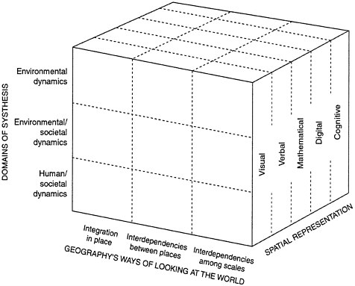
Necessary But Not Sufficient
Perspectives
Hanson: Geographic thinking varies with the personal and collective experience of the individual geographer and that individual’s position in society (2004)
Notes:
Are these all too generic? It is necessary but not sufficient to isolate our practices.
Perhaps we need to examine more precisely the ACTIONS of geographers, following the advice, “Geography is what geographers do.” or as Carl Sauer wrote, “What geography is, is determined by what geographers have worked at everywhere and at all times.”
Can we identify geographic thinking from examining what geographers do?
But this ignores the issue of the diversity of geography and its multiple, multiple perspectives that affect how we perceive the world, thus how we think illustrated by this cube entitled GEOGRAPHERS WAYS OF LOOKING AT THE WORLD.
Let alone the roles that personal and collective experience play in what we as geographers do. An idea I will come back to.
So as a way to move forward, for personal reasons, I decided to go back and review statements made by past presidents of the Association of American Geographers about geographic thinking. Three statements made the most impact.

Slide 9
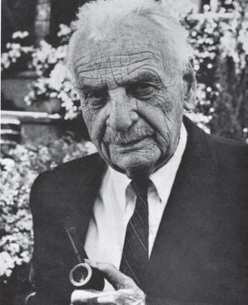
Past Presidents…
Carl O. Sauer
The Education of a Geographer (1956)
  “It is about as difficult to describe a geographer as it is to define geography…”
  Liking maps; traveling; seeing and thinking about what is in the landscape; description and analysis of distributions
  maps; traveling; seeing and thinking about what is in the landscape; description and analysis of distributions
Notes:
Most famously, Carl Sauer’s presidential address in 1956 was entitled “Education of a Geographer” in which he wrote, “IT IS ABOUT AS DIFFICULT TO DESCRIBE A GEOGRAPHER AS IT IS TO DEFINE GEOGRAPHY” or, for our purposes, to define geographic thinking.
Sauer, while taking digs at some of his fellow geographers whom he criticized as “regional geographers” as opposed to “topical geographers” emphasized that the “geographic bent” manifests itself by, among other things, liking maps, travel, and thinking about the landscape.

Slide 10
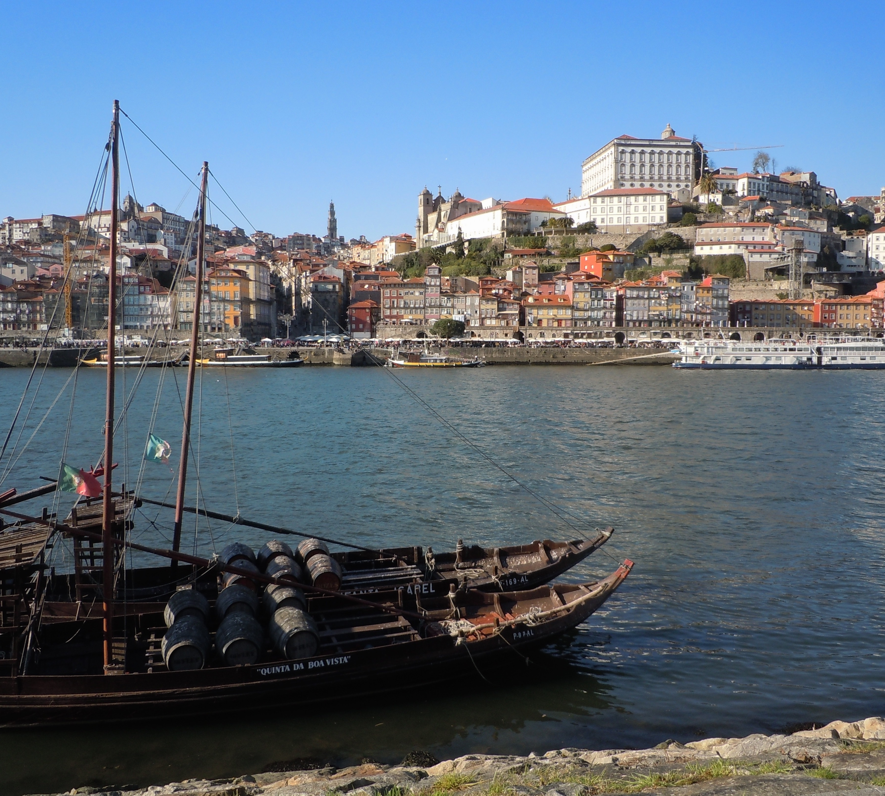
Past Presidents…
Morphological Eye
  Innate aptitude to register on differences and similarities; science of observation, i.e., fieldwork
    “spontaneous and critical attention to form and pattern”
Notes:
Geographers, according to Sauer, have the “MORPHOLOGICAL EYE” which he defined as “a spontaneous and critical attention to form and pattern.”
Thinking geographically, thus, involves observation with an eye, or perspective, seeking differences and similarities, likeness and unlikeness.

Slide 11
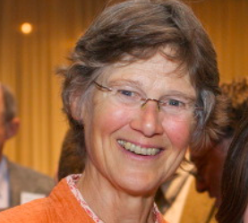
Past Presidents…
Susan Hanson
Who Are “We”? (2004)
  “…the questions we ask—the questions that define the discipline and energize us as geographers, usually, quite literally, by propelling us into the field—reflect in part the nature of our experiences, individual and collective.”
Notes:
Susan Hanson, an enormously influential and pioneering American geographer, made the point in her essay, “Who Are “We” examining the discipline of geography that it is our experiences that drive us to think in certain ways.
As a woman, Hanson asked questions about womens’ perceptions of urban environments in a way that no men had thought to do. This raises questions about the role of class, gender, and race and geographic thinking. Does geographic thinking change with who is doing the thinking? Is thinking geographically substantially different for some geographers based on certain characteristics? As geographers become more diverse, we are posing a wider range of questions.

Slide 12

Past Presidents…
The Geographic Advantage
The geographic advantage confers an understanding of
  relationships between people and the environment
  the importance of spatial variability, i.e., the place dependence of processes
  processes operate a multiple and interlocking geographic scales
  The integration of spatial and temporal analysis
Notes:
However, Hanson sought to identify an essential and enduring core to geography—”uniquely geographic propositions”-- which she said is the advantage of geography: human-environment interactions; interest in space; concern with processes at a range of scales; and integration of time and space.
So Hanson opens up geographic thinking while maintaining its central identity. Her essay concludes with a call to communicate the value of the geographic advantage through teaching.

Slide 13
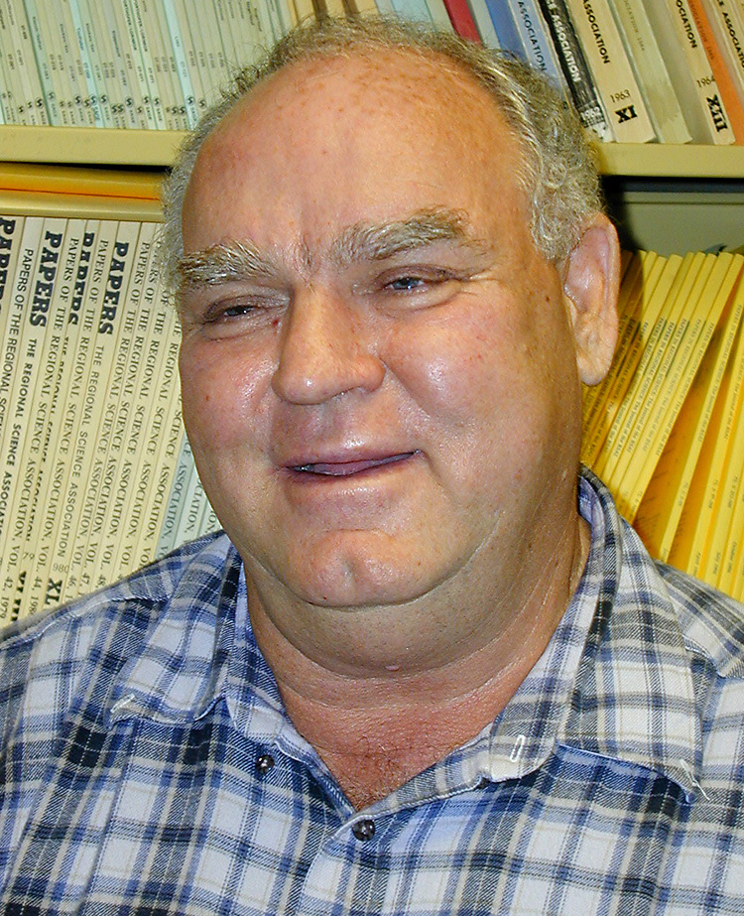
Past Presidents…
Reg Golledge
The Nature of Geographic Knowledge (2002)
  “Geographic knowledge is the product of geographic thinking and reasoning about the world’s natural and human phenomena.”
  Spatial concepts and relations the basis of geographic knowledge
Notes:
It was the behavioral geographer, Reg Golledge, who devoted much of his career to thinking about geographic thinking. In his presidential address “The Nature of Geographic Knowledge” he skirted the issue of defining geographic thinking by starting with knowledge and stating that it is the result of geographic thinking and reasoning, especially spatial concepts and relations. But what is geographic thinking and reasoning?

Slide 14
Past Presidents…
Geographic Thinking & Reasoning
Comprehending scale transformations
Superordinate & subordinate relations and frames of reference
Problems of spatial alignment
Distance effects
Spatial associations
Orientation & direction
Spatial classification (regionalization)
Overlay (spatial aggregation / disaggregation
Integration of geographic features as points, networks, regions
Proximity & adjacency (distance decay)
Recognizing spatial forms, e.g., city spatial structures
Notes:
To Golledge it was a detailed set of processes, partially listed on this slide. He developed the set from a review of geographic research in the last 50 years. And while taking a very particular, spatial & behavioral perspective you can see similarities with Sauer and Hanson, especially in terms of concerns with
space and scale,
locations and places,
recognizing spatial forms and patterns,
spatial associations,
spatial change and spread,
proximity and adjacency (nearest neighbor and distance decay) and so on.

Slide 15
Past Presidents…
Reg Golledge
Geographic Knowledge
The Nature of Geographic Knowledge (2002)
  Knowing why things are where they are and how and why they are spatially related to other things
Observe & apply fundamental geographic principles like location, place, connectivity, interaction, distribution, pattern, hierarchy, distance, direction, orientation, reference frame, geographic association, scale, region, geographic representation
Notes:
He summarizes the essence of geography by stating, “In short, geographic thinking and reasoning has provided a basis for understanding—or reasoning out—WHY there are spatial effects, not just finding WHAT they are.”
In conclusion he sums up geographic knowledge as the result of observation and the application of geographic principles, but makes the point that “the processes underlying geographic knowledge are different from the processes underlying other complex knowledge domains. Geographers as still ignorant of many of the processes (spatial and non-spatial) underlying geographic knowledge.”
How do we integrate Sauer’s morphological eye with Hanson’s geographic advantage, and Golledge’s spatial take on thinking and reasoning?

Slide 16
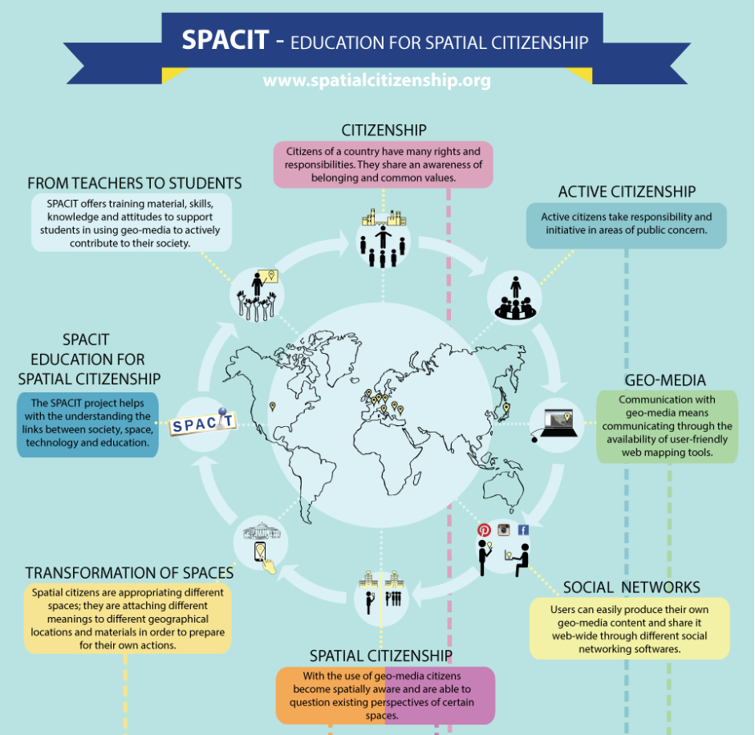
Spatial Citizenship
SPACIT
Learning how to navigate everyday life with respect to
  The physical world
  The meanings attached to physical objects and the environment
  The power relations involved in the production of meaning, including GIS and other instruments to naturalize meaning as well as new forms of collaboration and negotiation of meaning using Web 2.0 applications
Notes:
I am currently interested in exploring ways geography can contribute to the development of citizens—functioning members of society--, especially how geospatial technologies and social media influence the creation of identities related to social and political action. The work of the SPACIT group, particularly Thomas Jeckel and colleagues, offers a perspective on geographic thinking related to citizenship by adding a critical component absent in previous descriptions of geographic thinking.
They define spatial citizenship as one who… “[A spatial citizen] should be able to interpret and critically reflect on spatial information, communicate with the assistance of maps and other spatial representations, and express location-specific opinions using geomedia.”
Is this a starting point for a definition of geographic thinking?

Slide 17
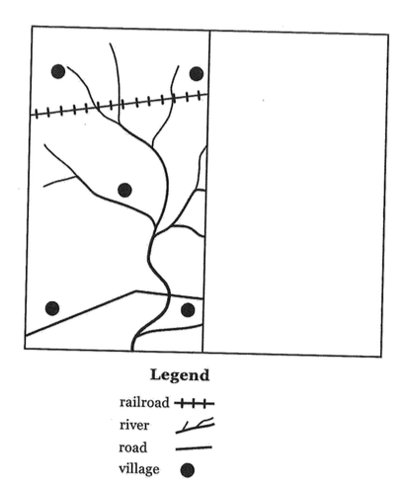
Geographic Thinking?
It is a cognitive process
It is about how, not what
Need to express it in action terms
Notes:
I am still not at the point of a definition but have flirted about the topic. I believe that geographic thinking and reasoning is a cognitive process, that it is about how we see worlds, not geographic knowledge per se (but of course, there is a relationship).
And we recognize that given the diversity of geography there may be different ways of geographic thinking, despite efforts to find common ground.
So this takes me to the renegade geographer Bill Bunge and to Roger Downs who is thinking and writing about the development of expertise in geography. Downs (2014) suggests that definitions of geographic expertise can be based on autobiographies like Sauer’s account of his education, “how to” accounts akin to Hanson and Golledge’s work and the geographic thought books referenced at the beginning, BUT that empirical studies focused on analyses of geographic thinking in practice may provide concrete evidence of what it means to think geographically.
But we know “little about the nature and development of geographic expertise.” or thinking.
This task by Bunge to apply geographic thinking to complete the other side of the map is the type of empirical activity that may help in defining and refining geographic thinking.

Slide 18


Best Practices
Notes:
I am not going to spend a lot of time on best practices. Many of—no MOST—of you know what is best for your students. And our students come in many guises, from 9th graders like this [delinquents] to stellar students like this [ ]
But this summary was created during the 2007 Reading by the 171 Readers and QLs and I think it still rings true. I will post this document on the newly named AP Human Geography Teachers. Of the 16 bullets, six are about training students to take the exam. But I want to highlight a few related to geographic thinking.

Slide 19
Best Practices
Focus on the course outline.
Stress interconnections across different sections of the course outline.
Reinforce the importance of being familiar with relevant vocabulary.
Stress the importance of a spatial perspective and applying concepts, analyzing spatial processes and linkages, across contexts and scales.
Make sure students understand the models, including their principles, processes, and assumptions.
Train students to be analytical, to focus on the geographic and spatial aspects of questions and to develop process-oriented responses
Integrate current events.

Slide 20
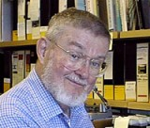
Advice: 1
Peirce Lewis
Educating Tomorrow’s Geographers (1985)
“We need, first and most basic of all to insist that students pay attention to the immediate world that lies all around them—in short—to use their eyes and attach them to their brains.”
Geographers as reporters of the world, the eyes of the public.
Notes:
Now, for some advice. Returning to another former AAG president, Pierce Lewis, who in 1985 wrote his address “Beyond Description.” He concluded with a section entitled “Educating Tomorrow’s Geographers” and provided four key pieces of advice.
1. We need, first and most basic of all to insist that students pay attention to the immediate world that lies all about them—in short—to use their eyes and attach them to their brains.” He went on to explain, “We geographers should be reporters of the world, the eyes of the public.” Try that with your students.

Slide 21
Advice: 2
Peirce Lewis
Educating Tomorrow’s Geographers (1985)
“To write good stuff, students have to read good stuff.”
Notes:
2. Train our students to describe things well. This loops back to preparing students for success on the exam. But his main point was captured by this sentence, “To write good stuff, students have to read good stuff.” Move your students to read beyond the textbooks, which are usually pretty poorly written.

Slide 22
Advice: 3
Peirce Lewis
Educating Tomorrow’s Geographers (1985)
“We need to reinforce their training in two major related fields: physical geography on the one hand, history on the other.”
Notes:
3. Writing about human geography, Lewis stated, “We need to reinforce their training in two major related fields: physical geography on the one hand, history on the other. He believed that both offer powerful explanations of why human phenomena are located and distributed the way they are.
APHG is already full but to fully engage students in geographic thinking it may be efficient to learn basic patterns and processes of physical geography and history.

Slide 23
Advice: 4
Peirce Lewis
Educating Tomorrow’s Geographers (1985)
“Don’t let anybody chill your enthusiasm for the world.
Notes:
4. “Don’t let anybody chill your enthusiasm for the world.”
Keep that in mind on the sixth day of the reading.
Or when you get your scores back and they are not what you expected. Do not despair.

Slide 24

Advice: 4
Eros
Educating Tomorrow’s Geographers (1985)
“Don’t let anybody chill your enthusiasm for the world.
Notes:
As teachers of geography you desire to know our world. And to help others to know it as well. You are moved by something that is erotic, as in Eros, the Greek god of love.
You have geographic Eros, a powerful attraction to Earth and a passionate desire to understand and experience it.
To be a geographer—to think geographically—is to desire for Knowledge of Earth.
It is not what you know, but your passion for the pursuit. This is the living heart of geography. You are the living heart of geography.
Thank you.

