Slide 1
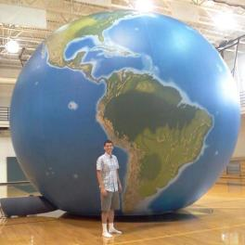










Teaching the Geography of Food

Slide 2
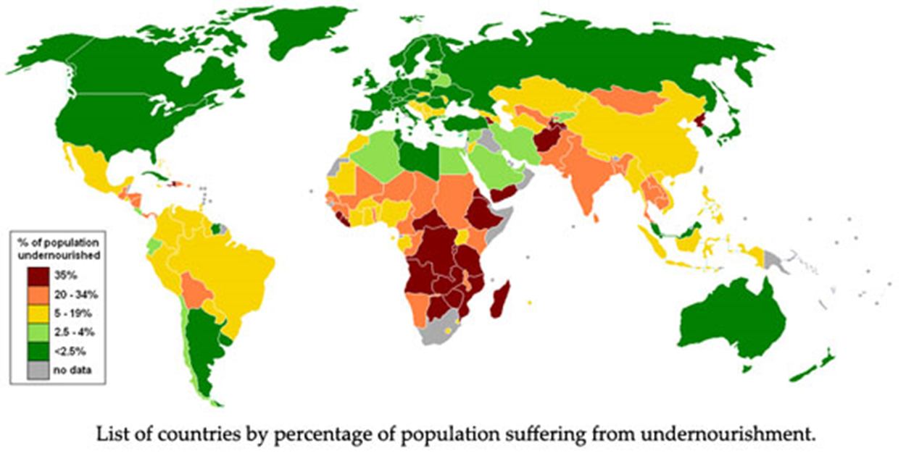
Teaching the Geography of Food
Caloric intact and undernourishment (Source)
http://geographyeducation.org/2015/03/03/teaching-the-geography-of-food/
http://blog.education.nationalgeographic.com/2015/02/25/teaching-the-geography-of-food/

Slide 3
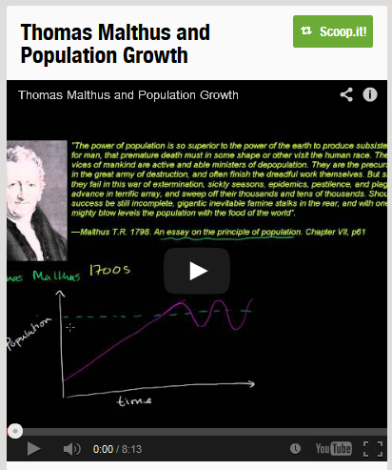

Teach with Population
http://www.scoop.it/t/geography-education/p/4030012410/2014/10/17/feeding-our-hungry-planet
http://www.scoop.it/t/geography-education?q=malthus

Slide 4
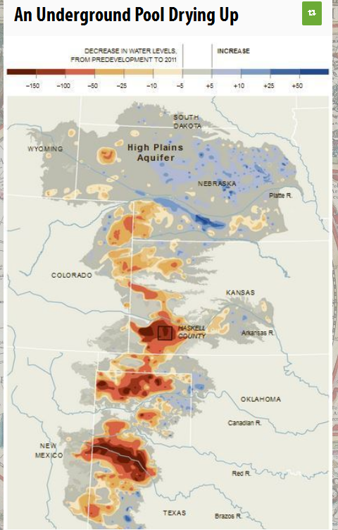

Include Environmental Issues…
http://www.scoop.it/t/geography-education?q=ogallala
http://www.scoop.it/t/geography-education/p/4001927804/2013/05/20/an-underground-pool-drying-up

Slide 5
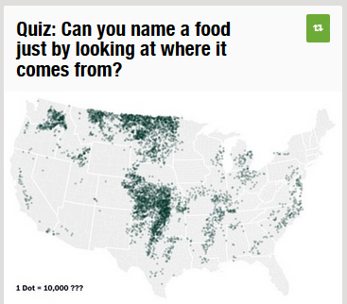
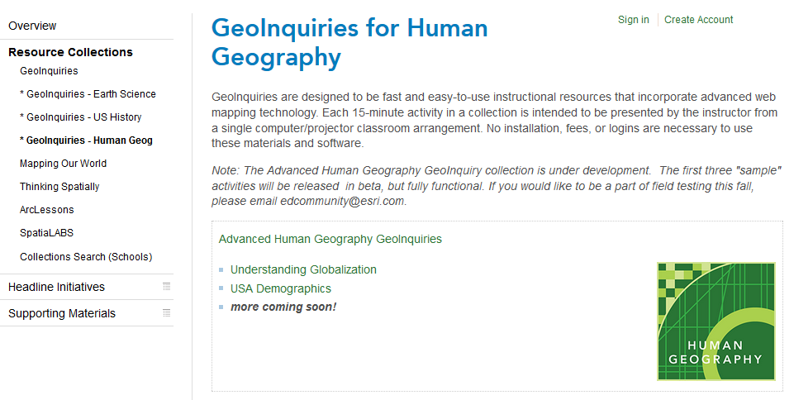
Use Maps and data…
http://www.scoop.it/t/geography-education?q=quiz+food
http://edcommunity.esri.com/Resources/Collections/human_geoinquiries

Slide 6
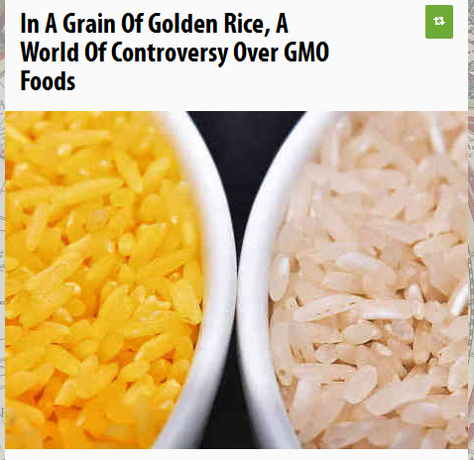
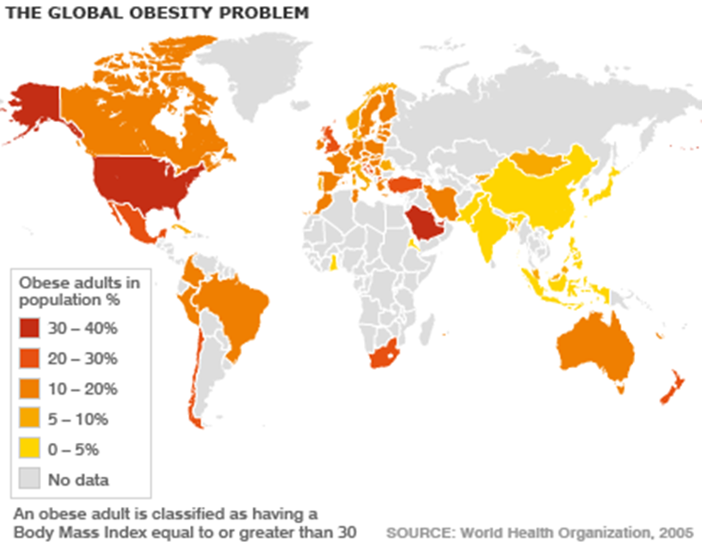
Development Matters: concerns are place-specific
http://www.scoop.it/t/geography-education/p/3998052932/2013/03/10/in-a-grain-of-golden-rice-a-world-of-controversy-over-gmo-foods

Slide 7
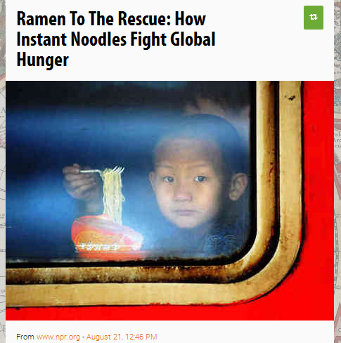
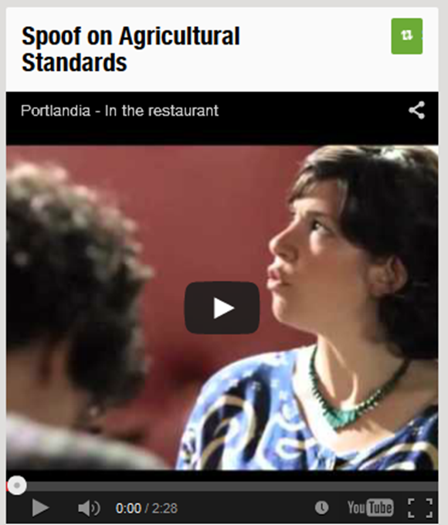
Levels of Development change the nature of the main concerns…
http://www.scoop.it/t/geography-education/p/4006403097/2013/08/21/ramen-to-the-rescue-how-instant-noodles-fight-global-hunger
http://www.scoop.it/t/geography-education?q=spoof

Slide 8
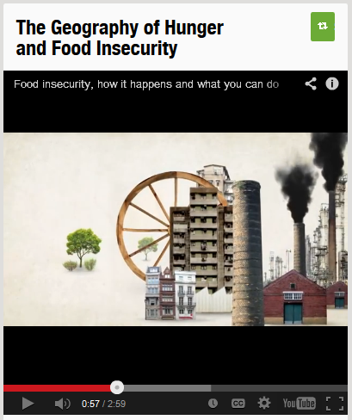
Political Geography
Famines reflect lack of power more than lack of food
Redirection of food
Destruction of capacity to grow food
Neglect of the starving
Rare in democracies, connected with authoritarian regimes
http://www.scoop.it/t/geography-education?q=hunger+food+insecurity

Slide 9
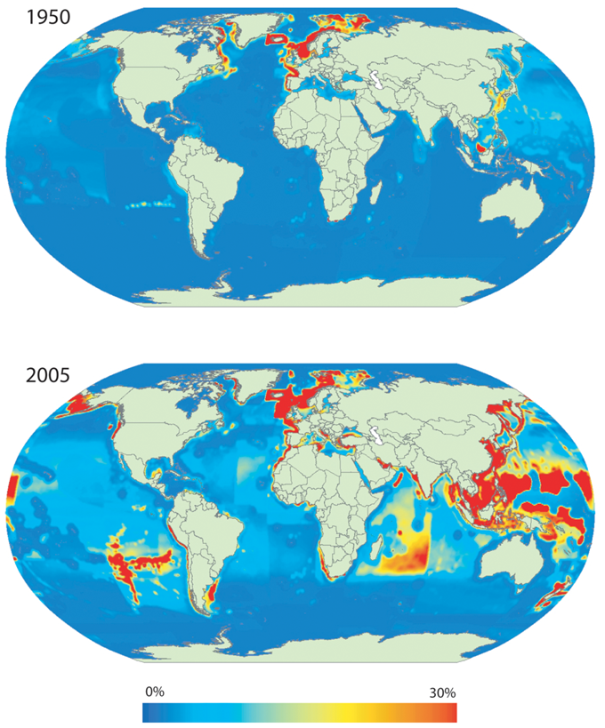
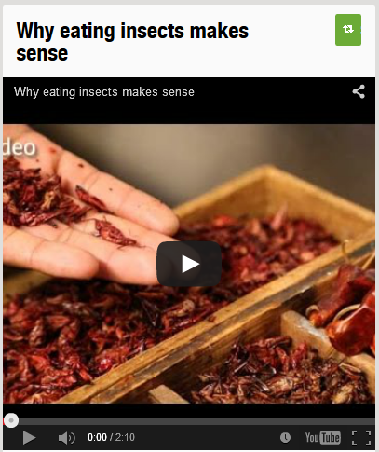
Cultural Geography: What foods are considered not considered food? What does a society choose to eat?
http://www.scoop.it/t/geography-education?q=eating+insects
Fisheries exploitation, 1950 and 2005

Slide 10
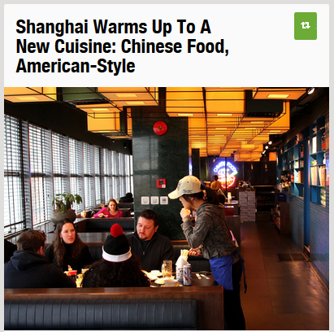
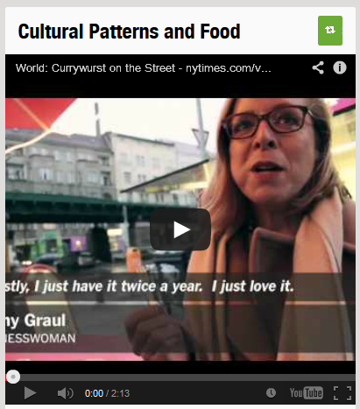
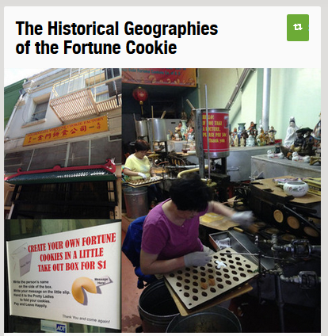
Food is perfect for cultural diffusion
http://www.scoop.it/t/geography-education?q=shanghai+cuisine
http://www.scoop.it/t/geography-education?q=currywurst

Slide 11
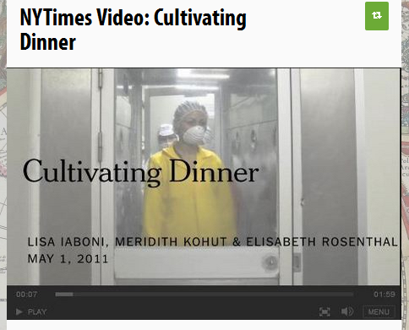
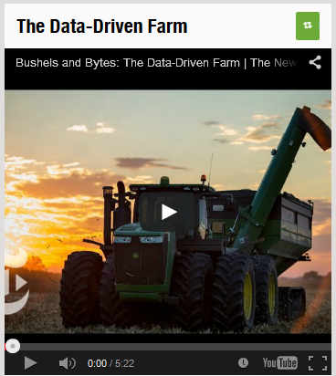
Technology reshapes systems and geographies
http://www.scoop.it/t/geography-education/p/4005179581/2013/07/25/nytimes-video-cultivating-dinner
http://www.scoop.it/t/geography-education?q=data+driven+farm

Slide 12
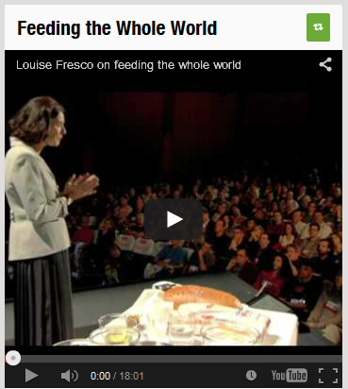
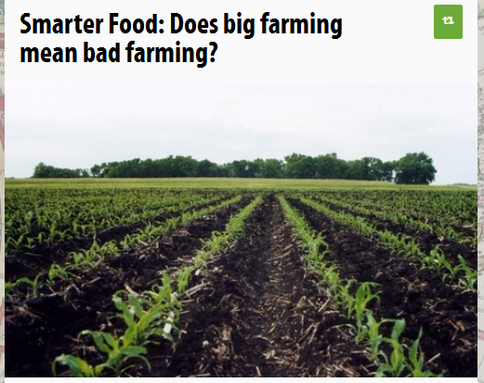
Technological advantages…
http://sco.lt/7uNlab
http://www.scoop.it/t/geography-education/p/4009688284/2013/10/22/smarter-food-does-big-farming-mean-bad-farming
http://www.scoop.it/t/geography-education?q=feeding+the+whole+world

Slide 13
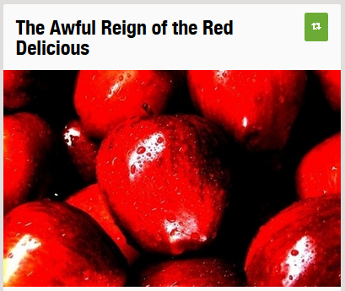
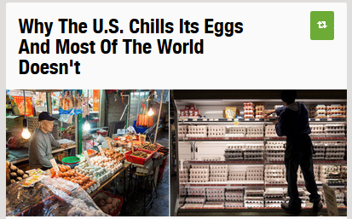
“That’s just the way things are…”
http://www.scoop.it/t/geography-education?q=red+delicious
http://www.scoop.it/t/geography-education?q=chills+eggs

Slide 14
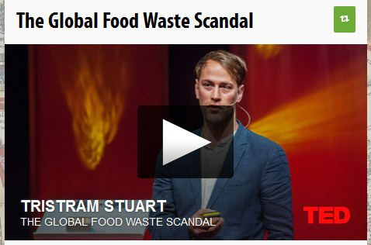
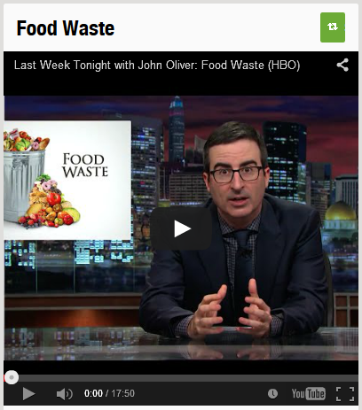
Get students a little angered at the system…
http://www.scoop.it/t/geography-education/p/2906246925/2012/10/07/the-global-food-waste-scandal

Slide 15
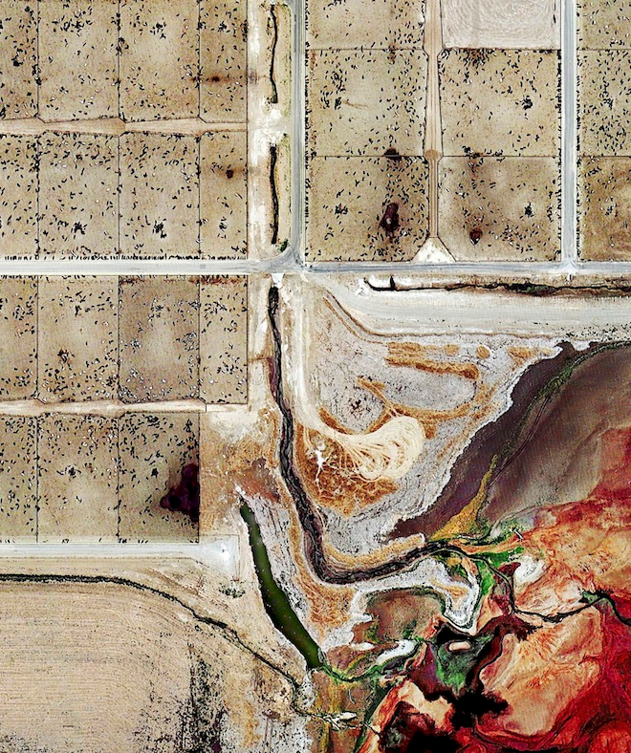
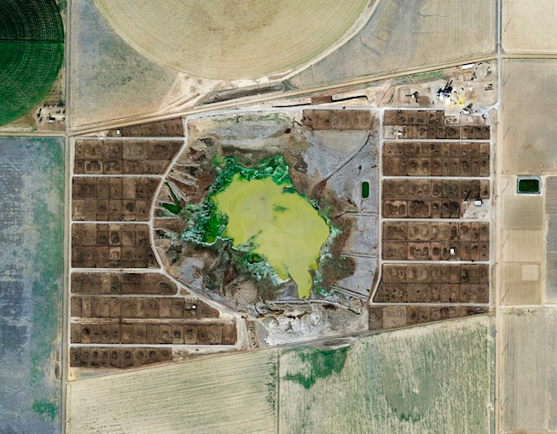
Questioning the Food Production System
Global trade and industrial agriculture changes the system

Slide 16
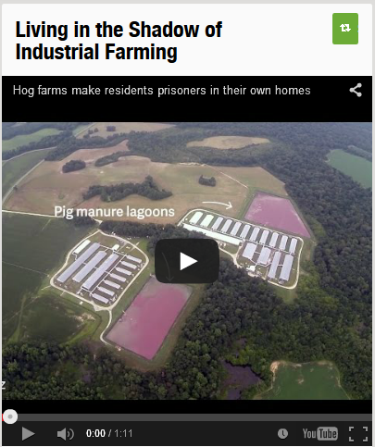
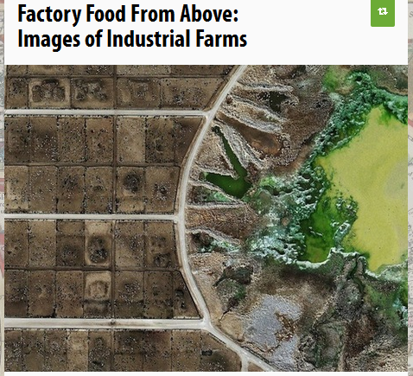
http://www.scoop.it/t/geography-education?q=bacon+pork
http://www.scoop.it/t/geography-education/p/4008094484/2013/09/23/factory-food-from-above-images-of-industrial-farms

Slide 17
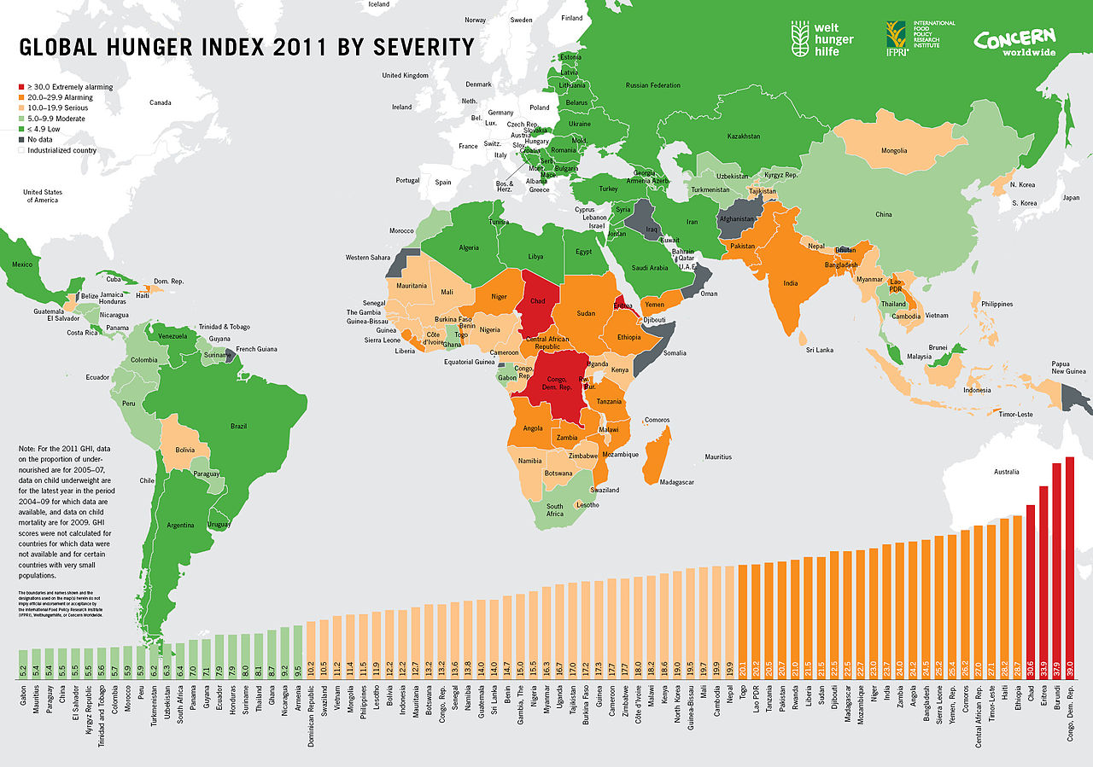
Figure 4.3: Global Hunger Index (Source)

Slide 18
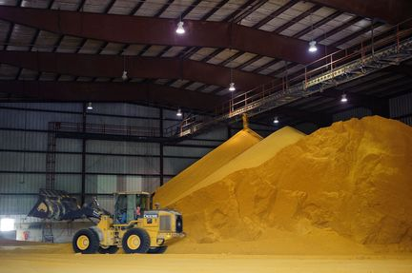
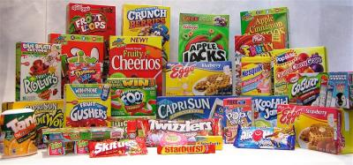
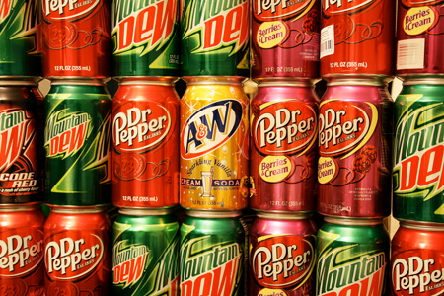
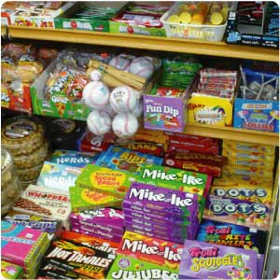
Questioning the Food Production System
Global trade and industrial agriculture changes the system
Govt. subsidies shape our food supply
  Example: U.S. govt. corn subsidy lead to an economic niche for high fructose corn syrup

Slide 19
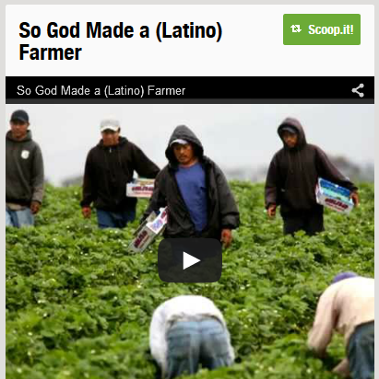
Questioning the Food Production System
Concerns:
--working conditions
--nutritional quality
--environmental impacts
http://www.scoop.it/t/geography-education/p/3996047080/2013/02/06/so-god-made-a-latino-farmer

Slide 20
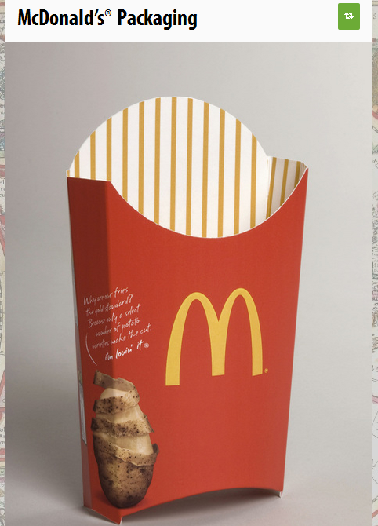
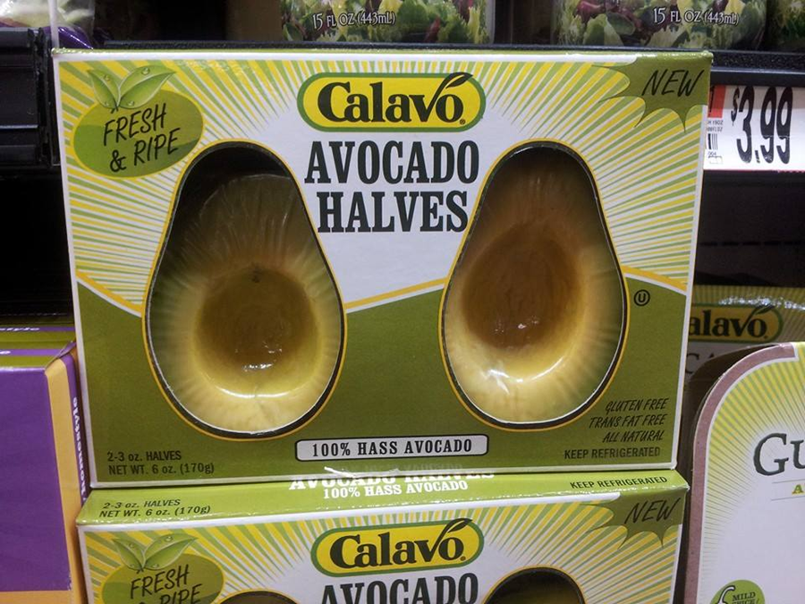
Make food systems more personal…
http://www.scoop.it/t/geography-education/p/4052339263/2015/09/26/overpackaged-foods
http://www.scoop.it/t/geography-education/p/3998143410/2013/03/10/mcdonald-s-packaging

Slide 21
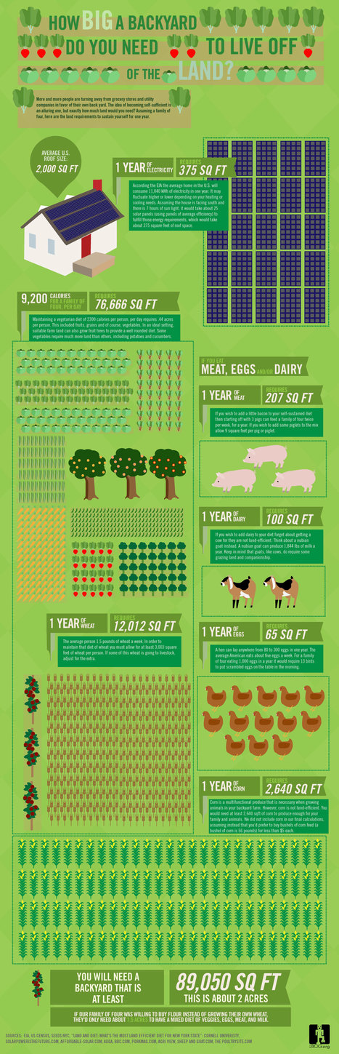
New Food Movements
Local food movements
Slow Food movement (opposite of fast food)
Concern for Agricultural workers
Raise issues about the treatment of animals in factory farms
http://www.scoop.it/t/geography-education/?tag=locavore

Slide 22
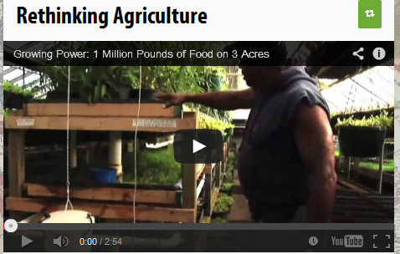
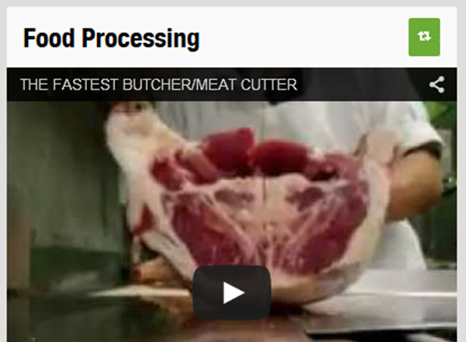
Urban Agriculture
community gardens
reconnecting people with their food
http://www.scoop.it/t/geography-education/p/4051900275/2015/09/28/food-processing
http://www.scoop.it/t/geography-education?q=rethinking+agriculture

Slide 23
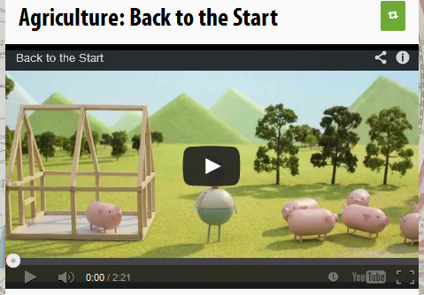

Economic Geography: Why is their added value for a company to connect itself with new food movements?
http://www.scoop.it/t/geography-education/p/1192434806/2012/02/13/agriculture-back-to-the-start
http://www.scoop.it/t/geography-education/p/4008676275/2013/10/03/chipotle-s-gamble

Slide 24
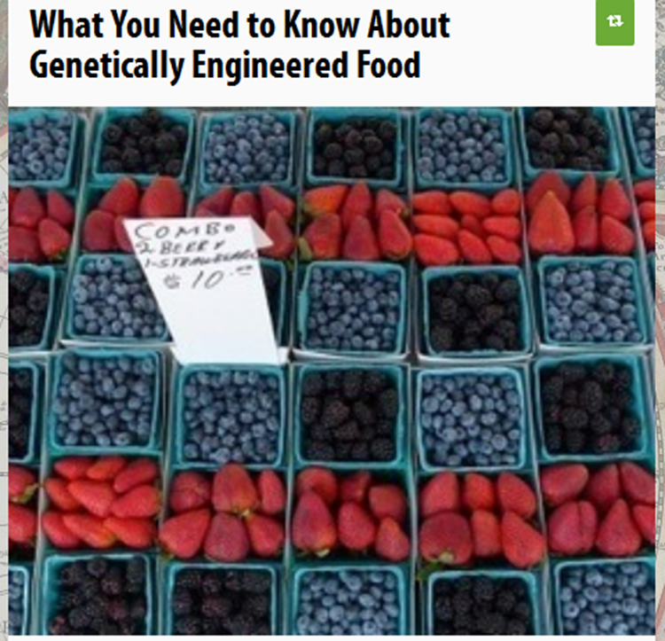

GMOs: teach the good, the bad and the ugly
http://www.scoop.it/t/geography-education/p/3997243571/2013/02/20/what-you-need-to-know-about-genetically-engineered-food
http://www.scoop.it/t/geography-education/p/1419632330/2012/03/14/genetically-modified-foods

