Slide 1
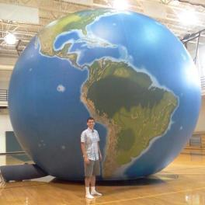








Engaging Students in Local & Global Issues: Looking at the World through a Geographic Lens
Notes:
Strengthening Geographic Content in the Classroom
Many efforts to strengthen geography education focus on altering the standards at the district, state and national levels. Sustained improvement in geographic content in the classroom needs to start with teachers and pre-service teachers, where that actual teaching happens. Practical ideas for teachers to strengthen geography education in their classrooms will be presented.

Slide 2
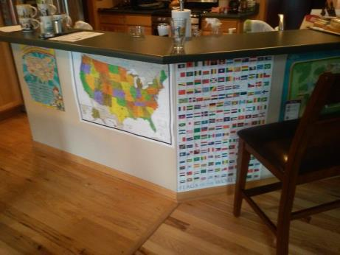
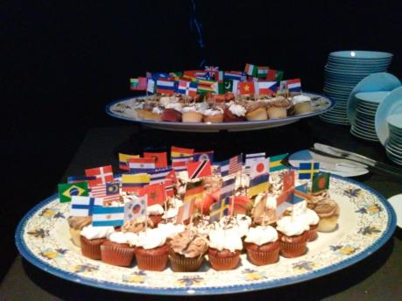



Slide 3
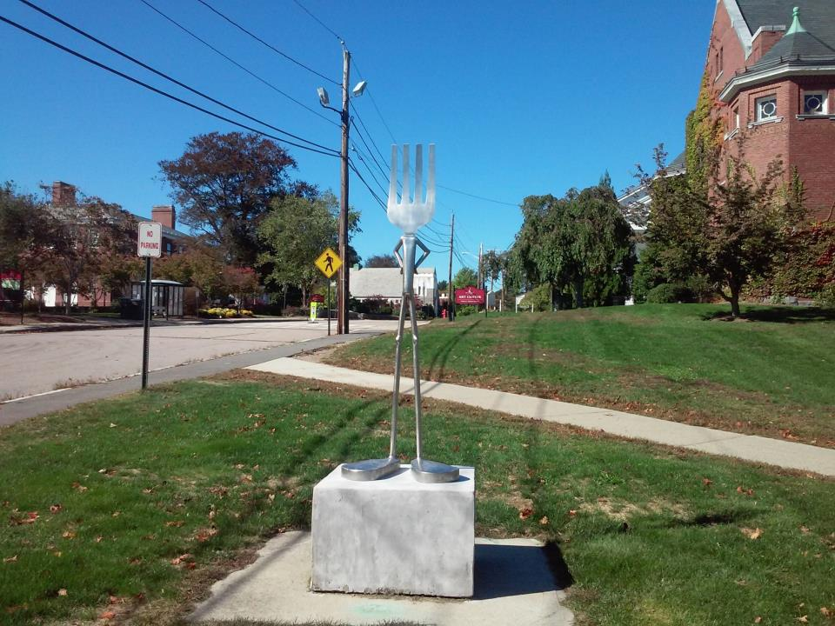

Slide 4



How do we combat boredom?
IGNORANCE
APATHY
Notes:
When do we see it? WHY is it there?

Slide 5




How would the stereotypical, bored student complete this sentence?
Notes:
NOT ENTERTAINMENT!!!!

Slide 6

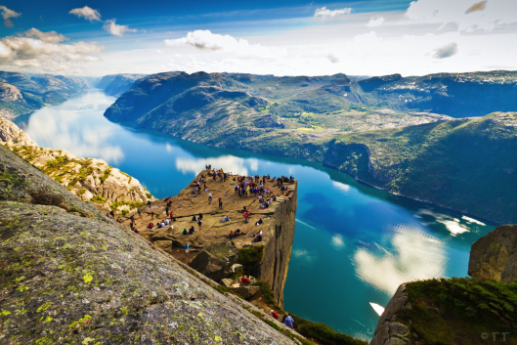


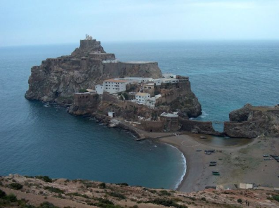

SPAIN
MOROCCO

Slide 7
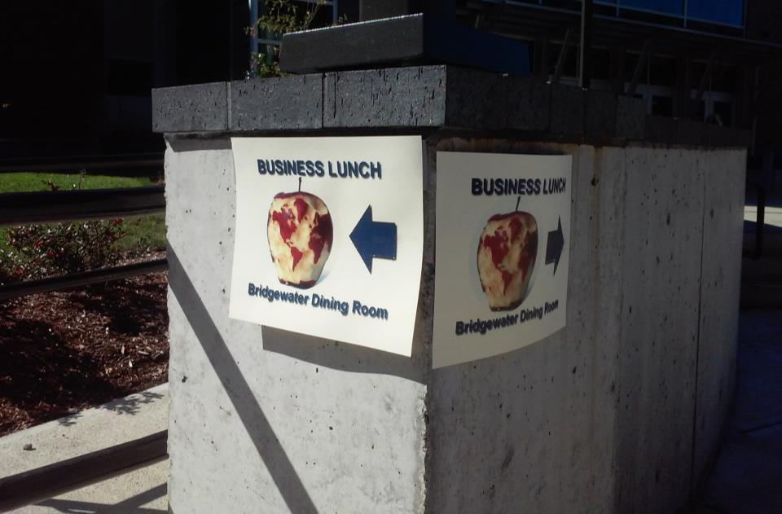
If you are bored and cynical…

Slide 8


Slide 9
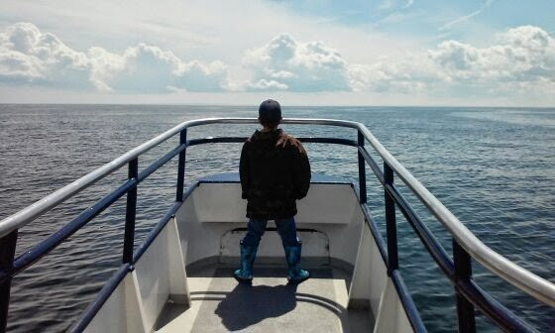


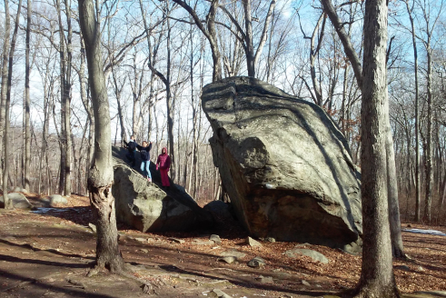
http://rigea.org/resources/geo-literacy/

Slide 10
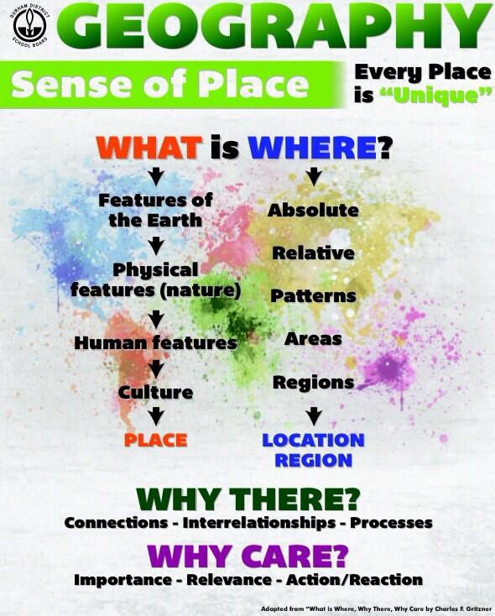
http://rigea.org/resources/geo-literacy/

Slide 11
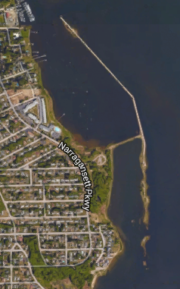
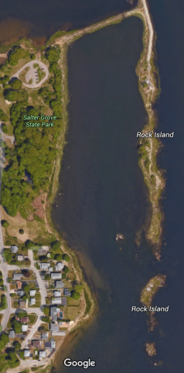
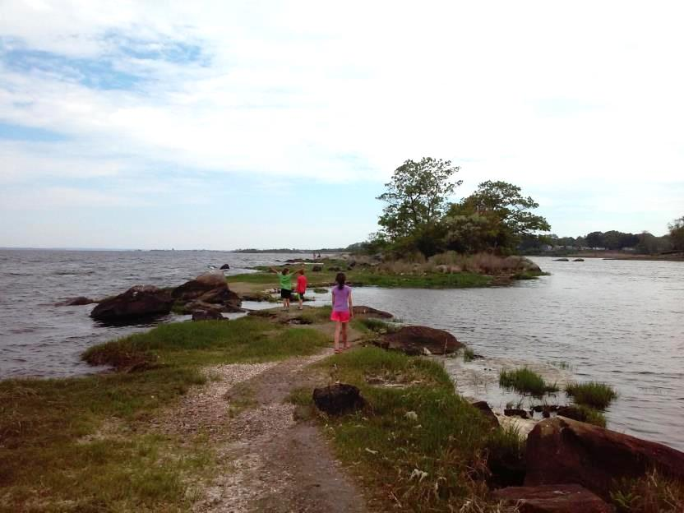

Slide 12
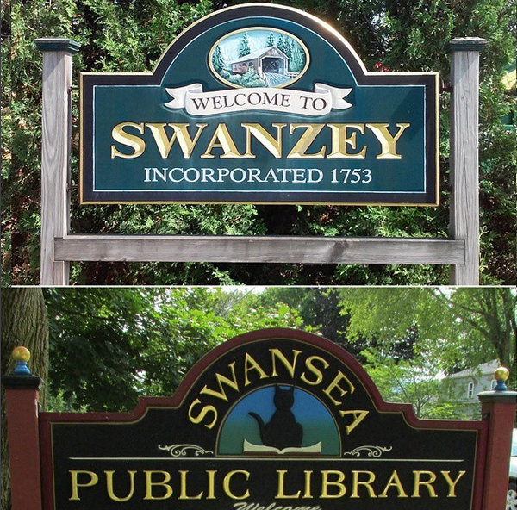
NH
MA
What’s the same? What’s different?

Slide 13
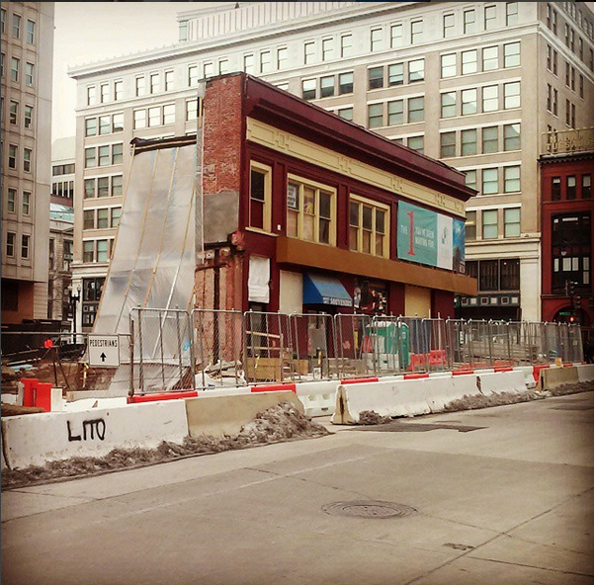
Washington DC (near Ford’s Theater)

Slide 14
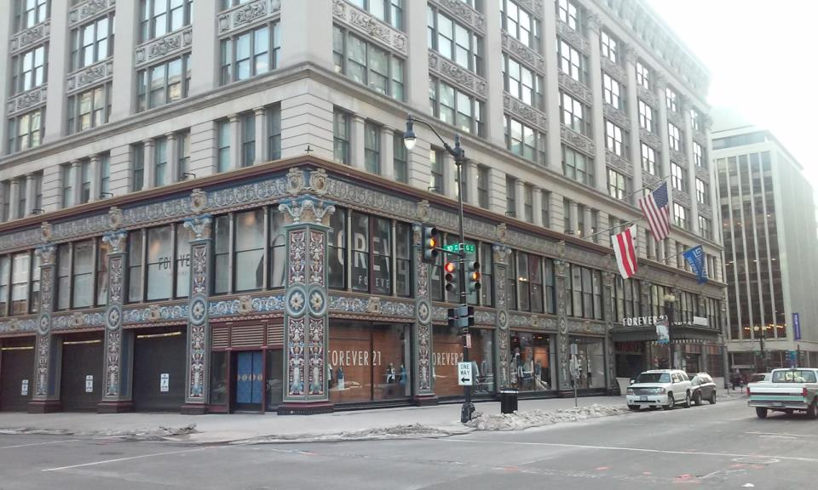
Washington DC (near Ford’s Theater)

Slide 15
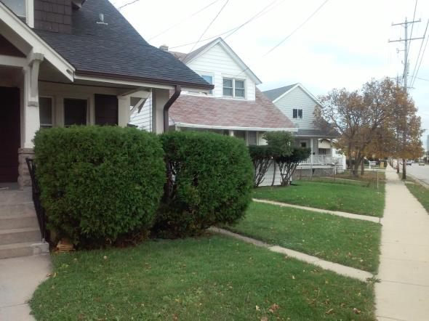
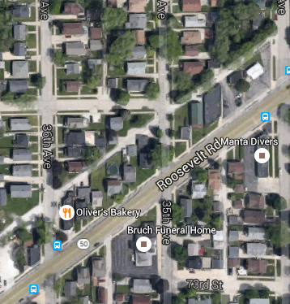
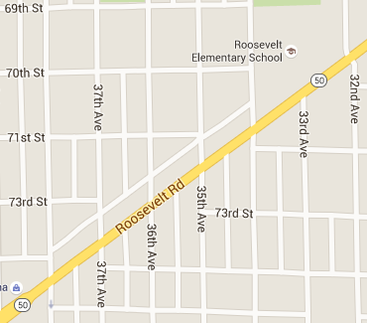
Kenosha, WI

Slide 16
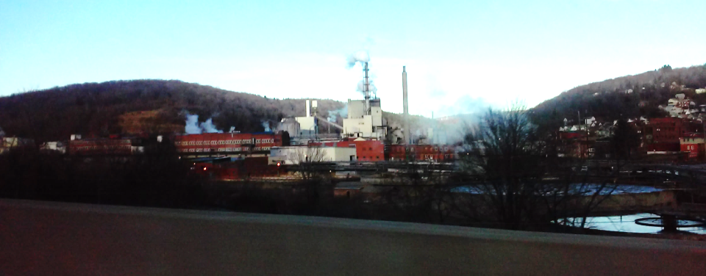
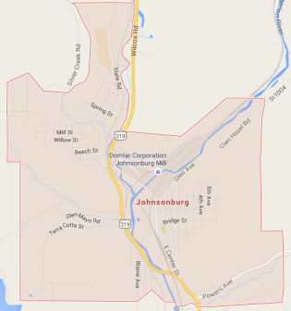
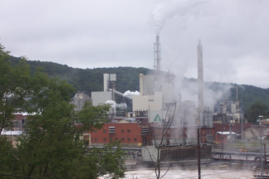
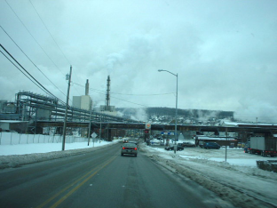
Johnsonburg, PA

Slide 17
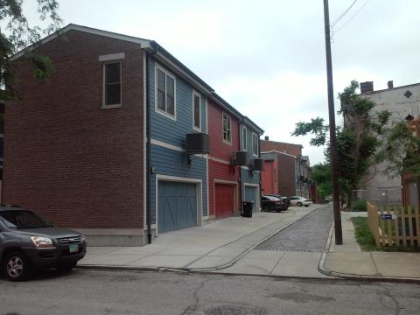
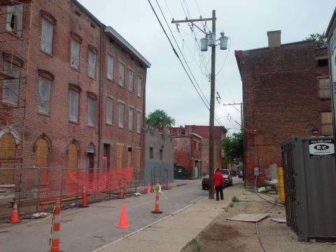
Both images from Cincinnati OH, 2015

Slide 18
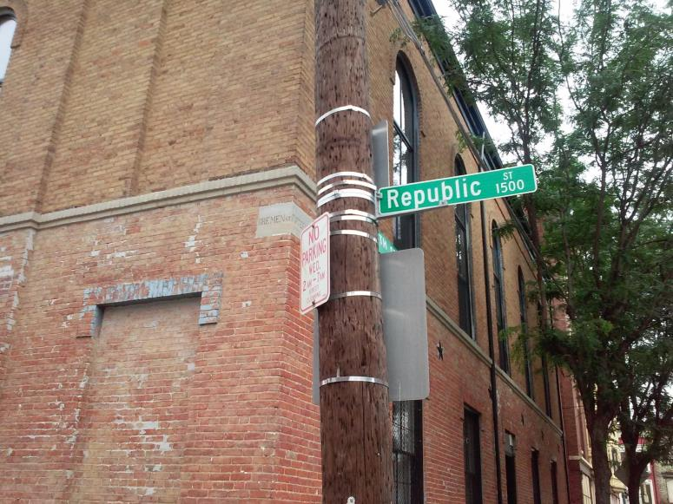
OTR (Over-the-Rhine), Cincinnati, OH
Sometimes we need more information to ask the right questions.

Slide 19
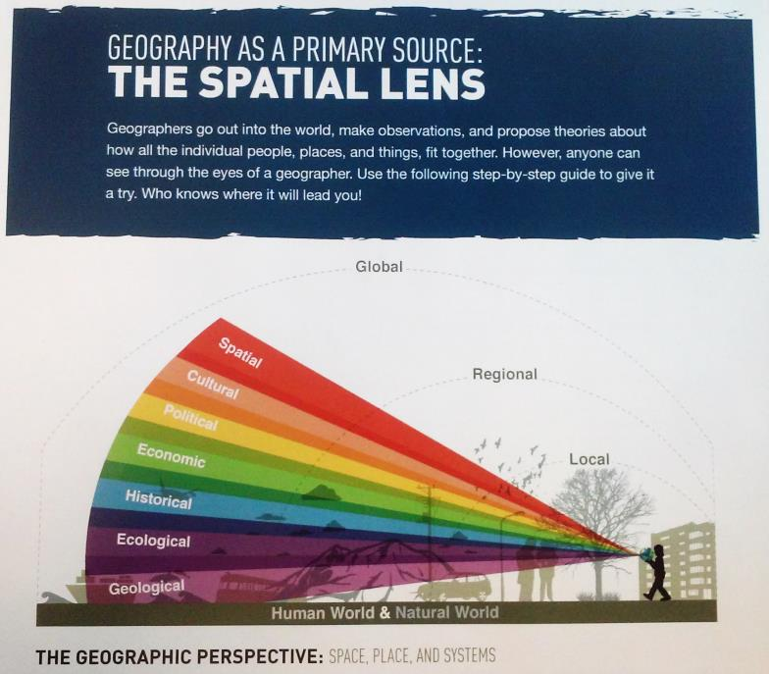

Slide 20
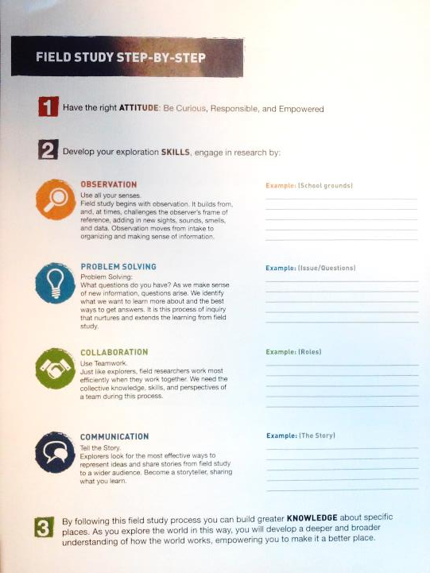

Slide 21
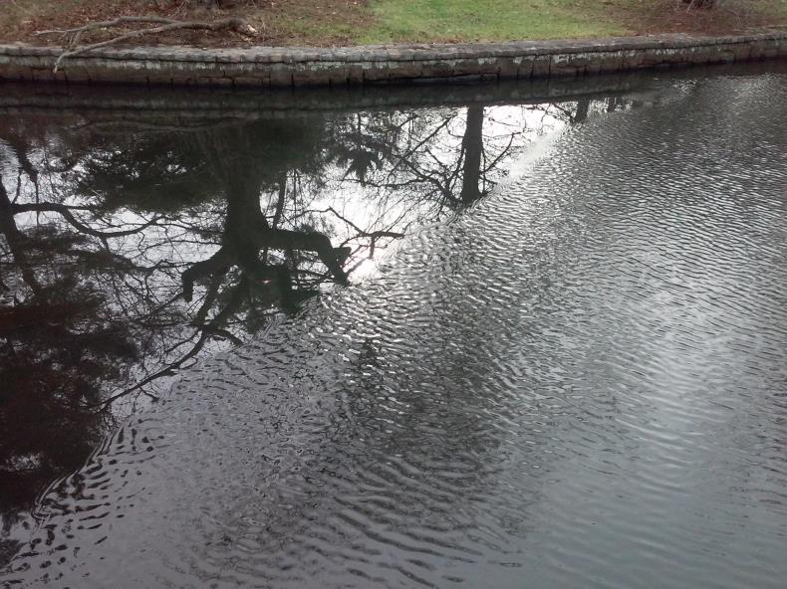
Roger Williams Park, Providence RI, Dec. 2015
What geographic questions do you want to ask?

Slide 22
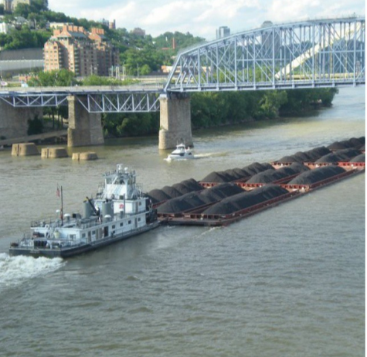
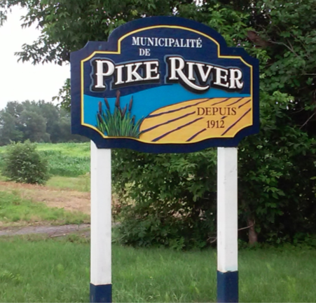
Pike River, Quebec, CA
The Ohio River, Cincinnati

Slide 23
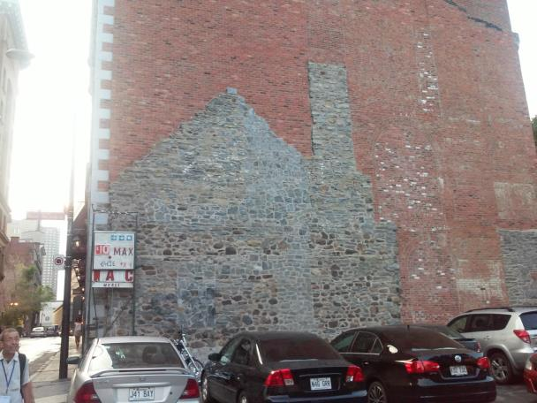

Vieux Montreal, QC
The natural and human landscape provides countless clues to mysteries IF we are curious enough to ask.

Slide 24
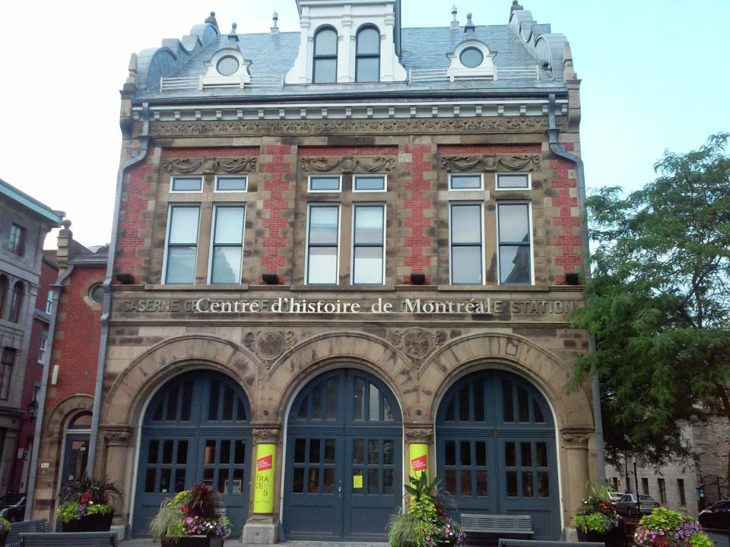
Caserne Central de Pompiers—Central Fire Station

Slide 25

Union Station, Washington, D.C.
What is unique about this place? How is it similar to other places?

Slide 26
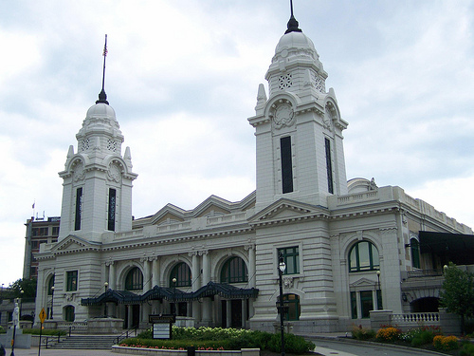
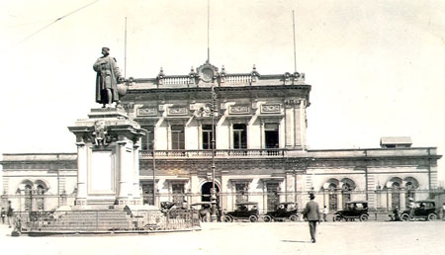
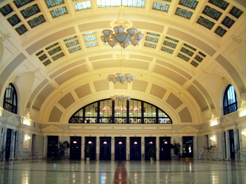
Mexico City
Worcester, MA

Slide 27
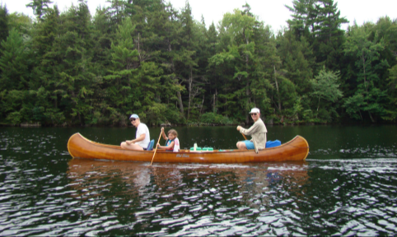
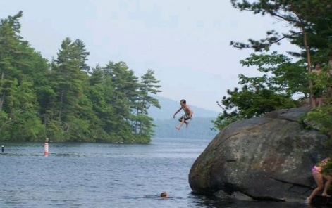
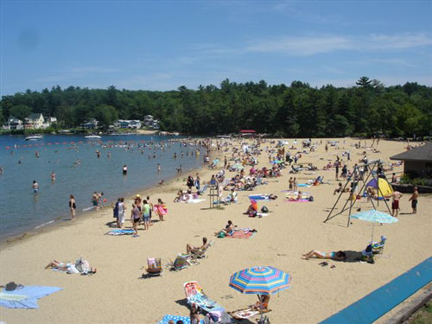
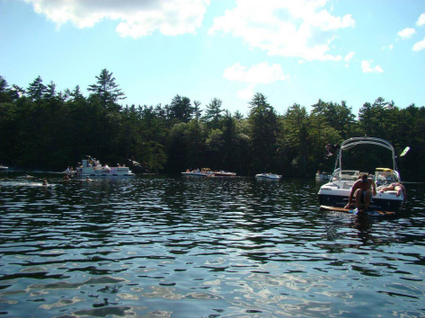
A.
B.
Squam Lake, NH
C.
D.
Which picture looks like the best vacation day for you?

Slide 28
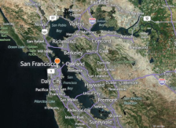
PLACE: Location
Site & Situation
Site: San Francisco
Situation: San Francisco
1769
In the Western Hemisphere
In the Midlatitudes
On the West Coast of North America
Mediterranean climate (but foggy!)
Peninsula and superb harbor
Today
In the Western Hemisphere
In the Midlatitudes
On the West Coast of North America
Mediterranean climate (foggy!)
Peninsula and superb harbor
1769
Outpost of Spain; in New Spain/Mexico; in Alta California
Primary political relationships: Monterey; Mexico City; Madrid
Primary trading relationships: New Spain, Philippines
Today
In California, USA
Primary political relationships: Sacramento; Washington DC
Primary trading relationships: Pacific Rim, Global

Slide 29
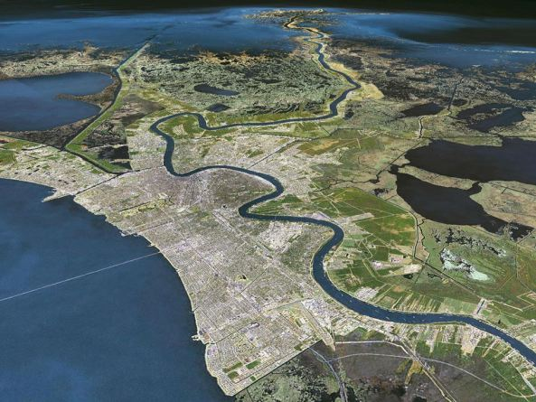
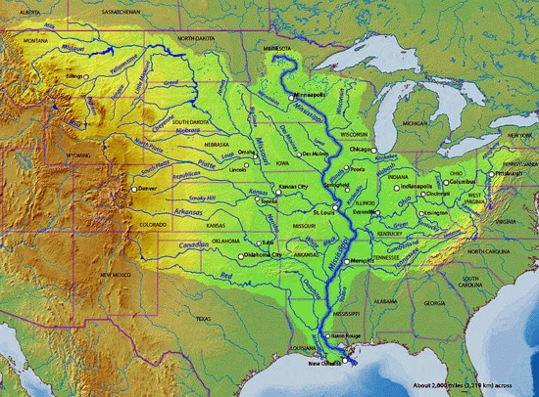
Site
Situation

Slide 30
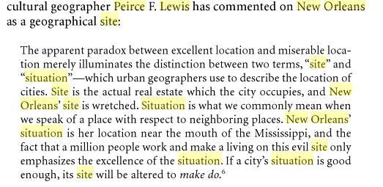

Slide 31
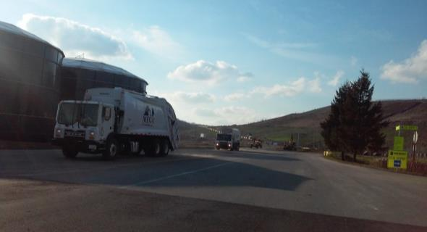
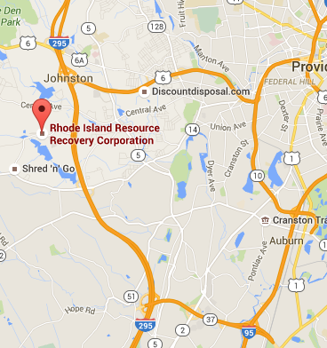
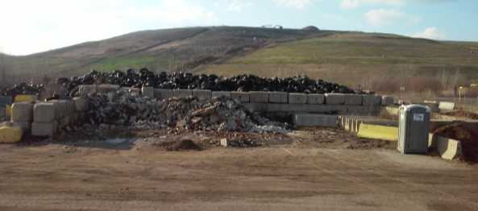
Resource Recovery Industrial Park, RI
Where would you put a dump in SE Massachusetts? Site? Situation?

Slide 32
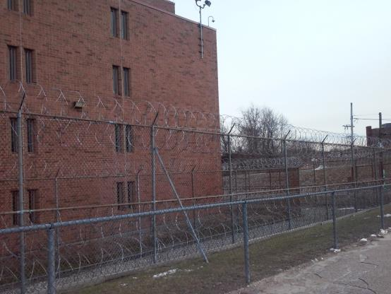
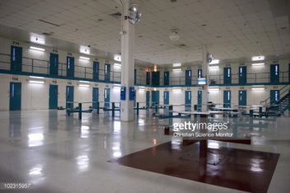

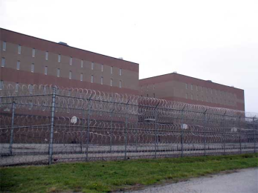
Intake Service Center, RI
How should space be arranged in a prison? School?

Slide 33


Beavertail State Park, RI
What geographic questions do you want to ask?

Slide 34




How can we help children be curious about the surroundings?

Slide 35

Start with their backyard
http://www.pbs.org/food/how-does-it-grow/cranberries/

Slide 36


Slide 37


Slide 38

Spatial Thinking and Reasoning

Slide 39




Slide 40

Jeremy Anderson

Slide 41
Railway
Line

Slide 43


Slide 44
Road

Slide 45
Road

Slide 46
Kink in the Road
--if unique & therefore not repeated, then road continues in straight line

Slide 48
Kink in the Road
--if unique & therefore not repeated, then road continues in straight line
--if recurring & therefore repeated property of space, then road will not continue in straight line

Slide 52
River

Slide 53


Slide 54


Slide 55



Slide 57


Slide 58
Villages

Slide 59
Villages

Slide 60


Slide 61
Town

Slide 62


Slide 63


Slide 64


Slide 65
Types of Inferences &
Levels of Expertise
1. rail line: relatively simple
2. kink in road: more challenging because multiple possibilities
3.stream system: stream order & topography; knowledge of theory of fluvial processes
4. villages: lattices; knowledge of central place theory

Slide 66
Engaging Students in Local & Global Issues: Looking at the World through a Geographic Lens
Notes:
Strengthening Geographic Content in the Classroom
Many efforts to strengthen geography education focus on altering the standards at the district, state and national levels. Sustained improvement in geographic content in the classroom needs to start with teachers and pre-service teachers, where that actual teaching happens. Practical ideas for teachers to strengthen geography education in their classrooms will be presented.

Slide 67



The truth…if you always lived in San Diego

Slide 68


What is this item called?

Slide 69
Truths can be spatially contingent
How far from the here do you live?
What time is it?

Slide 70


Slide 71
Truths can be scale-dependent
Where are you from?
Is overpopulation a problem in North America?

Slide 72




GEOGRAPHICAL CLASSIFICATION
World
Realms
Neighborhoods
Regions
Notes:
Truth is also dependent on scale.

Slide 73





Place still matters
Distance and Time

Slide 74


How can competent teachers help students understand a complex interconnected world?
Provide geographic information
Teach geographic concepts
Use data, maps, and geospatial technology
Ask questions which encourage spatial thinking.
Geographic Literacy

Slide 75



Perspective

Slide 76


Slide 77

4. Ask questions which encourage spatial thinking.

Slide 78

How is this a “human” landscape?
Notes:
A Union Pacific freight train passes between windmills on January 17, 2010 near of Palm Springs, California.

Slide 79

ee
Boeing 787 assembly plant in Everett, Washington
How is this representative of globalization?

Slide 80




Messages of cultural landscapes?

Slide 81


Cultural Landscape Meanings
http://www.scoop.it/t/geography-education/?tag=landscape
Notes:
Canal Burano Venice Italy Mesa Verde National Park (Cliff Palace)

Slide 82

Cultural Landscapes
Notes:
If you were to parachute in to a new place, where you didn’t speak the language, what are some clues you might be able to get about the culture just from looking around?
You would “read” the cultural landscape—This is the Orkhon Valley Cultural Landscape World Heritage Site (Mongolia)

Slide 83




Slide 84


A spatial perspective is not just for geographers
spatial
mapping
map projections

Slide 85



The Global becomes Local

Slide 86



How can competent teachers help students understand a complex interconnected world?
Provide geographic information
Teach geographic concepts
Use data, maps, and geospatial technology
Ask questions which encourage spatial thinking.
Geographic Literacy
Notes:
Strengthening Geographic Content in the Classroom
Many efforts to strengthen geography education focus on altering the standards at the district, state and national levels. Sustained improvement in geographic content in the classroom needs to start with teachers and pre-service teachers, where that actual teaching happens. Practical ideas for teachers to strengthen geography education in their classrooms will be presented.

Slide 87


Slide 88



Slide 89

OTR, Cincinnati

Slide 90

Pawtuxet Village, RI, July 4th

