Slide 1
Geographies of Home: producing home across scales in Japan and Singapore
Chris McMorran
Department of Japanese Studies
National University of Singapore

Slide 2
Outline
Home is fundamental to Geography
Home as a production
Home is produced at multiple scales
  Japan
  Singapore
Teaching the Production of Home

Slide 3
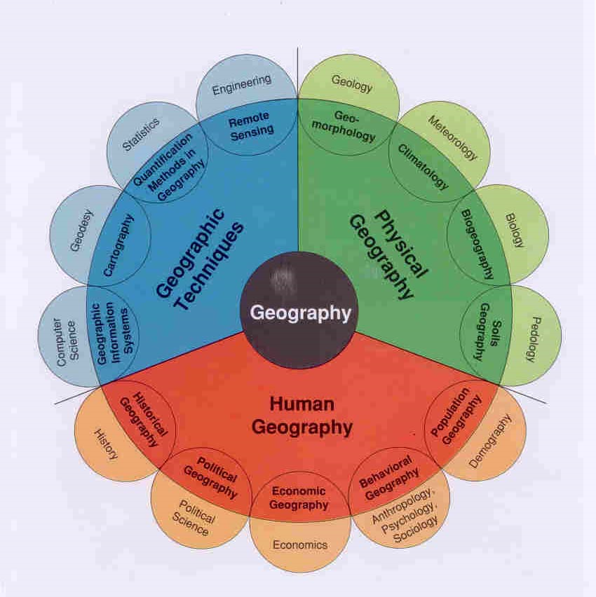

Slide 4
Economic Geography
Cultural Geography
Non–work site; financial aspects of housing provision
Site of belonging/exclusion; site of place-making
Home in HG
Homeland security; borders; nationalism
Center of one’s identity; formed through routine
Political Geography
Humanistic Geography
Site of departure &return; mobility and home
Site of domestic/gendered labor
Feminist Geography
Migration Studies

Slide 5
What is Home?

Slide 6
What is Home?
1. Residence
The house as “our corner of the world. […] our first universe, a real cosmos in every sense of the word” (Bachelard 1994: 3-4)
A place “to which one withdraws and from which one ventures forth” (Tuan 1971: 189)

Slide 7

What is Home?
2. Where one feels local
Selasi 2014 ->
“Home is no longer just one place. It is locations.” (hooks 1991: 148)

Slide 8
What is Home?
3. The nation as home
A socially-constructed community in which everyone feels they belong and most are willing to die to protect it (think Dept of Homeland Security) (Anderson’s “Imagined community”(1991))

Slide 9
What is Home?
4. Planet Earth as home
“a sparkling blue and white jewel, a light, delicate sky-blue sphere laced with slowly swirling veils of white, rising gradually like a small pearl in a thick sea of black mystery. […] this is Earth . . . home.” (Edgar Mitchell 1971: Apollo 14 Mission)

Slide 10
Questions
Which definition do you most identify with?
Residence
Where one feels local
The nation as home
Planet Earth as home
What do they have in common?
At what scales do they operate?

Slide 11
What do they have in common?
All highlight the role of home in providing comfort, belonging, and identity
All require ongoing maintenance (both physical and emotional), or “production,” by individuals and institutions across geographic scales: residence, neighborhood, city, nation, planet

Slide 12
Production of home
Includes, but is not limited to, the related idea of home-making (including scales beyond the residence).
Acknowledges that home is always in process (never static), always being made and re-made, at multiple scales.

Slide 13
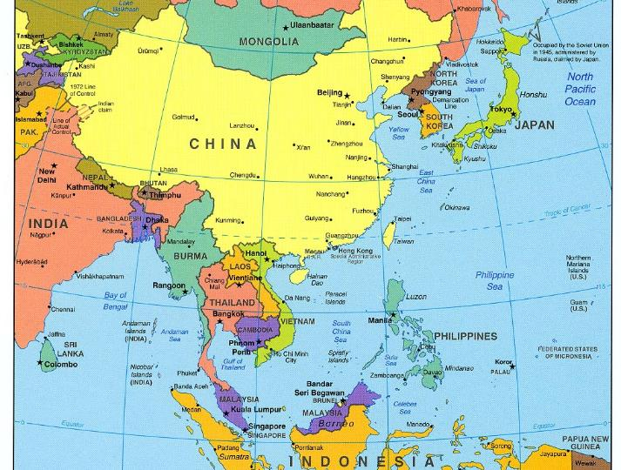
Producing home in Japan

Slide 14
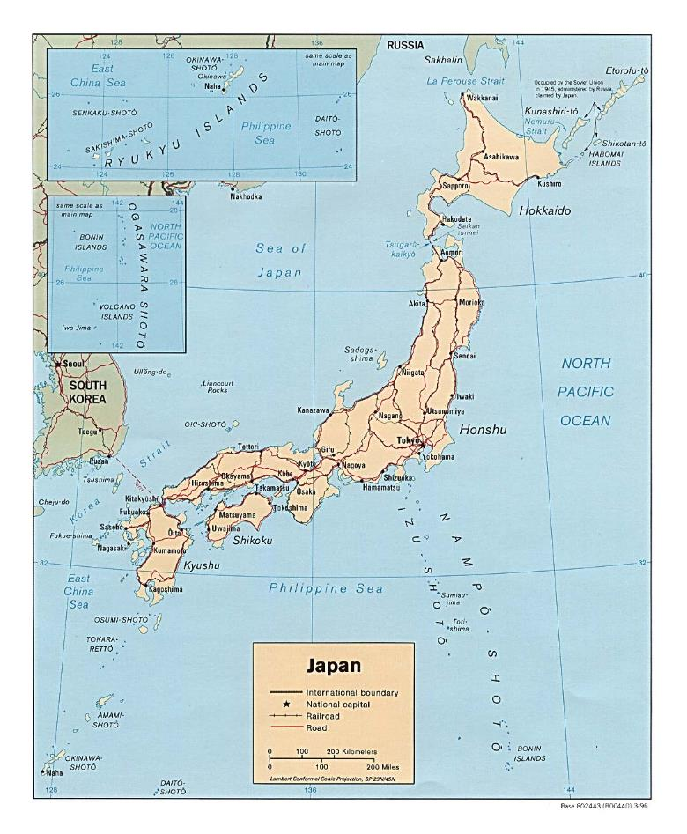

Slide 15
Common narratives about Japan

Slide 16
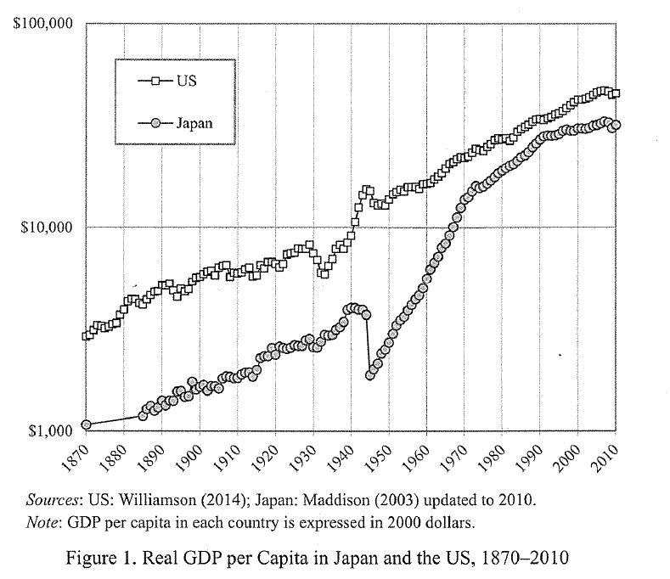
Economic miracle

Slide 17
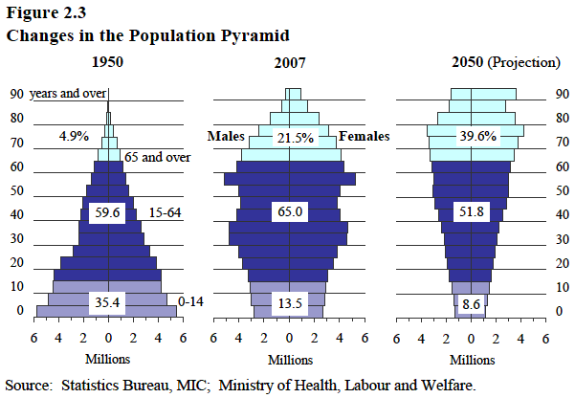
Population debacle

Slide 18
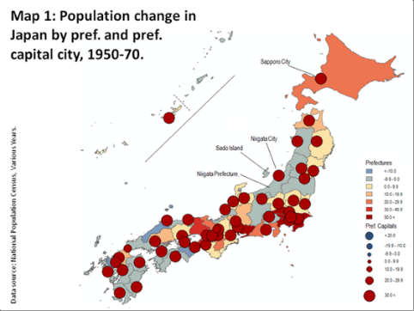
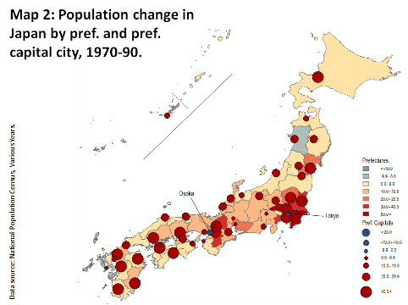
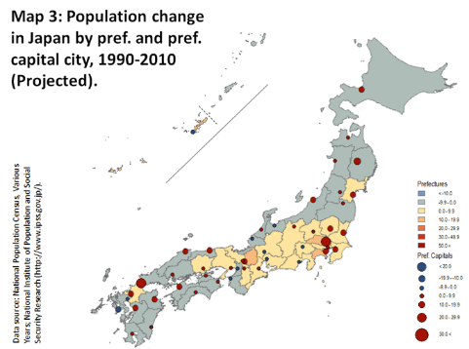
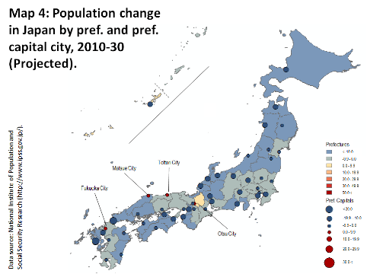
Growth
Consolidation
Source: Peter Matanle 2011; see also Matanle and Sato 2010
Stagnation
Shrinkage

Slide 19
Cultural response
Nostalgia for rural life, rural landscapes
furusato ふるさとー古里
Lit. “old village”
Rural, generic “hometown” given greater cultural value, especially in the face of urbanization, economic growth, globalization

Slide 20
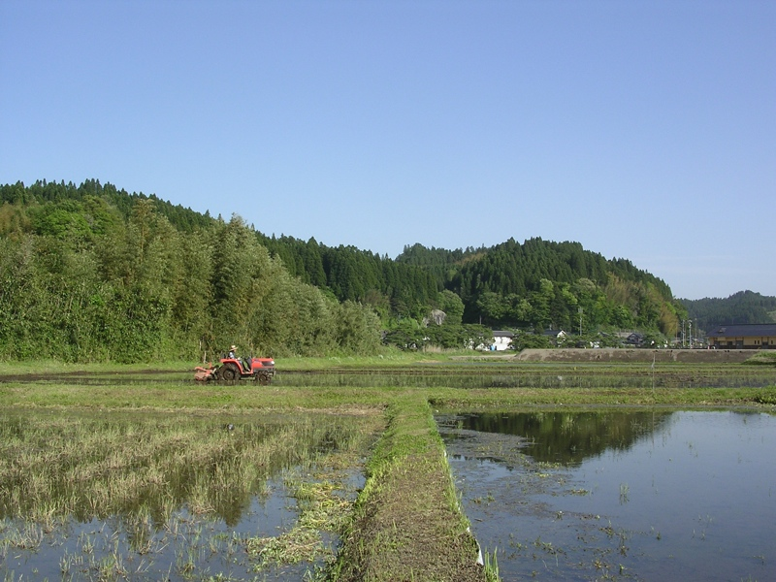

Slide 21
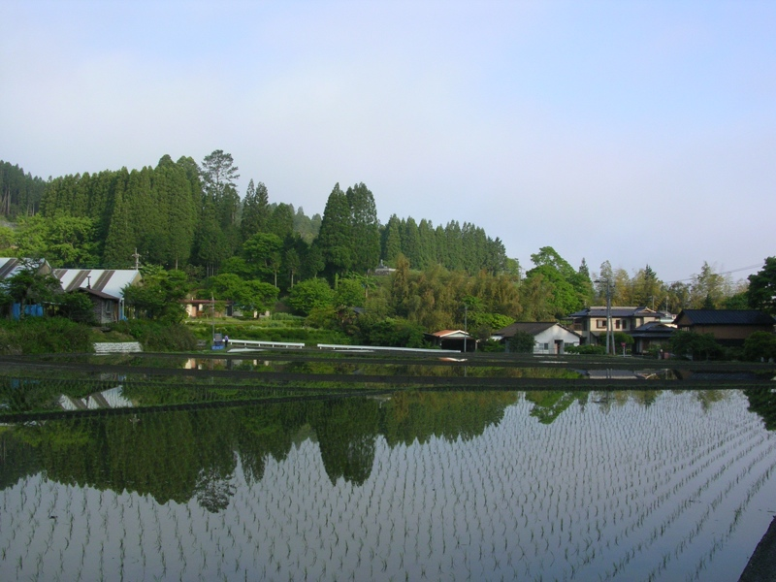

Slide 22
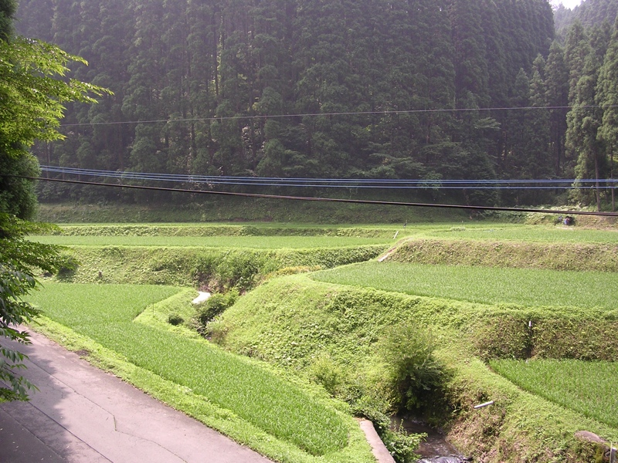

Slide 23
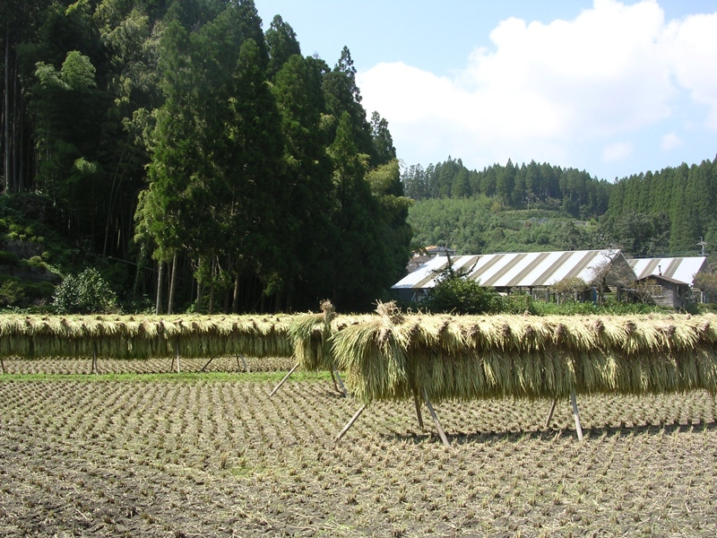

Slide 24
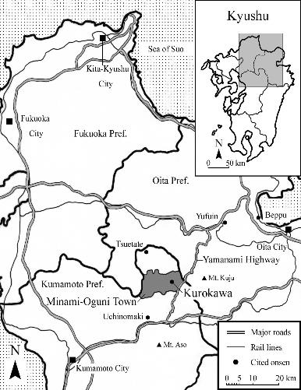
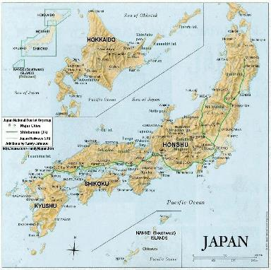
Case of Kurokawa Onsen – mid-1980s+

Slide 25
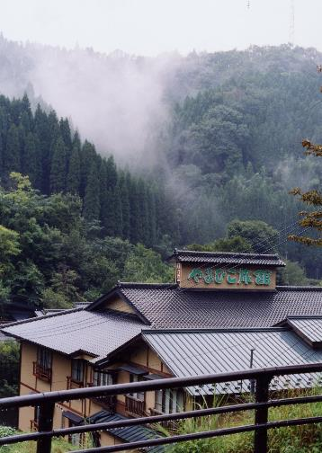
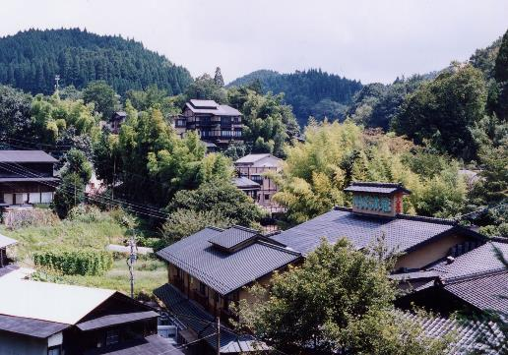
Producing “Japan’s hometown”
In the early 1980s “Kurokawa was just a backwards
hot springs village deep in the mountains.
There was nothing to do but sell itself to guests
interested in such a place.” (Gotō, inn owner)

Slide 26
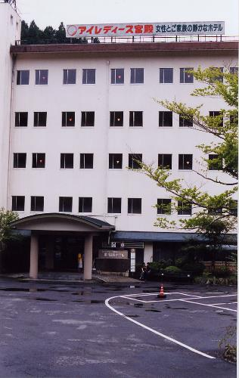
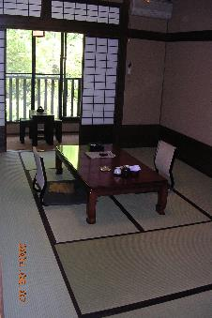
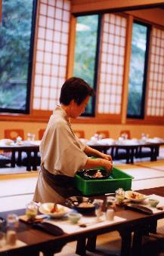
Hot springs 1950s-80s
“Modern” exteriors,
Japanese interiors

Slide 27
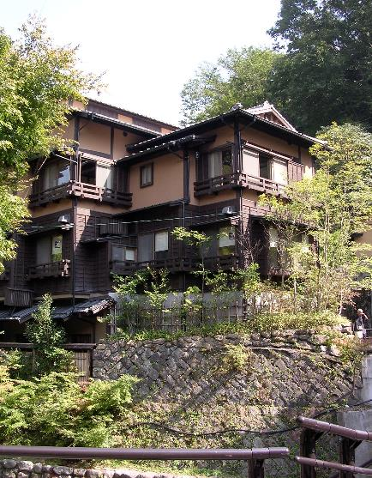
Producing the inn as home away from home for guests
Traditional architecture
Family businesses

Slide 28
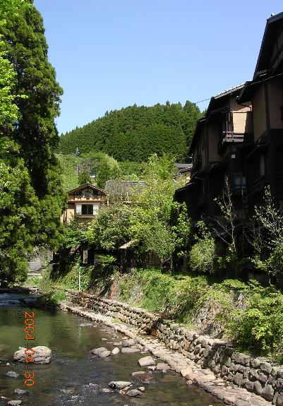
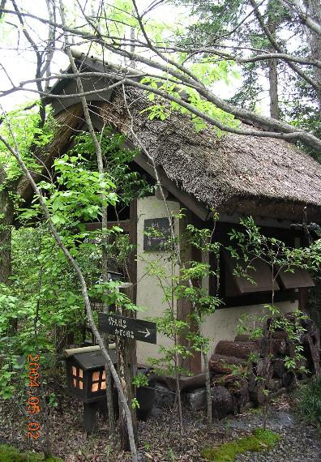
Producing the village as home for locals

Slide 29
Producing the inn as home away from home for guests
Traditional architecture
Family businesses
Gendered hospitality, by a mother/grandmother figure

Slide 30
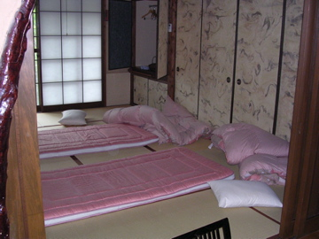
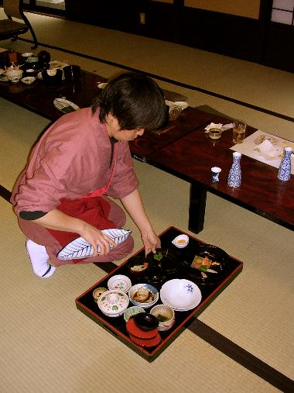
Producing home through caring, embodied, gendered labor
Comfort at the scale of the body

Slide 31
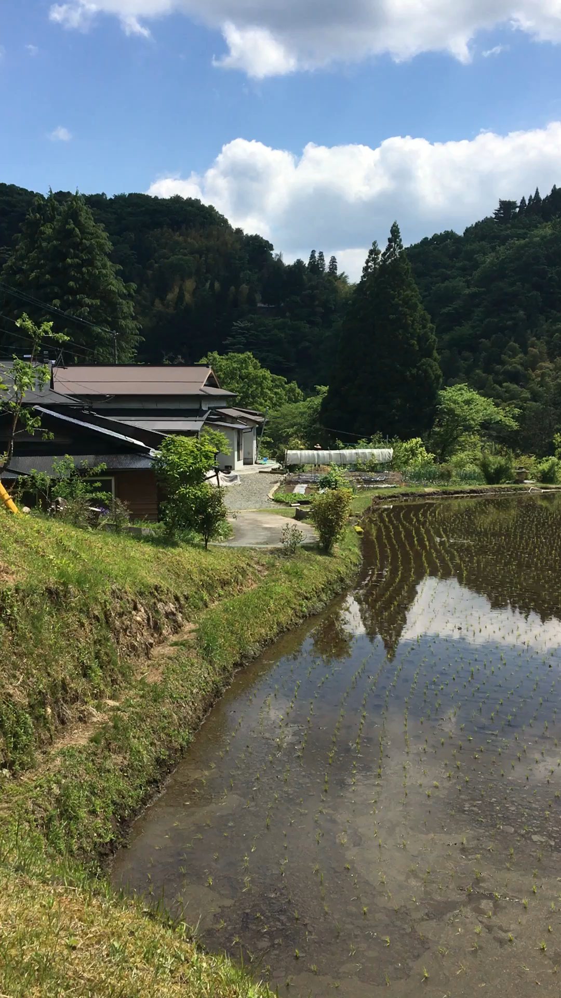

Today: Kurokawa’s continued success
rural landscape & life = home
May 2017: NUS student planting rice

Slide 32
Growth
Consolidation
Stagnation
Shrinkage

Slide 33
Discussion
What APHG units relate to this example of the production of home?
What geographic scales are involved?

Slide 34
APHG themes
  Cultural patterns and processes
  Agriculture, food production, and rural land use
  Cities and urban land use

Slide 35
Summary
Producing home at the scale of the…
Nation: rural villages are a distinctly Japanese home
Village: Kurokawa’s entrepreneurs cooperating on landscape decisions
Residence: inn as a home away from home
Body: gendered domestic labor associated with a motherly or grandmotherly figure

Slide 36
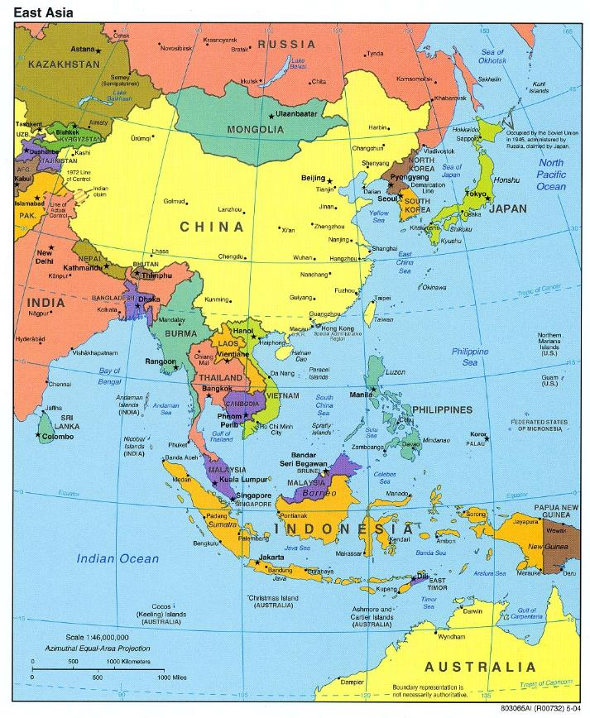
Producing home in Singapore

Slide 37
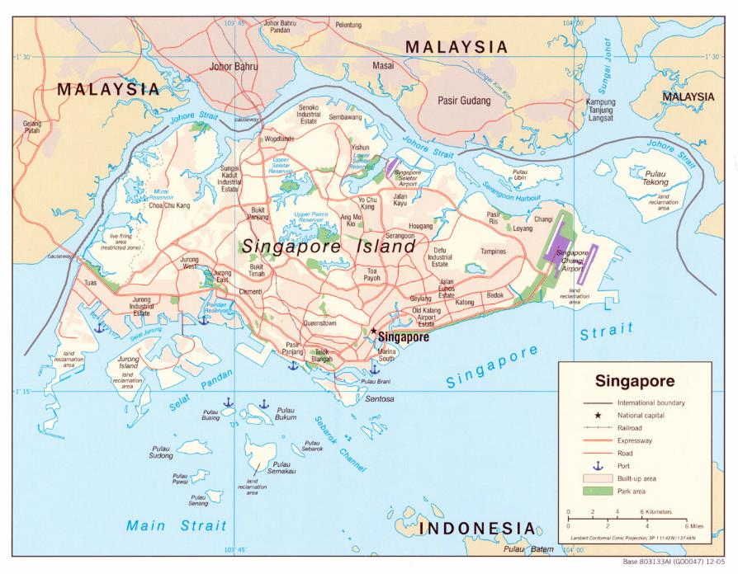

Slide 38
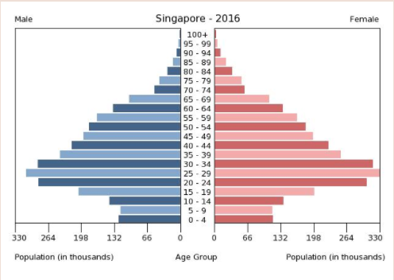
Producing home in Singapore
697km (192nd) 3.5x Washington, D.C.
5.7 million people (among highest density)
Chinese 74.3%
Malay 13.4%
Indian 9.1%

Slide 39
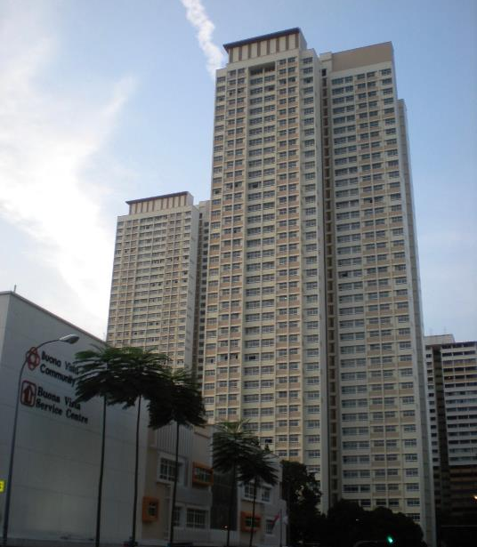
Home in SG?
Housing Development Board (HDB)
Over 80% of residents live in HDB housing (around 70% are owner-occupiers)
HDB est. 1960, began providing rental units for the poor – turned to home ownership in 1964

Slide 40
How does HDB produce home?
It controls:
Land acquisition
Resettlement
Town planning
Architectural design
Engineering work
Flat allocation
Everything except actual construction

Slide 41
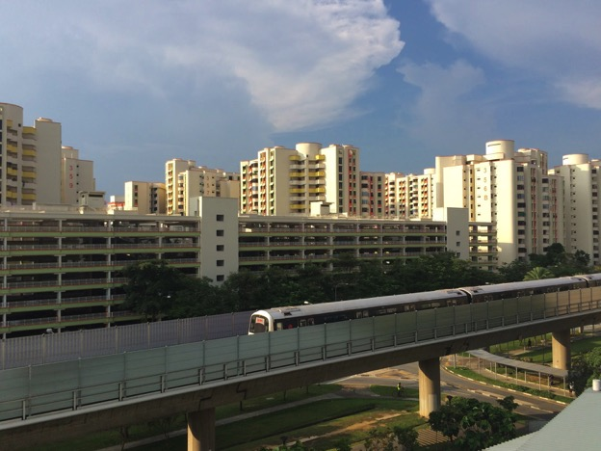
“Town Centres”: transport hubs with retail shops (including malls)

Slide 42
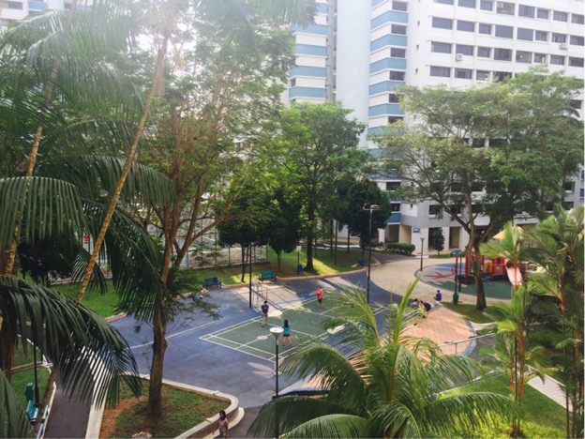
  “Neighbourhoods”: housing blocks, parks and other amenities surrounding Town Centres

Slide 43
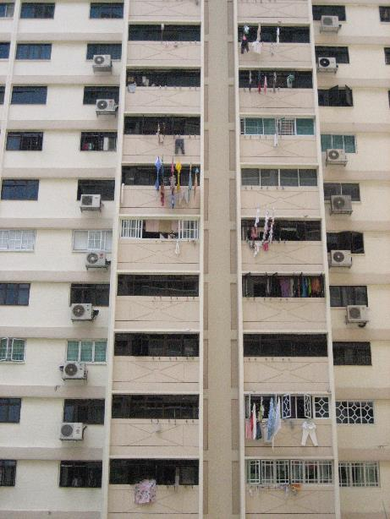
“Flats”
Variety: studio, 2-5 rooms
Can appear generic, impersonal

Slide 44
HDB “homes”?
“High density living is said to produce family breakdown, delinquency and a variety of social problems… provides a bad environment in which to raise children, and [creates a situation whereby] families are denied the privacy to which they are entitled. It is commonly suggested that these people are thrown into dangerous idleness when they have no garden to tend.” (Stevenson et al 1967, in Blunt & Dowling 2008: 108)

Slide 45
How does HDB produce home?
It normalizes certain behaviors and attitudes
HDB residence linked to positive national identity
Public housing and high-rise housing have no stigma (Western, non-urban bias)
HDB maintains ethnic quotas, to prevent racial clustering and encourage mutual understanding
It prioritizes families who living near each other (encouraging so-called “Asian values”)
It prioritizes purchase by heterosexual, married couples
It provides a visible reminder of the PAP’s success

Slide 46
Visible reminder
“In Singapore, the overwhelming presence of more than half a million completed dwelling units is a constant reminder to the population of the PAP government’s achievement. The extensive public housing programme is symbolically, hence ideologically, a powerful sign of the existing regime’s ability to fulfill its promise to improve the living conditions of the entire nation.” (Chua 1997: 139)

Slide 47
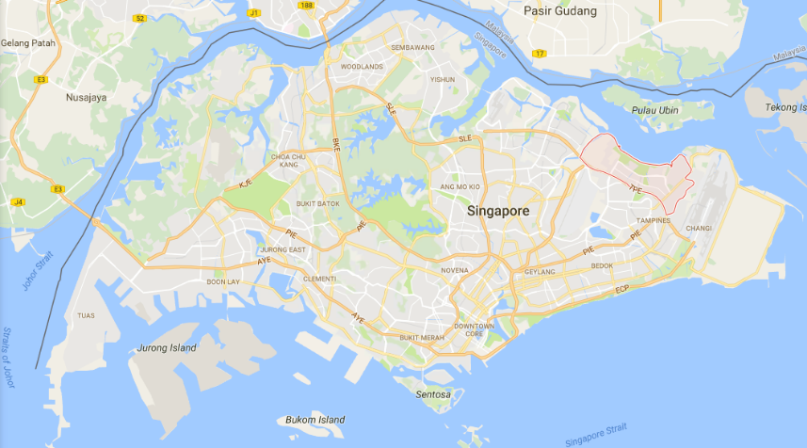
Case study: producing home in Pasir Ris

Slide 48
Recent News
“HDB to build 2,000 flats next to Pasir Ris Park as part of town's renewal plans” (CAN April 29, 2017)
http://www.channelnewsasia.com/news/singapore/hdb-to-build-2-000-flats-next-to-pasir-ris-park-as-part-of-town-8799490

Slide 49
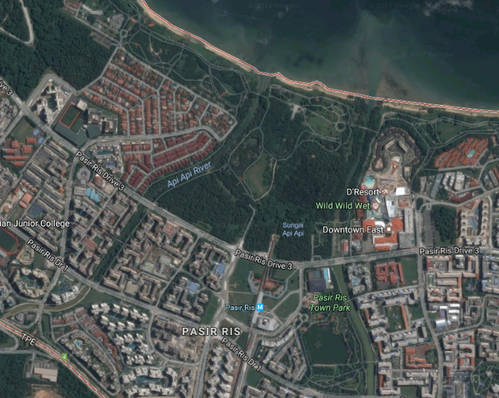
Pasir Ris – Singapore’s hinterland

Slide 50
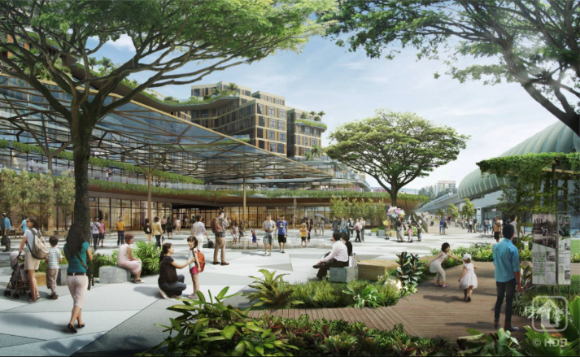
Pasir Ris – Town Centre
Pasir Ris Town Centre will be transformed into a vibrant hub, with a new mixed-use commercial and residential development integrated with a bus interchange. It will also feature a new Town Plaza and Heritage Garden, where residents can gather for community activities and learn more about the town’s history. (Facebook)

Slide 51
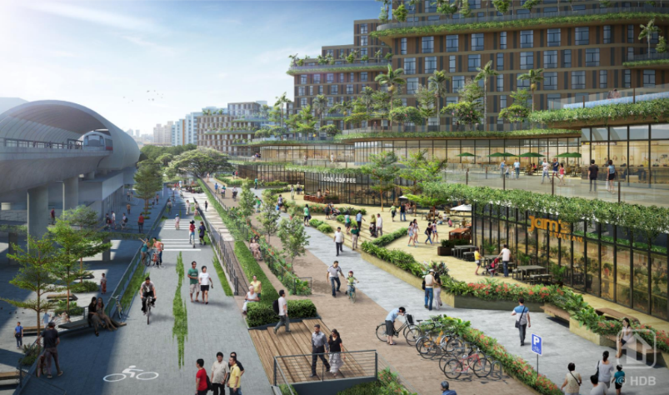
Pasir Ris – Town Centre
A new Central Greenway will provide a direct and seamless connection from
Pasir Ris Town Centre to Pasir Ris Park (Facebook).

Slide 52
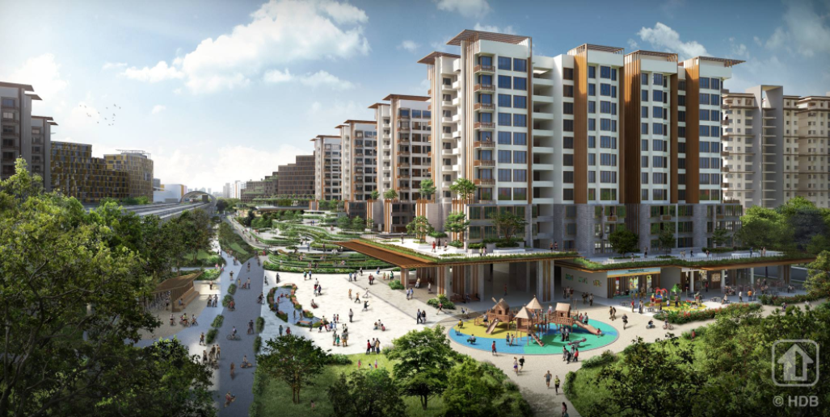
Pasir Ris – Residential Blocks
New public housing developments, located next to Pasir Ris Park, will offer a refreshing
living-by-the-park experience. (Facebook)

Slide 53
Pasir Ris – Singapore’s hinterland

Slide 54
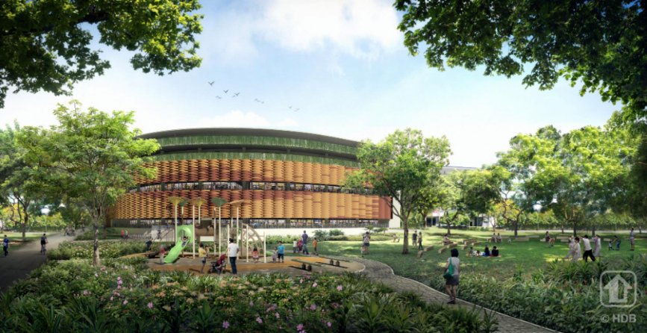
Pasir Ris – F&B spaces
New hawker centre and facilities will be added to the Pasir Ris Town Park, to give
residents more dining and recreational options in the park. (Facebook)

Slide 55
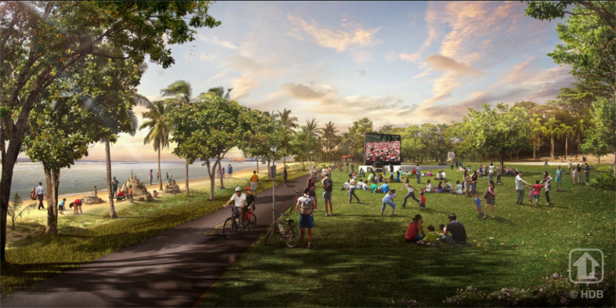
Pasir Ris – Recreation Spaces
The lawn area, cycling paths, and sand play areas in Pasir Ris Park and Beach will be
enhanced to improve the overall beach experience. (Facebook)

Slide 56
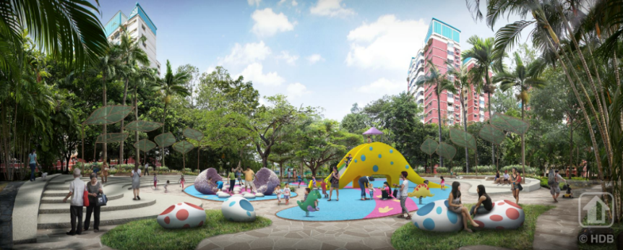
Pasir Ris – Neighbourhood Parks
The Brontosaur Park … will be enhanced with new facilities such as dinosaur-themed
playground and seating areas. Other Neighbourhood Parks will also be upgraded. (FB)

Slide 57
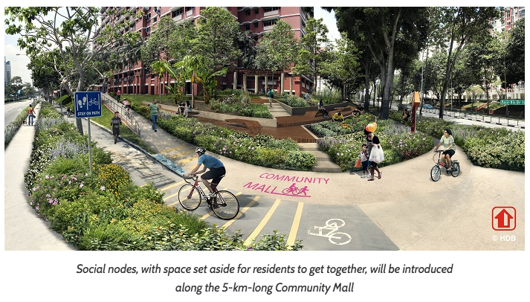
Pasir Ris – social nodes

Slide 58
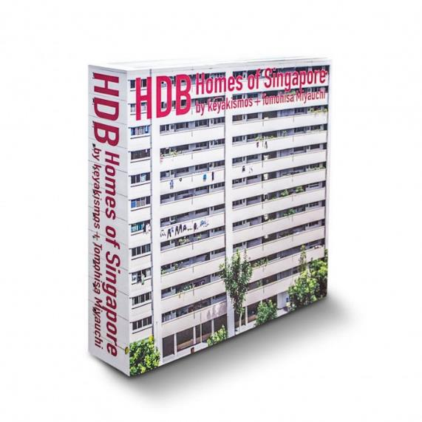
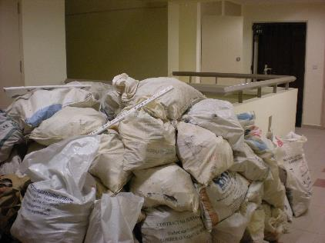
Residents also produce home
Renovations
Decorations

Slide 59
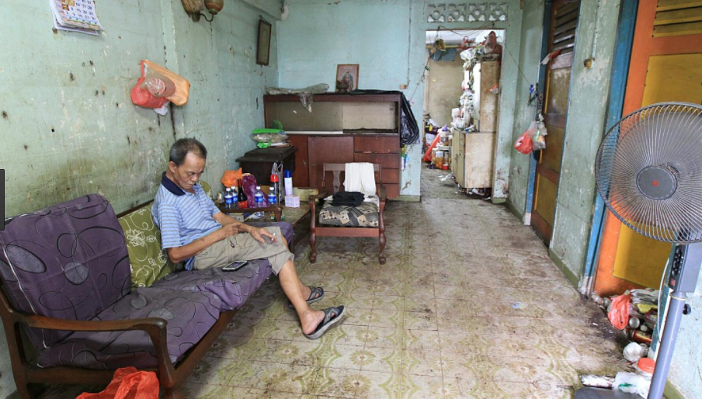
Different HDB homes

Slide 60
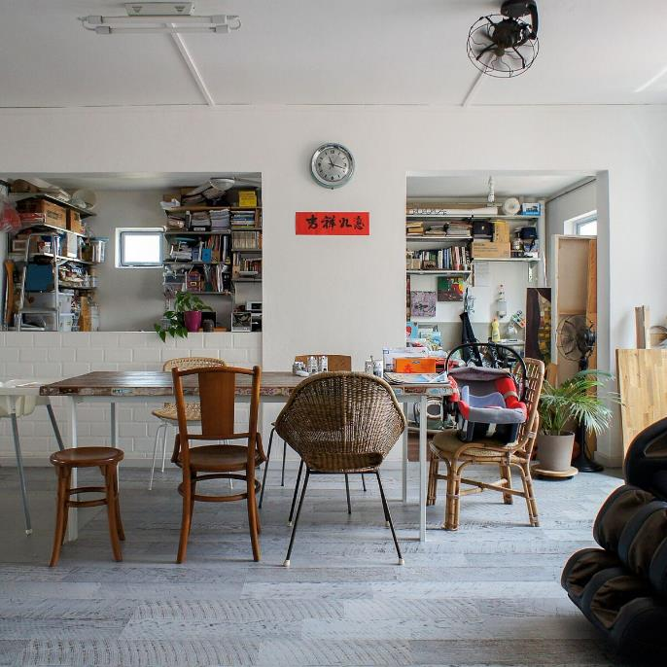

Slide 61
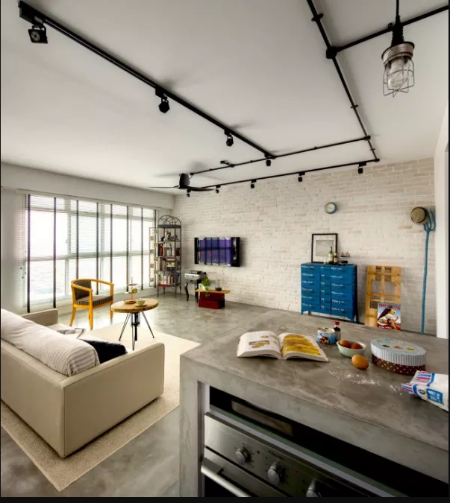

Slide 62
Residents also produce home
Renovations
Decorations
Everyday movement through space
Interactions with family, friends
Interactions with representatives of the state

Slide 63
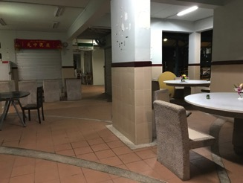
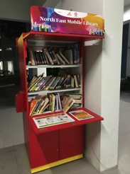
Use of void decks

Slide 64
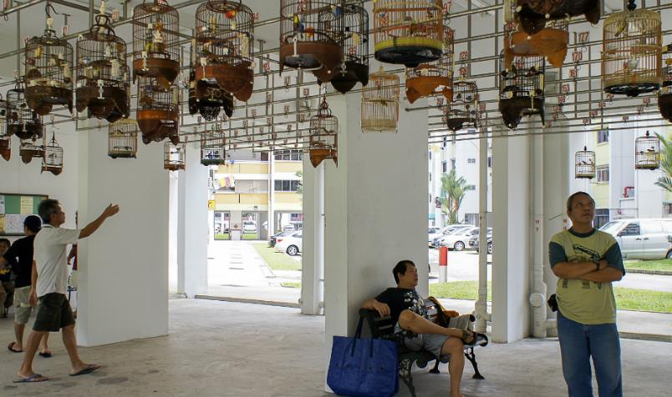
Use of void decks

Slide 65

Use of corridors

Slide 66
Discussion
What APHG units relate to this example of the production of home?
Cultural patterns and processes
Cities and urban land use

Slide 67
Summary
The state actively produces home by constructing residences, as well as by constructing a narrative of the HDB flat as a source of national pride, evidence of government efficacy, and a space where “Asian values” are respected and continued
Residents actively produce home through their everyday use of the space, as well as their individualization of flats to reflect their cultural heritage and/or unique, modern cosmopolitan identities

Slide 68
Teaching the Production of Home
“Home” - Level 1000 course, enrolment 100
From the syllabus: This module explores the political, social, economic, and cultural aspects of home.
Major topics include: sense of place, home technologies and design, gender and housework, home and travel, globalization, nationalism, homelessness, and exile.
You will complete the module with a new appreciation for the complexity of the places – house, neighborhood, nation, planet – you call home.

Slide 69
1. Home in an object (individual)
In the spirit of BBC’s “A History of the World in 100 Objects,” identify an object you identify with “home.” This can be something nostalgic (a photograph, a childhood toy) or everyday (a coffee cup, the front gate of your house). The more personal, the better.
Write an essay (600 words, excluding references) that tells the history of the object (interview family members or neighbors if necessary) and explains why it signifies home for you. Incorporate ideas from the module, as well as one or more images of the object.

Slide 70

“Zam chia” (sewing machine) by Tan-Min
“The zam chia is not only viewed as evoking notions of home, but even more so, the very materiality of it is taken to be home in and of itself. This is evinced through a discourse of nostalgia and a reconstruction of Heidegger’s “hearth as home” (1996) to “zam chia as home” and thus, anchoring the deeply intimate social relations.”

Slide 71

“Zam chia” (sewing machine) by Tan-Min
“One of my fondest childhood memories was playing with my toys beside Ah Ma (grandma), listening to the electric motor as she sewed all day. The sound has always been a reminder of Ah Ma’s presence and her immense love and affection. Today, her fingers are not as nimble and her eyesight has deteriorated, resulting in a break from her sewing. Each time I return home, the absence of the mechanical drone jolts me into a sense of unfamiliarity and discomfort where home does not seem like home anymore.”

Slide 72
2. Home Fieldtrip (group)
Visit a display condo, community centre/club, clan association, heritage centre, IKEA, or other site selling or promoting (literally or figuratively) the idea of “home.”
Your task is to see how home is presented in this space and to reflect on how that idea of home relates to the different theories we have discussed in lectures and/or readings.
10-minute presentation + 1000-word paper (podcast option)

Slide 73

“HDB: an ideological tool,” by Reno Ho, Tang Hui Jun, Ryan Ang
“We argue that public housing is one of the mechanisms through which the state builds and reinforces ideological hegemony. Through monopoly on the provision of public housing, the state has the power to influence private lives and to promote specific ideas and values as natural and commonsensical. The state does this via its representation of HDB as home.
Blunt and Dowling (2006, p.29) urge for analyses of homes to go beyond the house, into larger scales such as the neighbourhood, and the nation. They posit that homemaking processes occur simultaneously at multiple scales with each scale overlapping and being constituted in one another. Borrowing their multi-scalar framework, we illustrate how the state’s representation of HDB as home is enacted among multiple scales, namely the home as residence, the home as community, and lastly the home as the nation.”

Slide 74
Conclusions: Production of home
Home provides comfort, belonging, and identity
Home is always in process (never static), always being made and re-made, at multiple scales.
Home requires ongoing maintenance (both physical and emotional), or “production,” by individuals and institutions across geographic scales: residence, neighborhood, city, nation, planet
Students can grasp these connections and reflect on how home is produced in their own lives

Slide 75
References
Anderson, B. 1991. Imagined communities: reflections on the origin and spread of nationalism. London; New York: Verso.
Bachelard, G. 1964. The poetics of space. New York,: Orion Press.
Blunt, A. & R. M. Dowling. 2006. Home. New York NY: Routledge.
Chee, L. 2017. Unhousing sexuality: Sexuality and singlehood in Singapore’s public housing. In Sexualities at Home: Experience, Politics, Transgression, eds. B. Carnell, R. Scicliuna, B. Campkin & B. Penner, 35-51. London: Bloomsbury.
Chua, Beng Huat. 1995. Communitarian ideology and democracy in Singapore. London ; New York: Routledge.
hooks, b. 1990. Yearning: race, gender, and cultural politics. Boston, MA: South End Press.
Matanle, P. & Y. Sato (2010) Coming Soon to a City Near You! Learning to Live ‘Beyond Growth’ in Japan's Shrinking Regions. Social Science Japan Journal, 13, 187-210.
Selasi, T. 2014. Don’t ask me where I’m from, ask where I’m a local. TED Talks.
Tuan, Y. F. (1971) Geography, phenomenology and the study of human nature. Canadian Geographer, 15, 181-92

