Slide 1


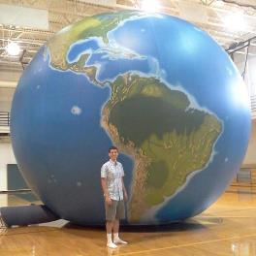


Bringing the World into your APHG Classroom
Seth Dixon
Rhode Island College
@ProfessorDixon #APHG
geographyeducation.org
Notes:
Strengthening Geographic Content in the Classroom
Many efforts to strengthen geography education focus on altering the standards at the district, state and national levels. Sustained improvement in geographic content in the classroom needs to start with teachers and pre-service teachers, where that actual teaching happens. Practical ideas for teachers to strengthen geography education in their classrooms will be presented.

Slide 2
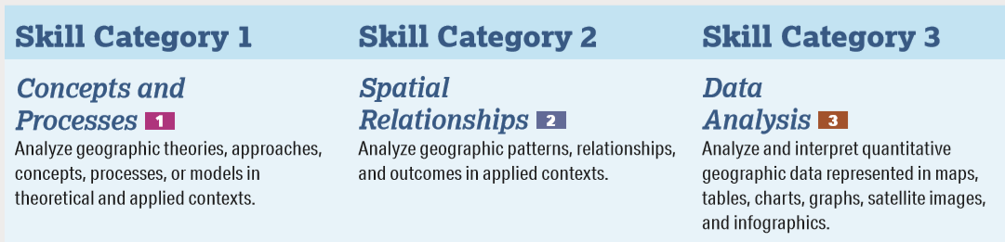
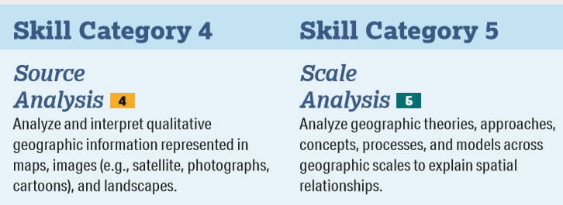

Slide 3
Skills and Content
Each MCQ and each FRQ point will be linked to a specific Learning Objective
Each MCQ and each FRQ point will be linked to a specific skill

Slide 4

5 task verbs (let’s not discuss discuss…)
These are the verbs in EVERY SKILL
Identify
Define
Describe
Explain
Compare

Slide 5
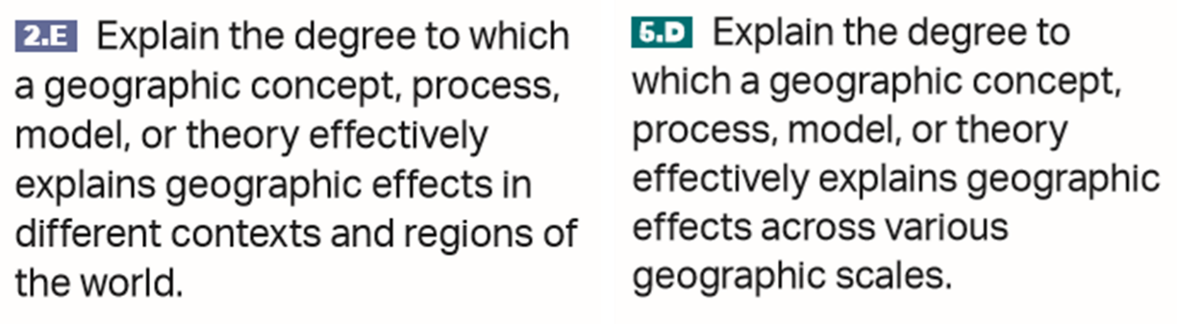
The hidden “6th task verb”

Slide 6
Stimulus—We’ve got more!!
If given data about a country, be prepared to explain the data for that example using course concepts.

Slide 7
Common FRQ errors in 2019
Poor map reading skills (or they just didn’t take the time)
Answer the question at the wrong scale…
Didn’t read/analyze the stimulus/stimuli
Just repeated the stem OR ignored the info given in the stem
Models show change…student answers rarely reflect that
Don’t know the examples in the CED
Too many regional stereotypes, not enough regional analysis
  Inequality only is an issue in developing countries

Slide 8
Bringing the World into your APHG Classroom
Seth Dixon
Rhode Island College
@ProfessorDixon #APHG
geographyeducation.org
Notes:
Strengthening Geographic Content in the Classroom
Many efforts to strengthen geography education focus on altering the standards at the district, state and national levels. Sustained improvement in geographic content in the classroom needs to start with teachers and pre-service teachers, where that actual teaching happens. Practical ideas for teachers to strengthen geography education in their classrooms will be presented.

Slide 9
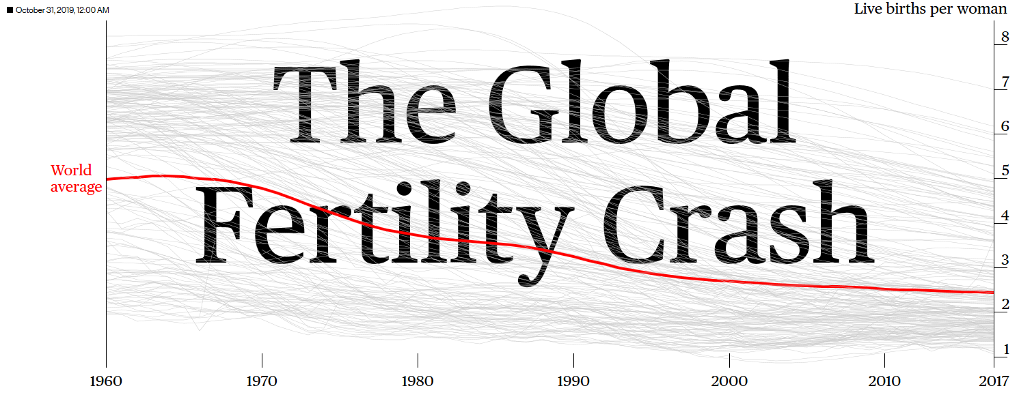
https://www.bloomberg.com/graphics/2019-global-fertility-crash/?utm_source=pocket-newtab

Slide 10
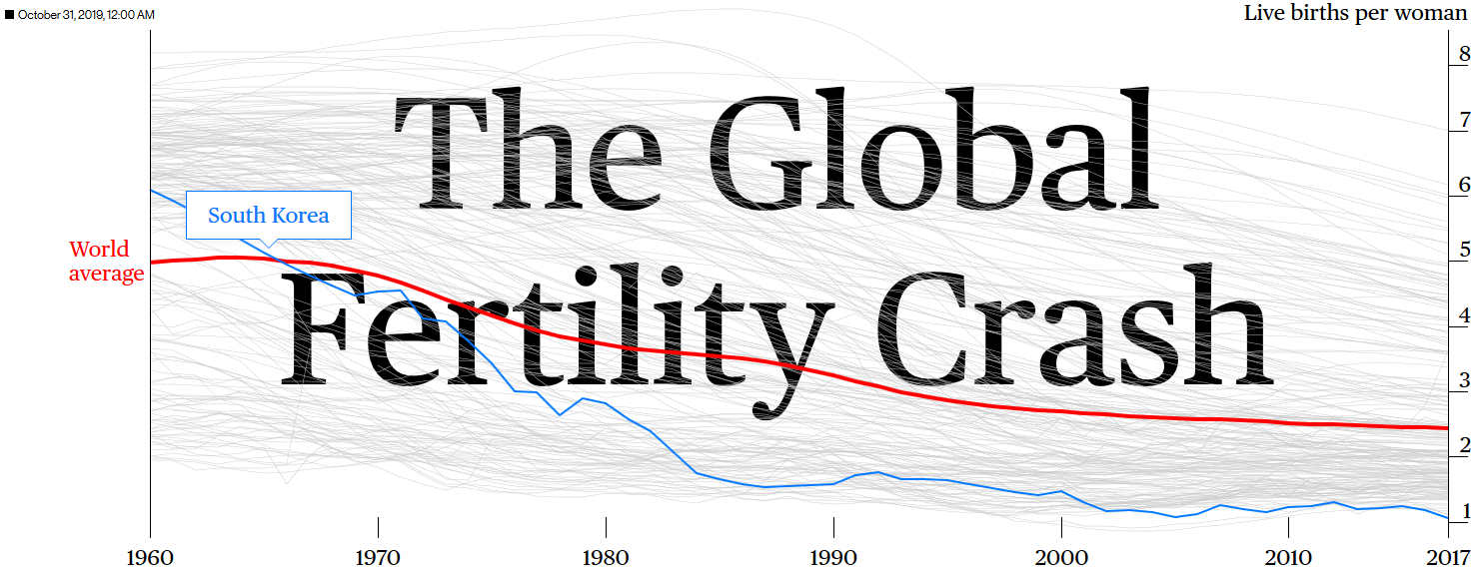

Slide 11


Slide 12


Slide 13
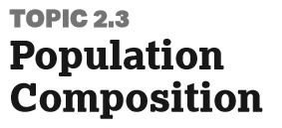
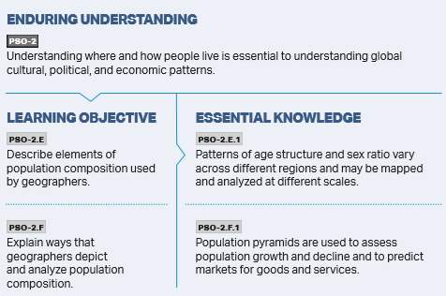

Slide 14
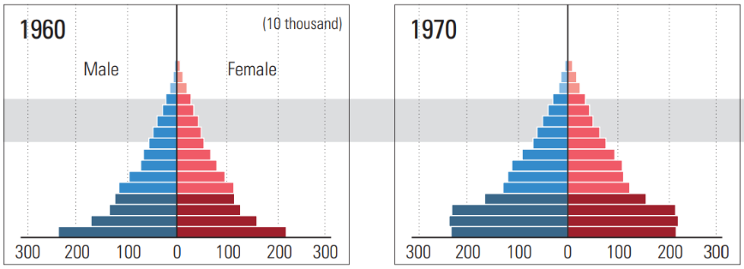
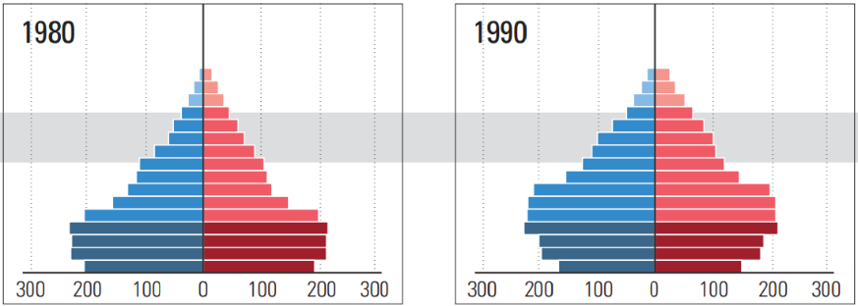
Notes:
MCQ: Identify the stage of the DTM
FRQ: Describe 1 social and 1 economic impact of the shifts represented in these population pyramids.
Explain one cultural and one economic factor that influence fertility rates

Slide 15
Possible MCQ with these stimuli?
Notes:
MCQ: Identify the stage of the DTM
FRQ: Describe 1 social and 1 economic impact of the shifts represented in these population pyramids.
Explain one cultural and one economic factor that influence fertility rates

Slide 16
Identify the stages of the DTM for the following
Notes:
FRQ: Describe 1 social and 1 economic impact of the shifts represented in these population pyramids.
Explain one cultural and one economic factor that influence fertility rates

Slide 17
Possible part of an FRQ?
Notes:
MCQ: Identify the stage of the DTM
FRQ: Describe 1 social and 1 economic impact of the shifts represented in these population pyramids.
Explain one cultural and one economic factor that influence fertility rates

Slide 18
Describe 1 social and 1 economic impact of the shifts represented in these population pyramids.
Notes:
MCQ: Identify the stage of the DTM
FRQ:

Slide 19
Explain one cultural and one economic factor that influence fertility rates
Notes:
MCQ: Identify the stage of the DTM
FRQ: Explain one cultural and one economic factor that influence fertility rates

Slide 20
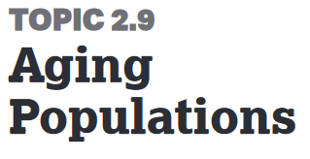
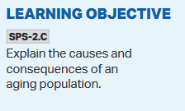
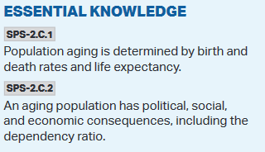


Slide 21
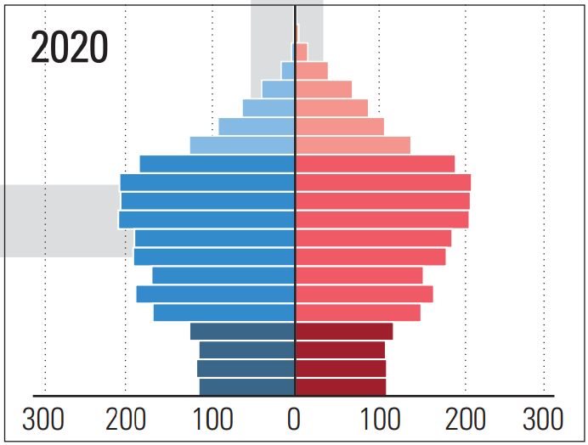
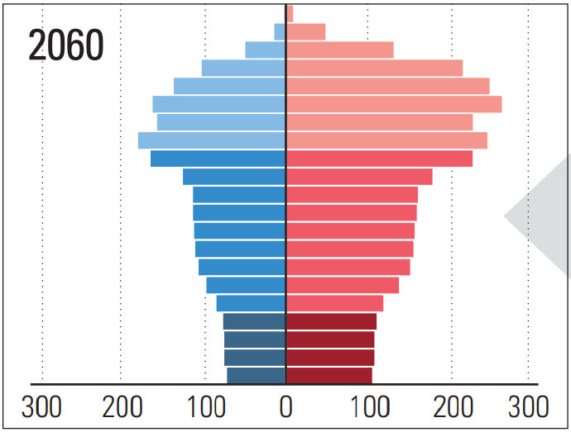
Notes:
Describe one potential policy that might be implemented based on these changing demographics for South Korea.

Slide 22
Possible FRQ?
Notes:
Describe one potential policy that might be implemented based on these changing demographics for South Korea.

Slide 23
Describe one potential policy that might be implemented based on these changing demographics for South Korea.
Notes:
Describe one potential policy that might be implemented based on these changing demographics for South Korea.

Slide 24
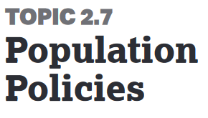
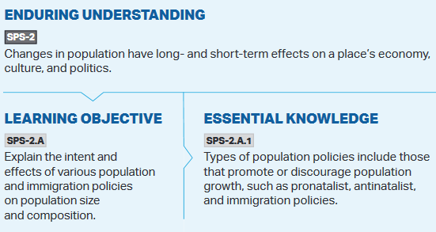

Slide 25
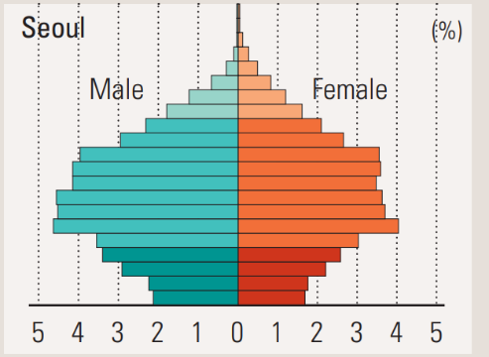
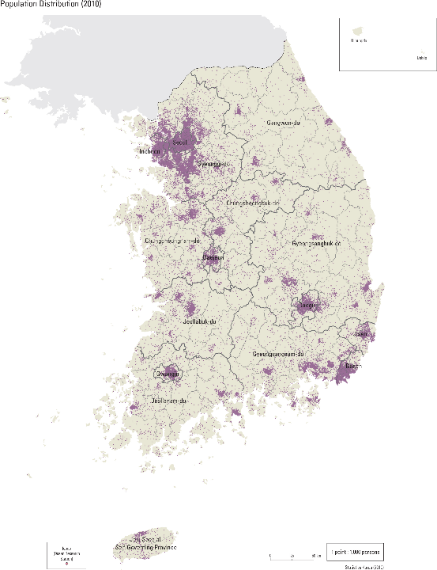
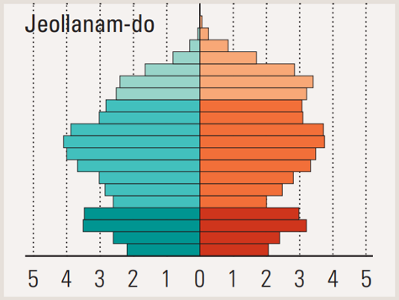
http://nationalatlas.ngii.go.kr/pages/page_834.php
Notes:
Describe 1 difference between the population pyramids of Seoul and Jeolla.
Compare the different population pyramids of Seoul and Jeolla.

Slide 26

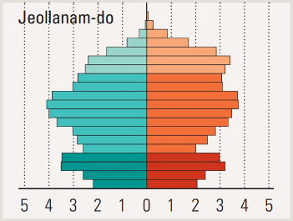
Describe 1 difference between the population pyramids of Seoul and Jeolla.
http://nationalatlas.ngii.go.kr/pages/page_834.php
Notes:
Compare the different population pyramids of Seoul and Jeolla.

Slide 27

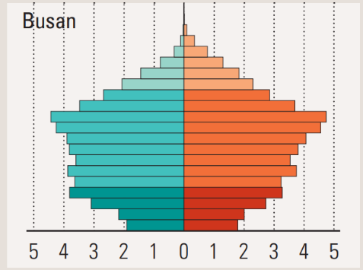
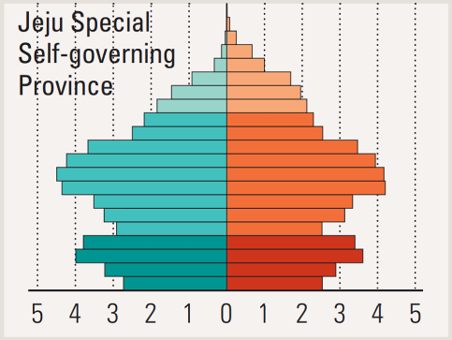
Notes:
Explain why the Busan’s demographic profile is different than that of Jeju.

Slide 28


Explain why Busan’s demographic profile is different than that of Jeju.

Slide 29
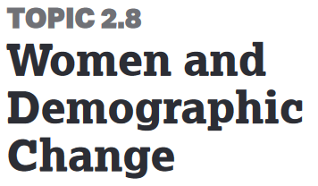
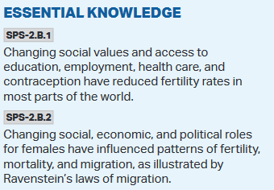
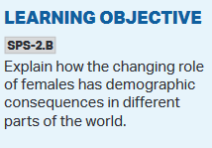
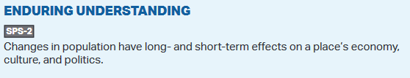

Slide 30
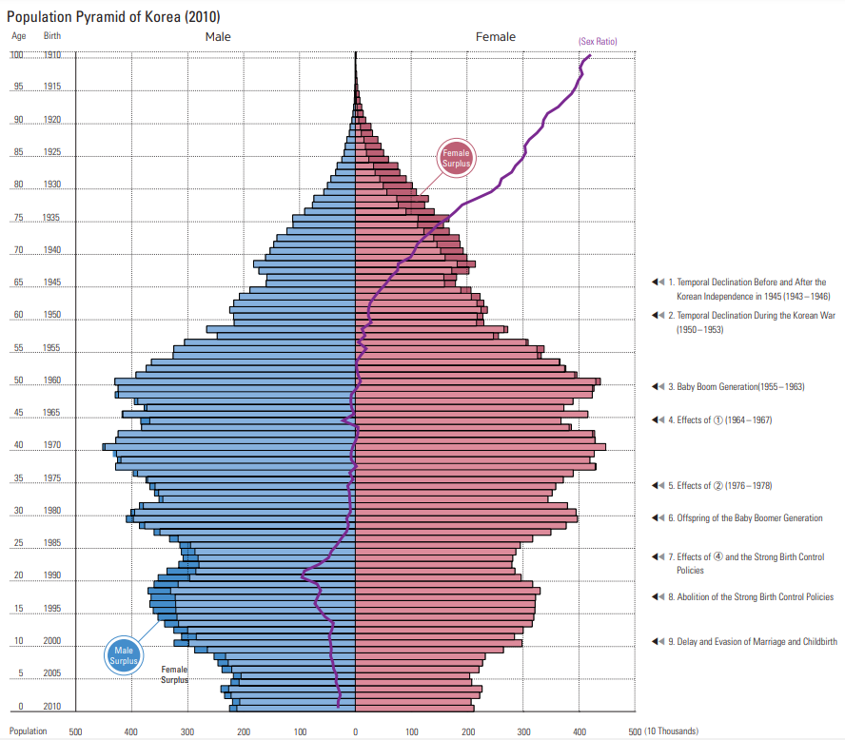

Slide 31
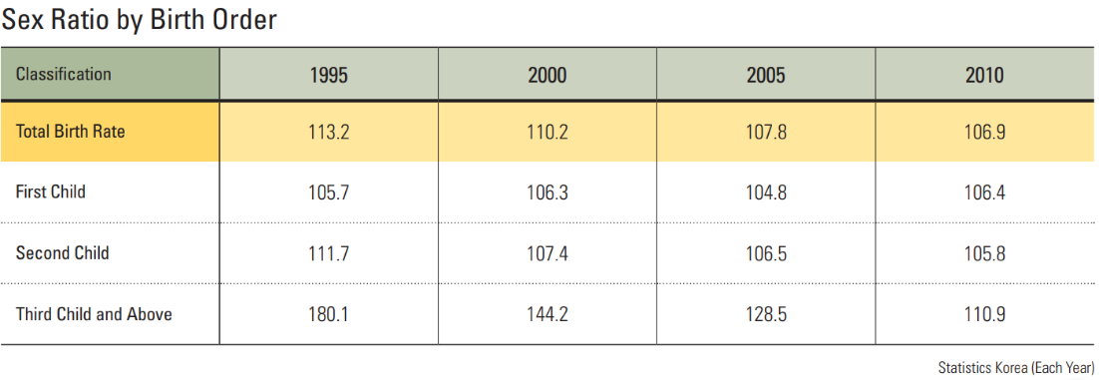

Slide 32

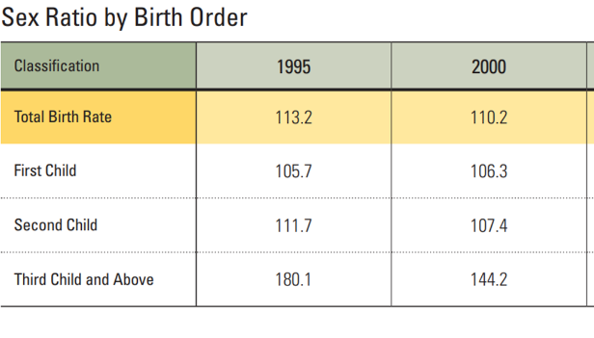
Explain ONE reason for the gender ratio patterns in the 0-30 age cohort.

Slide 33
Explain ONE reason for the gender ratio patterns in the 60 and older age cohort.

Slide 34
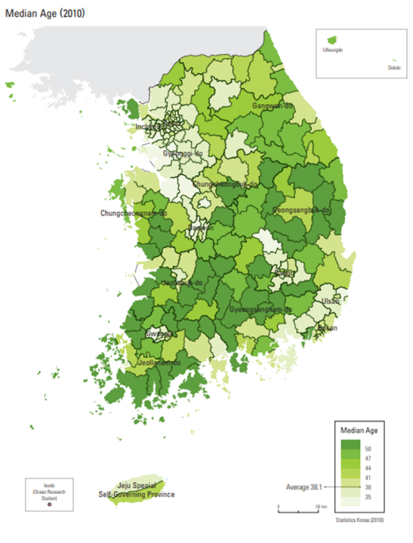


Slide 35

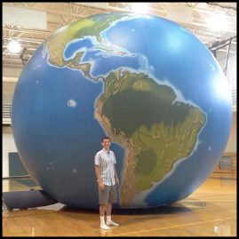
How can teachers help students understand a complex interconnected world?
Provide geographic information
Teach geographic concepts
Use data, maps, and graphs
Ask questions which encourage spatial thinking.
Geographic Literacy
Notes:
Strengthening Geographic Content in the Classroom
Many efforts to strengthen geography education focus on altering the standards at the district, state and national levels. Sustained improvement in geographic content in the classroom needs to start with teachers and pre-service teachers, where that actual teaching happens. Practical ideas for teachers to strengthen geography education in their classrooms will be presented.

Slide 36
FRQs : Improving Student Performance
Read the prompt carefully and to answer all parts of the question (Label the parts).
--Scale of the question?
--Command verb
Integrate units with S.P.E.E.D. and E.S.P.N. activities.
Cover all key words/concepts in CED. Have students master vocabulary and be able to apply the terms to various contexts.
Do not rely on a single textbook. Use multiple textbooks.
Penmanship: if it can’t be read, it can’t be scored.
36

Slide 37

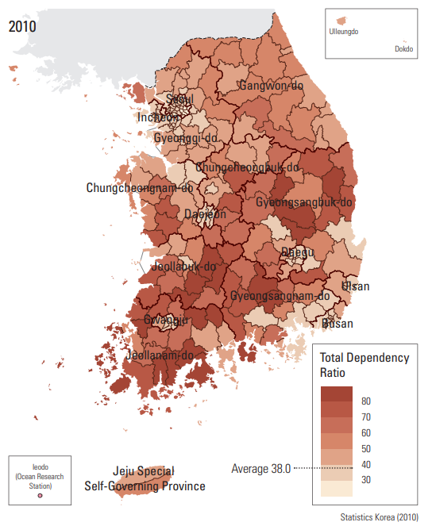

Slide 38
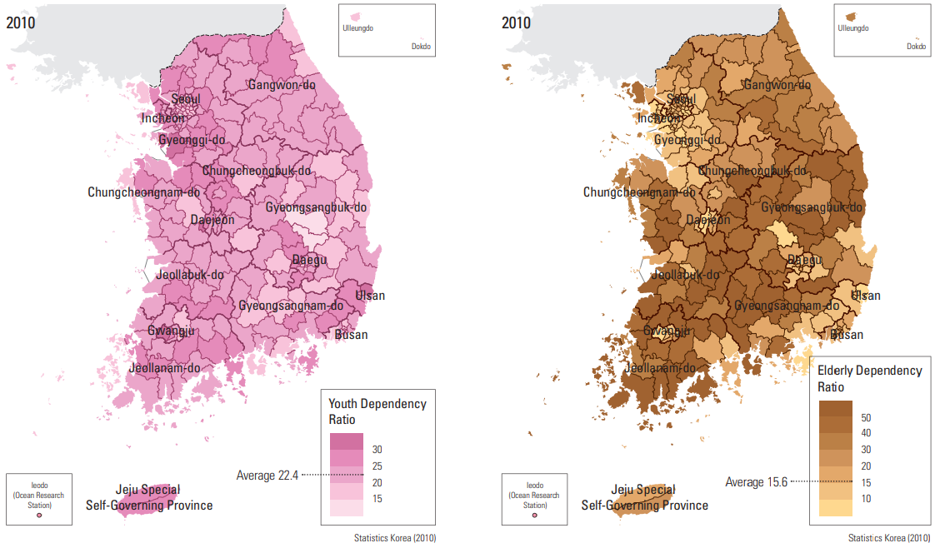

Slide 39
